Slide 1
Mathematical Modeling
with Differential Equations

Slide 2
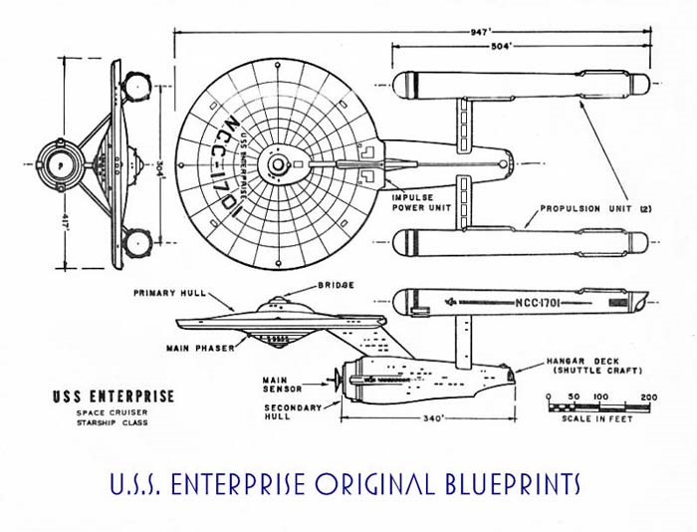
What is a model?
It is a way of representing something complicated by capturing some, but not all of its characteristics.
Starship Enterprise
Which is a better model of the Enterprise?
Starship Enterprise

Slide 3
The United States of America
Which is a better model of the US?

Slide 4
Mathematical Models
In the same way, a mathematical model takes a real world situation and captures some, but possibly not all of its characteristics.
The “real” world gives us a situation.
We construct a mathematical model
We use mathematics to study the model
We draw conclusions about the real world the model

