Slide 1
Differentiating “Combined” Functions
Deriving Product Rule for Differentiation.

Slide 2
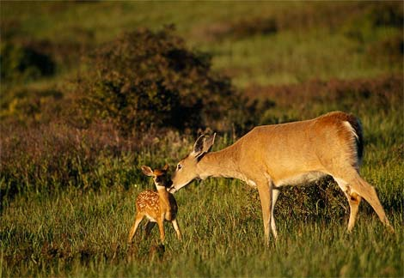
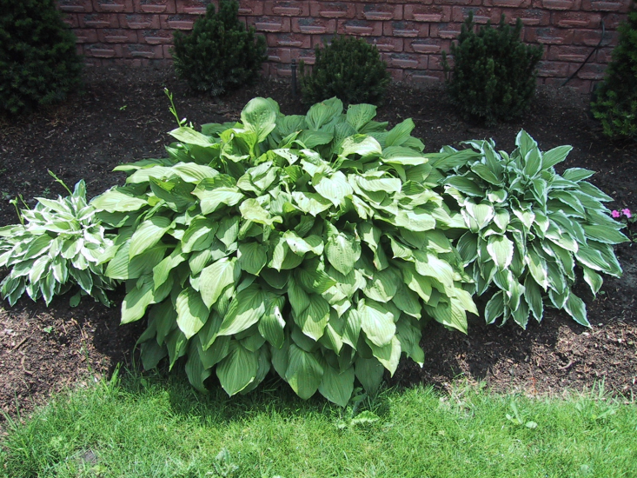
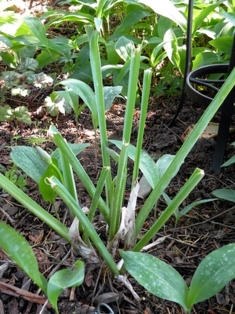
Products: A Gambier Example
LARGE RATS!!!!

Slide 3
A Gambier Example
The rate at which the deer gobble my hostas is proportional to the product of the number of deer and the number of hostas. So we have a gobble function:
What can we say about the rate of change of this function?
What if over a short period of time Δt, from t to t + Δt the deer population increases by a small amount by ΔR_{L} and the hosta population increases by ΔH. How much does the gobble rate change between time t and time t + Δt ?

Slide 4
A Gambier Example

Slide 5
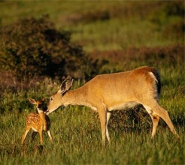
A Gambier Example
The change in g has three relevant pieces:
Old Rats eating poor baby hostas
“Cute” baby rats eating vulnerable old hostas
“Cute” baby rats eating poor baby hostas

Slide 6
A Gambier Example
0

Slide 7
SO, the rate of change of gobble is given by . . .
The rate at which the number of hostas is changing times the number of large rats.
The rate at which the number of large rats is changing times the number of hostas.

Slide 8
The Product Rule for Derivatives
So the rate at which a product changes is not merely the product of the changing rates.
The nature of the interaction between the functions, causes the overall rate of change to depend on the size of the quantities themselves.

Slide 9
In general, we have…

Slide 10
Continuity Required!
In the course of the calculation above, we said that
Is this actually true? Is it ALWAYS true?
x
x + h

Slide 11
The Limit of the Product of Two Functions
Would be zero if g were continuous at x=a. Is it?

Slide 12
The Limit of the Product of Two Functions
g is continuous at x=a because g is differentiable at x=a.

