Slide 1
The Implicit Function Theorem---Part 1
Equations in two variables

Slide 2
Solving Systems of Equations
Eventually, we will ask: “Under what circumstances can we solve a system of equations in which there are more variables than unknowns for some of the variables in terms of the others?”
Sometimes we can….
(Linear Systems!)
Other times…..
(Non-linear Systems!)

Slide 3
“Solving” Systems of Equations
The existence of a “nice” solution
vs
Actually finding a solution

Slide 4
For now…..Equations in two variables: Can we solve for one variable in terms of the other?
Linear equations: Easy to solve.
Some non-linear equations Can be solved analytically.
Can’t solve for
Either variable!

Slide 5
Some observations

Slide 6
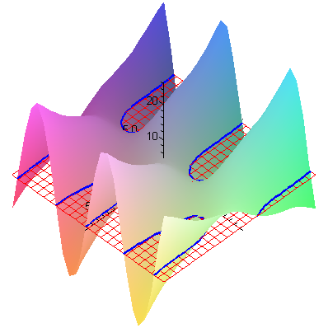
Further observations
The pairs (x,y) that satisfy the equation F(x,y)=0 lie on the 0-level curves of the function F.
That is, they lie on the intersection of the graph of F and the horizontal plane
z = 0.

Slide 7
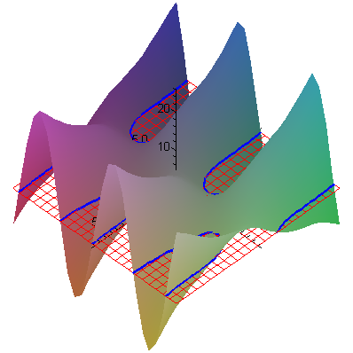
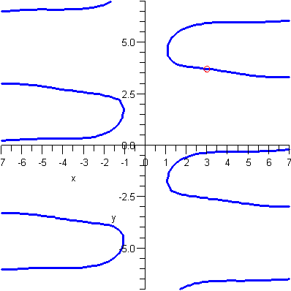
Taking a “piece”
The 0-level curves of F.
Though the points on the 0-level curves of F do not form a function, portions of them do.

Slide 8
Summing up
Solving an equation in 2 variables for one of the variables is equivalent to finding the “zeros” of a function from
Such an equation will “typically” have infinitely many solutions. In “nice” cases, the solution will be a function from

Slide 9
More observations
The previous diagrams show that, in general, the 0-level curves are not the graph of a function.
But, even so, portions of them may be.
Indeed, if the function F is “well-behaved,” we can hope to find a solution function in the neighborhood of a single known solution.
Well-behaved in this case means differentiable (locally planar).

Slide 10
y
x
Consider the contour line f (x,y) = 0 in the xy-plane.
Idea: At least in small regions, this curve might be described by a function y = g(x) .
Our goal: To determine when this can be done.

Slide 11
In a small box around (a,b), we can hope to find g(x).
y
(a,b)
x
Start with a point (a,b) on the contour line, where the contour is not vertical.
(a,b)
(What if the contour line at the point is vertical?)
y = g(x)

Slide 12
If the contour is vertical. . .
We know that y is not a function of x in any neighborhood of the point.
What can we say about the partial of F(x,y) with respect to y?
Is x a function of y?
y
(a,b)
x

Slide 13
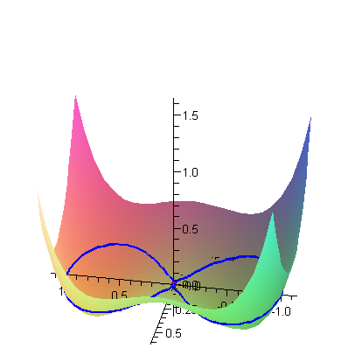
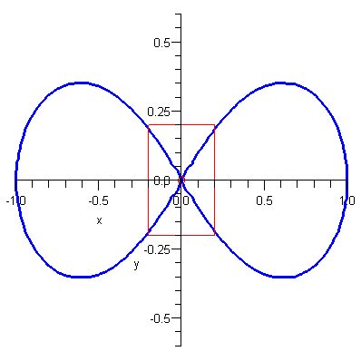
Other difficult places: “Crossings”

Slide 14
If the 0-level curve looks like an x. . .
We know that y is not a function of x and neither is x a function of y in any neighborhood of the point.
What can we say about the partials of F at the crossing point?
(Remember that F is locally planar at the crossing!)

