Slide 1
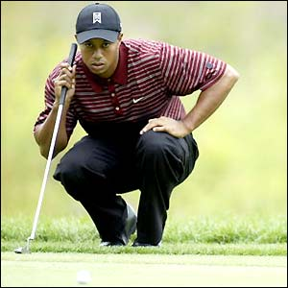
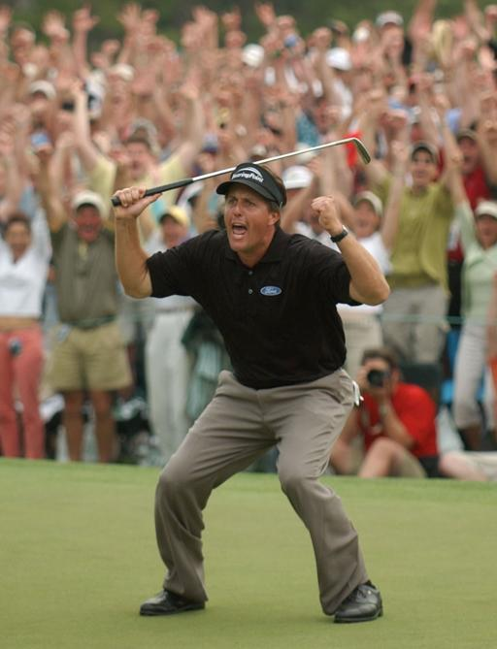
“Drive For Show, Putt For Dough”
By Waleed Khoury and Justin Greenlee

Slide 2
“Bridging Different Eras in Sports”: A Brief Summary
What the article says:
The authors use “bridges” to compare players from different generations:
Compares Player A ➔ Player D by comparing Player A ➔ Player B ➔ Player C ➔ Player D
The article makes these comparisons by considering 4 factors:
True Ability (their average ability over their career)
The effect of aging (in relation to a mean aging curve)
Strength of field
The narrowing of the distribution of scoring over time

Slide 3
“Bridging Different Eras in Sports”: A Brief Summary
Comparing scores in golf can be difficult, since there are many other variables to consider, like:
Weather
Advancements in technology
Improved conditions of courses (modern courses have faster greens, which makes putting more difficult; alternatively, greens today have a truer roller, making putting easier)

Slide 4
“Bridging Different Eras in Sports”: A Brief Summary
Top Ten golfer’s of all time, according to the article:
J. Nicholas
T. Watson
B. Hogan
N. Faldo
A. Palmer
G. Norman
J. Leonard
E. Els
G. Player
G. Couples
Notable exclusion: TIGER WOODS! (this article was written in 1999)

Slide 5
“Bridging Different Eras in Sports”: A Brief Summary
Other Interesting Conclusions:
The peak age for a golfer is 34, with a “peak range” of ages 30-35.
Jack Nicholas was the best player of all time before the age of 43
Ben Hogan was the best golfer of all time over the age of 43
A golfer is as good at 50 as he is at 20

Slide 6
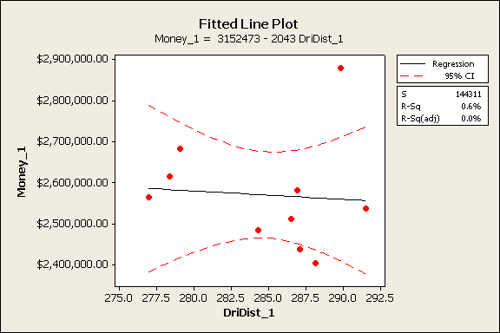
Earnings according to Driving Distance Among Players Ranked 15-24

Slide 7
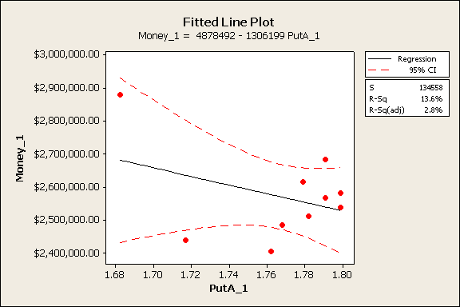
Earnings according to Putting Average Among Players Ranked 15-24

Slide 8
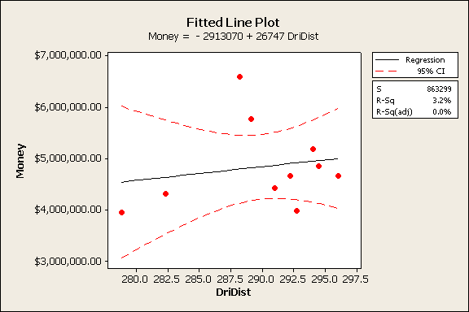
Earnings according to Driving Distance Among Players Ranked 1-10

Slide 9
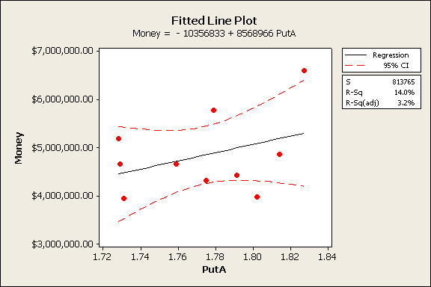
Earnings according to Putting Average Among Players Ranked 1-10

Slide 10
Comparing Generations:
We also compared putters from the 80’s, 90’s, and 00’s using the authors’ ideas from “Bridging Different Eras in Sports”:
We took the two players who won the most majors in their decade…
00’s – Tiger Woods (11) and Phil Mickelson (3)
90’s– Nick Faldo (4) and Nick Price (3)
80’s– Tom Watson (5) and Larry Nelson (3)
…and compared the 80’s vs. the 90’s, and then the 90’s vs. 00’s in terms of their putting statistics (Putts/Round, Putts/Hole, Birdie Conversion Rate).

Slide 11
Comparing Generations: Dataset
Putts/R. 00s Putts/R. 90s Putts/R.80s
28.93 (Tiger) 29.64 (Nick Faldo) 29.53 (Tom Watson)
28.80 (Mickelson) 29 (Nick Price) 29.28 (Larry Nelson)
Putts/H. 00s Putts/H.90s Putts/H.80s
1.733 (Tiger) 1.806 (Nick Faldo) 1.790 (Tom Watson)
1.751 (Mickelson) 1.768 (Nick Price) 1.785 (Larry Nelson)
Bird Conv. 00s Bird Conv. 90s Birdie Conv. 80s
31.98 (Tiger) 28.5 (Nick Faldo) 28.5 (Tom Watson)
31.60 (Mickelson) 31.2 (Nick Price) 28.1 (Larry Nelson)

Slide 12
Results of 2 Sample-t Test: Putts/Round
The 80’s vs. the 90’s:
Difference = mu (Putts/Round 80s) - mu (Putts/Round 90s)
Estimate for difference: 0.085
95% CI for difference: (-4.280, 4.450)
T-Test of difference = 0 (vs not =): T-Value = 0.25 P-Value = 0.846 DF = 1
The 90’s vs. the 00’s:
Difference = mu (Putts/Round 90s) - mu (Putts/Round 00s)
Estimate for difference: 0.455
95% CI for difference: (-3.694, 4.604)
T-Test of difference = 0 (vs not =): T-Value = 1.39 P-Value = 0.396 DF = 1

Slide 13
Results of 2 Sample-t Test: Putts/Hole
The 80’s vs. the 90’s:
Difference = mu (Putts/Hole 80s) - mu (Putts/Hole 90s)
Estimate for difference: 0.0005
95% CI for difference: (-0.2430, 0.2440)
T-Test of difference = 0 (vs not =): T-Value = 0.03 P-Value = 0.983 DF = 1
The 90’s vs. the 00’s:
Difference = mu (Putts/Round 90s) - mu (Putts/Round 00s)
Estimate for difference: 0.455
95% CI for difference: (-3.694, 4.604)
T-Test of difference = 0 (vs not =): T-Value = 1.39 P-Value = 0.396 DF = 1

Slide 14
Results of 2 Sample-t Test: Birdie Conversion Rate
The 80’s vs. the 90’s:
Difference = mu (Birdie Conv. 80s) - mu (Birdie Conv. 90s)
Estimate for difference: -1.55
95% CI for difference: (-18.89, 15.79)
T-Test of difference = 0 (vs not =): T-Value = -1.14 P-Value = 0.460 DF = 1
The 90’s vs. the 00’s:
Difference = mu (Birdie Conv. 90s) - mu (Birdie Conv. 00s)
Estimate for difference: -1.94
95% CI for difference: (-19.26, 15.38)
T-Test of difference = 0 (vs not =): T-Value = -1.42 P-Value = 0.390 DF = 1

Slide 15
Results of 2 Sample-t Test:
It would seem like there is nothing to conclude…
But the P-values DO decline:
Putts/Round = 0.846 (80’s v. 90’s) → 0.396 (90’s v. 00’s)
Putts/Hole = 0.983 (80’s v. 90’s) → 0.396 (90’s v. 00’s)
Birdie Conversion Rate = 0.460 (80’s v. 90’s) → 0.390 (90’s v. 00’s)
Which is interesting: it suggests that while there was not much difference in ability between putters in the 80’s and 90’s, there is a larger difference in ability between putters in the 90’s and 00’s.

Slide 16
What statistics have the strongest correlation to earnings: driving stats or putting stats?
Top-10 Drivers vs. Top-10 Putters:
Player Driving AVG Earnings1 Player2 Putts/Round Earnings2
Bubba Watson 315.1 1533523 Corey Pavin 27.92 924282
Robert Garrigus 311.0 756732 Padraig Harrington 28.04 4313551
J.B. Holmes 310.3 2166131 Daniel Chopra 28.06 1630690
Dustin Johnson 309.7 1789895 John Mallinger 28.14 1201433
Steve Allan 303.2 743970 Bob Tway 28.23 785641
Tag Ridings 303.0 568494 Nathan Green 28.24 912867
Nick Watney 302.9 878173 Brian Gay 28.34 2205513
Adam Scott 302.1 1979160 Aaron Baddeley 28.38 1665587
Davis Love III 301.3 1695237 Jeff Quinney 28.39 1999371
Charles Warren 301.1 800694 Ryuji Imada 28.43 3029363

Slide 17
What statistics have the strongest correlation to earnings: driving stats or putting stats?
Pearson correlation of Driving AVG and Earnings1 = 0.293
P-Value = 0.411
Mean earnings of Top-10 Drivers= 1,291,201
Pearson correlation of Putts/Round and Earnings2 = 0.104
P-Value = 0.775
Mean earnings of Top-10 Putters= 1,866,830
2 sample-t test of Top-10 Driver’s Earnings vs. Top-10 Putter’s Earnings:
Difference = mu (Earnings1) - mu (Earnings2)
Estimate for difference: -575629
95% CI for difference: (-1433896, 282638)
T-Test of difference = 0 (vs not =): T-Value = -1.45 P-Value = 0.171 DF = 13

Slide 18
Class Activity
How good are the Top-10 Putters in the PGA?
Using the appropriate data from ESPN.com, determine whether the Top-10 putters on the PGA Tour in 2008 were significantly better than the putters ranked 41-50.
http://sports.espn.go.com/golf/statistics?type=type2&sort=savePct&season=2008

Slide 19
Homework
Using PGA.com and ESPN.com, find out if there is evidence supporting the claim that those golfers who earn more are all around better players. Choose and record which combination of variables give you the strongest correlation to earnings.
(Hint: Give us a Regression formula and the R-Sq Value)

Slide 20
http://www.puttingzone.com/Stats/ppgir.html
Career stats, including putts/rounds, on PGAtour.com
http://sports.espn.go.com/golf/statistics?type=type2&sort=savePct&season=2008
Where these great players great putters?
Puttting AVG (per hole)
Putts per Round
3-Putt Avoidance
Performance on Par-3’s
Correlation between Putts/Round and Scoring AVG
Putts/Round and earnings
Compared to correlation between Driving distance and Scoring AVG
10-year range of greatest putters vs. longest drivers
Inference:
Great putters– top putters, compared to the rest of the field
T-test with putting AVG, Putts/Round, 3-Putt Avoidance
Comparing correlation between putting, earnings; and driving, earnings

