Slide 1
The age-performance relationship in the mlb
Nate Fedor, Tom Geiger, Jimmy Wendt

Slide 2
“Measuring the Experience-Productivity Relationship: The Case of Major League Baseball” by Gregory Krohn (1983)
Krohn’s research question
Avg_{i}(t) = β₀ + β₁Age_{i}(t) + β₂[Age_{i}(t)²] + µ_{i}(t)
where i = 1, 2, …, N; t = 1, 2, …, T;
Avg_{i}(t) = the batting average of player i in year t;
Age_{i}(t) = the age of player i in year t;
µ_{i}(t) = error term for observation i in year t
Krohn found the age of peak performance to be 28 years of age

Slide 3
Hypothesis
The age of peak performance has increased since 1983 due to:
Technology
Training techniques
Steroids

Slide 4
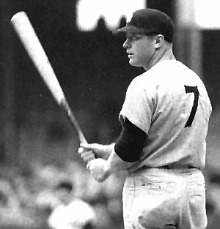
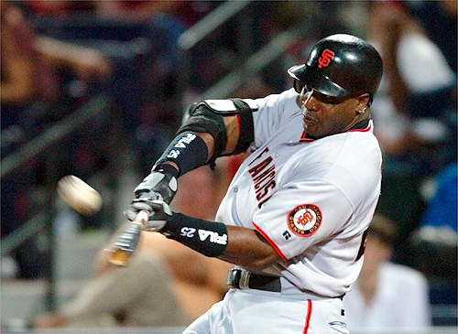
The Data
10 “Steroid Era” sluggers
10 “Historical” sluggers
Season by season stats (minimum of 200 at-bats)

Slide 5
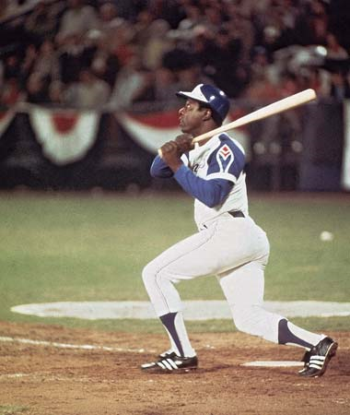
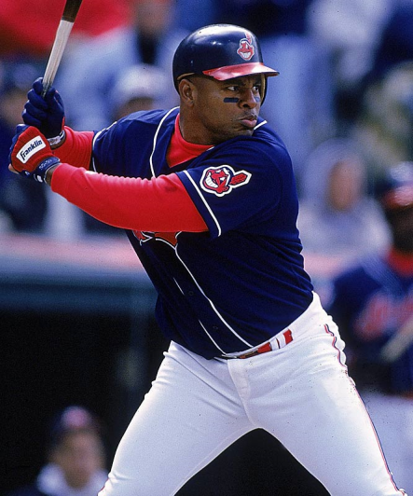
The Players
“Historical”
“Steroid Era”
Mickey Mantle
Frank Robinson
Eddie Mathews
Willie Mays
Ernie Banks
Harmon Killebrew
Hank Aaron
Carl Yastrzemski
Stan Musial
Willie Stargell
Barry Bonds
Mark McGwire
Sammy Sosa
Rafael Palmeiro
Juan Gonzalez
Jose Canseco
Albert Belle
Greg Vaughn
Ken Caminiti
Jeff Bagwell

Slide 6
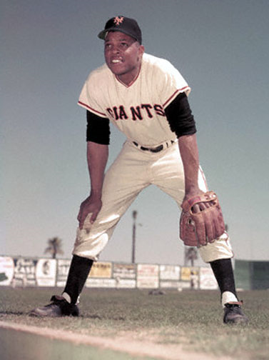
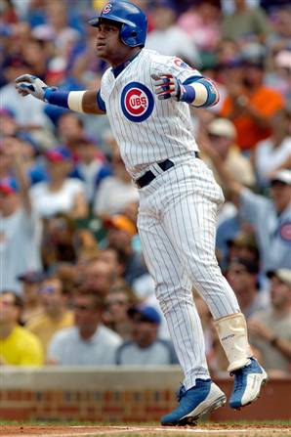
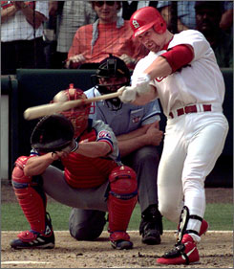
Models
Avg_{i}(t) = β₀ + β₁Age_{i}(t) + β₂[Age_{i}(t)²] + µ_{i}(t)
AB/HR_{i}(t) = β₀ + β₁Age_{i}(t) + β₂[Age_{i}(t)²] + µ_{i}(t)

Slide 7
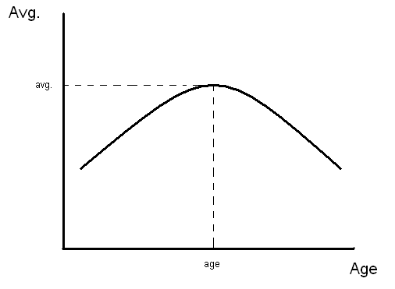

Slide 8
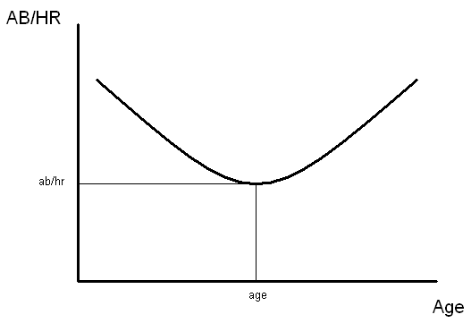

Slide 9
“Historical” Player Results
The regression equation is
AVG = 175 + 9.81 Age - 0.194 Age^2
Predictor Coef SE Coef T P
Constant 175.31 53.87 3.25 0.001
Age 9.809 3.607 2.72 0.007
Age^2 -0.19370 0.05853 -3.31 0.001
S = 33.6690 R-Sq = 17.2% R-Sq(adj) = 16.4%
By taking the first derivative of the regression equation and then setting it equal to zero, we can calculate the peak age
Peak age (for batting avg) = 25 years

Slide 10
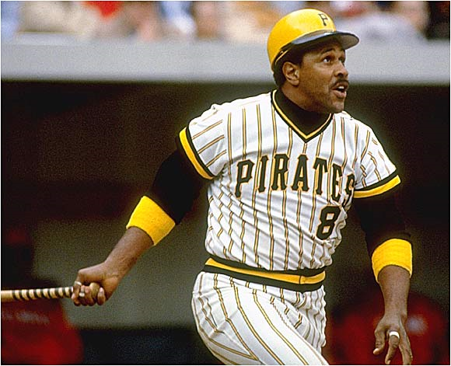
“Historical” Results (Cont.)
The regression equation is
AB/HR = 105 - 5.80 Age + 0.0961 Age^2
Predictor Coef SE Coef T P
Constant 104.66 14.54 7.20 0.000
Age -5.8010 0.9629 - 6.02 0.000
Age^2 0.09612 0.01551 6.20 0.000
S = 7.84034 R-Sq = 17.7% R-Sq(adj) = 16.8%
Peak age (for AB/HR) = 30 years

Slide 11
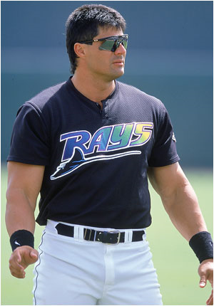
“Steroid Era” Results
The regression equation is
AVG = 39.2 + 15.5 Age - 0.245 Age^2
Predictor Coef SE Coef T P
Constant 39.21 98.89 0.40 0.692
Age 15.525 6.527 2.38 0.019
Age^2 -0.2446 0.1058 -2.31 0.022
S = 34.2338 R-Sq = 4.0% R-Sq(adj) = 2.7%
Peak age (for batting avg) = 32 years

Slide 12
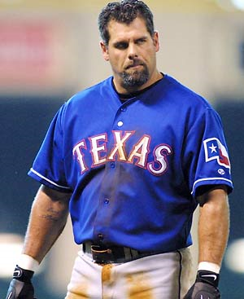
Class Activity
P:\temp\0 Nate Tom Jimmy\class activity.MTW
We will estimate the peak age for AB/HR for “Steroid Era” players

Slide 13
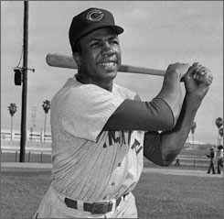
Conclusion
 | Peak age (avg) | Peak age (AB/HR)
Historical | 25 | 30
Krohn | 28 | ***
Steroid Era | 32 | 38
Peak age of performance did increase
Training?
Technology?
Steroids?
Coaching?
R-Sq values are very low
Omitted variable bias
Talent, injuries, coaching. Ideas?
More explanatory variables needed
Larger random sample data set.

Slide 14
HW Problem
In class we estimated the regression equation
AB/HR = 104 - 4.72 Age + 0.0618 Age^2
for modern day sluggers. Barry Bonds was born on July 24 1964. If he were playing this season, estimate what his at-bats per home run ratio would be.

