Slide 1
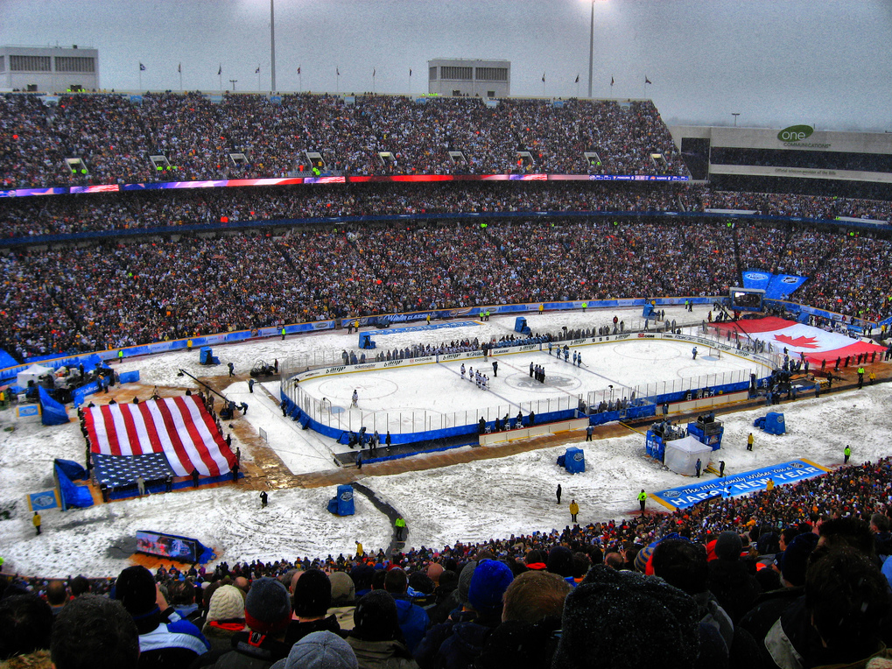
Home Ice Advantage in the NHL
By: Devin Ensing and James Asimes

Slide 2
Table of Contents
Hypothesis
Data Collection
Results
Histogram of all Home Point %
Boxplots of USA vs. Canada 3 years
Boxplots of Traditional vs. Non Traditional 3 years
Conclusion
Sources

Slide 3
Hypothesis
We believe that a Canadian NHL team’s home record will be better than an American team’s home record because Canadian fans are, in general, more passionate about the game, more likely to attend a game and know what is going on.
We also compared traditional American hockey cities with non-traditional American hockey cities to see if the tradition made a difference to a team’s home record.

Slide 4
Data Collection
We decided to take information for all 30 NHL teams for only the past 3 seasons since the cancelled lockout season of 2004 - 2005.
We looked at each team’s home record, comparing percentage of points at home in each season.
A team receives two points for a victory and one point for an overtime loss or shootout loss.
We separated the teams into four different categories:
Canadian and American, Traditional and Non-Traditional

Slide 5
Categories
Canadian:
Calgary, Edmonton, Montreal, Ottawa, Toronto, Vancouver
American
All other 24 teams
Traditional:
All Canadian teams; Boston, Buffalo, Chicago, Colorado, Detroit, Minnesota, New York Rangers, Philadelphia, and St. Louis
Non-traditional
Anaheim, Atlanta, Carolina, Columbus, Dallas, Florida, Los Angeles, Nashville, New Jersey, New York Islanders, Phoenix, Pittsburgh, San Jose, Tampa Bay, and Washington

Slide 6
Total Home Points % over 3 years

Slide 7
American vs. Canadian Home Points (2005 – 2006)

Slide 8
American vs. Canadian Home Points Percentage (2005 – 2006)

Slide 9
American vs. Canadian Home Points (2006 – 2007)

Slide 10
American vs. Canadian Home Points Percentage (2006 – 2007)

Slide 11
American vs. Canadian Home Points (2007 – 2008)

Slide 12
American vs. Canadian Home Points Percentage (2007 – 2008)

Slide 13
Traditional vs. Non-Traditional Home Points (2005 – 2006)

Slide 14
Traditional vs. Non-Traditional Home Points Percentage (2005 – 2006)

Slide 15
Traditional vs. Non-Traditional Home Points (2006 – 2007)

Slide 16
Traditional vs. Non-Traditional Home Points Percentage (2006 – 2007)

Slide 17
Traditional vs. Non-Traditional Home Points (2007 – 2008)

Slide 18
Traditional vs. Non-Traditional Home Points Percentage (2007 – 2008)

Slide 19
HP% vs. AVG Temperature

Slide 20
Conclusion
Canadian teams have equal or higher home points percentages as American teams since the lockout.
Home points percentages removes difference in overall team performance for each season.
Traditional hockey cities do not have a home ice advantage and finished worse off than non-traditional cities in terms of home points percentage in two of the last three years.
Last year traditional hockey cities finished just above non-traditional hockey cities in terms of home points percentage.

Slide 21
Sources
Data:
NHL.com
Photographs
NHL.com
ESPN.com
NYDailyNews.com
Weather
American weather: Weather.com
Canadian weather: www.climate.weatheroffice.ec.gc.ca

