Slide 1
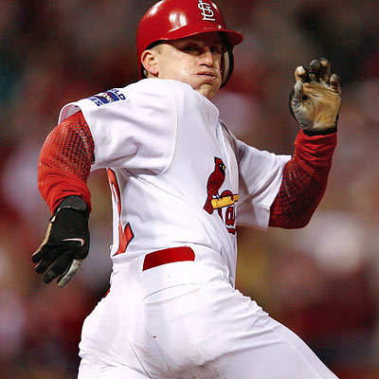
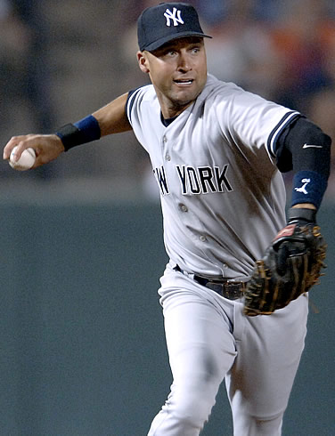
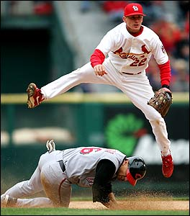
A Comparison of MLB Shortstops
By Drew Jack and Lauren McNulty

Slide 2
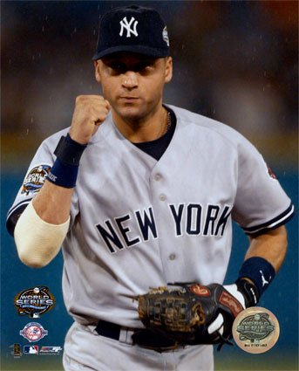
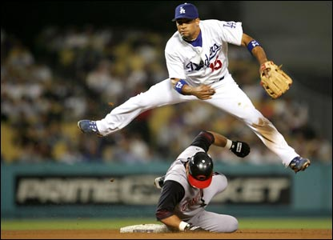
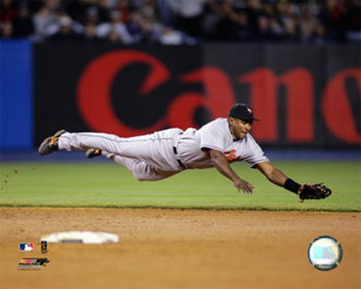
Salary over $10 million
Rafael Furcal
$15,730,196
Derek Jeter
$21,600,000
Miguel Tejada
$14,811,415

Slide 3
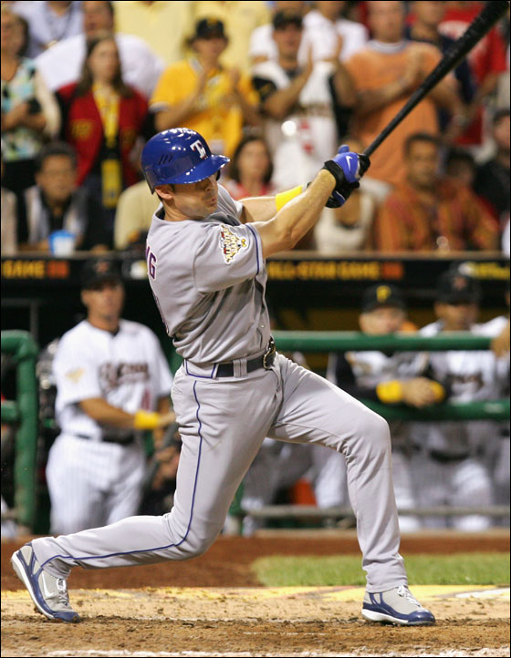
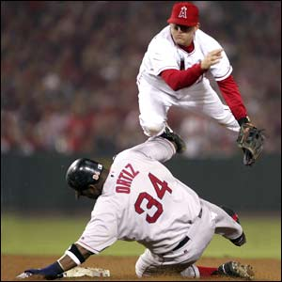
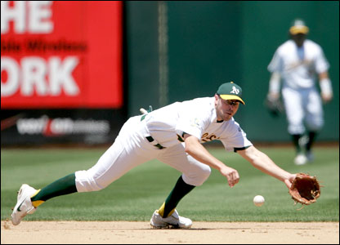
Salary over $1 million
David Eckstein
$4,500,000
Bobby Crosby
$3,550,000
Michael Young
$6,174,974

Slide 4
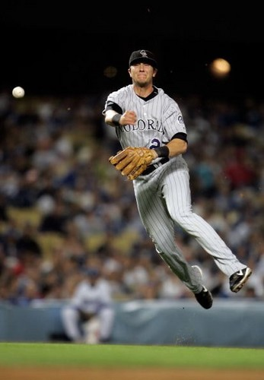
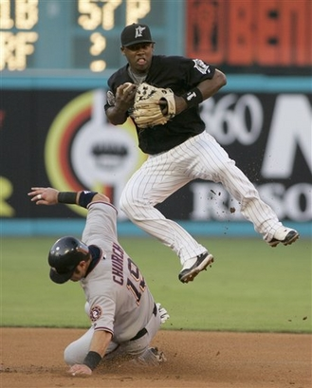
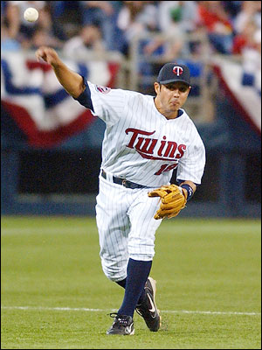
Salary under $1 million
Jason Bartlett
$416,600
Hanley Ramirez
$439,000
Troy Tulowitzki
$750,000

Slide 5
Statistics Used for Comparison
Offensive Statistics:
OPS = OBP + SLG
RC/AB = [(H + BB)(TB)/(AB + BB)]/AB
Defensive Statistics:
Fielding Percentage
DP/GP
*Used two proportions test

Slide 6
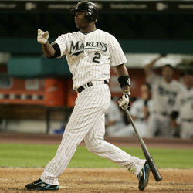
OPS
Jeter Furcal Tejada Young Eckstein Crosby Tulowitzki Ramirez Bartlett
Jeter * * * 0.000 0.000 0.00 0.000 1 0.000
Furcal * * * 0.998 0.000 0.00 0.902 1 0.000
Tejada * * * 0.000 0.000 0.00 0.000 1 0.000
Young 1 .002 1 * * * 0.297 1 0.000
Eckstein 1 1 1 * * * 1.000 1 0.169
Crosby 1 1 1 * * * 1.000 1 0.810
Tulowitzki 1 .098 1 0.703 0.000 0.00 * * *
Ramirez 0 0 0 0.000 0.000 0.00 * * *
Bartlett 1 1 1 1.000 0.831 0.19 * * *
Cumulative p-values:
Ramirez – 0
Jeter – 1
Tejada – 1
Tulowitzki – 2.801
Furcal – 2.9
Young – 3.299
Bartlett – 5.021
Eckstein – 5.169
Crosby – 5.81

Slide 7
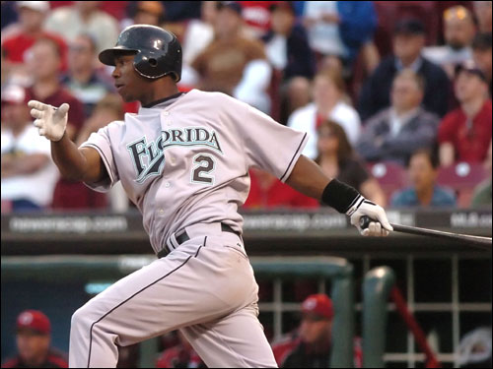
RC/AB
Jeter Furcal Tejada Young Eckstein Crosby Tulowitski Ramirez Bartlett
Jeter * * * 0.001 0.000 0.000 0.017 0.993 0.000
Furcal * * * 0.866 0.000 0.000 0.597 1.000 0.004
Tejada * * * 0.263 0.000 0.000 0.209 1.000 0.000
Young .999 .134 .737 * * * 0.335 1.000 0.000
Eckstein 1 1 1 * * * 0.991 1.000 0.388
Crosby 1 1 1 * * * 0.996 1.000 0.606
Tulowitzki .983 .403 .891 0.665 0.009 0.004 * * *
Ramirez .007 0 0 0.000 0.000 0.000 * * *
Bartlett 1 .996 1 1.000 0.612 0.394 * * *
Cumulative p-values:
Ramirez – 0.007
Jeter – 1.011
Tejada – 1.472
Furcal – 2.467
Tulowitzki – 2.955
Young – 3.205
Bartlett – 5.002
Eckstein – 5.37
Crosby – 5.602

Slide 8
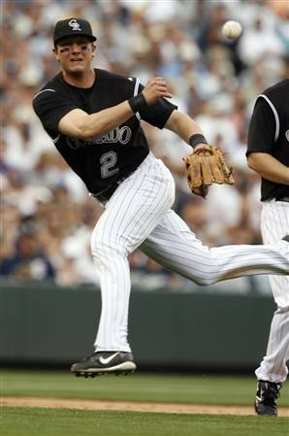
Fielding Percentage
Jeter Furcal Tejada Young Eckstein Crosby Tulowitzki Ramirez Bartlett
Jeter * * * 0.739 0.850 0.285 0.995 0.003 0.024
Furcal * * * 0.999 1.000 0.953 1.000 0.338 0.582
Tejada * * * 0.938 0.976 0.606 0.999 0.030 0.119
Young .261 .001 .062 * * * 0.981 0.002 0.014
Eckstein .150 0 .024 * * * 0.972 0.001 0.005
Crosby .715 .047 .394 * * * 0.997 0.040 0.118
Tulowitzki .005 0 .001 0.019 0.028 0.003 * * *
Ramirez .997 .662 .970 0.998 0.999 0.960 * * *
Bartlett .976 .418 .881 0.986 0.995 0.882 * * *
Cumulative p-values:
Tulowitzki – 0.056
Eckstein – 1.152
Young – 1.321
Crosby – 2.311
Jeter – 2.896
Tejada – 3.668
Furcal – 4.872
Bartlett – 5.138
Ramirez – 5.586

Slide 9
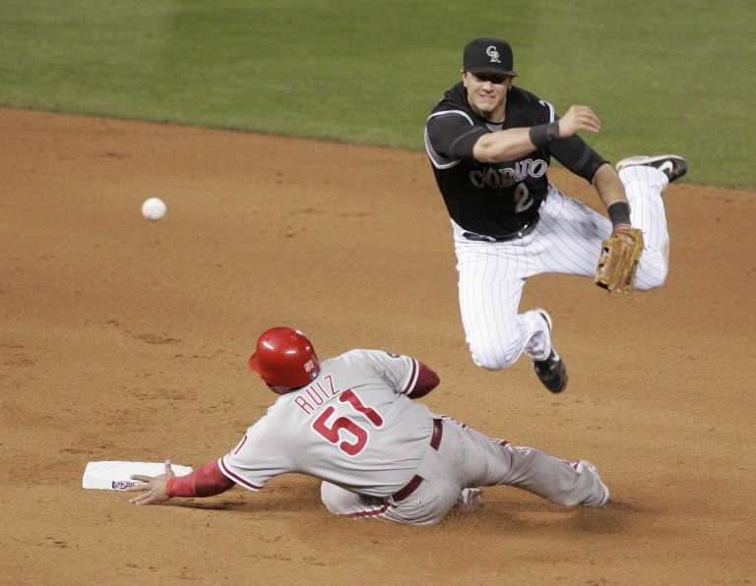
DP/GP
Jeter Furcal Tejada Young Eckstein Crosby Tulowitski Ramirez Bartlett
Jeter * * * 1.000 1.000 1.000 1.000 1.000 0.988
Furcal * * * 0.106 0.000 0.125 0.929 0.028 0.000
Tejada * * * 0.696 0.009 0.672 0.997 0.318 0.005
Young 0.000 0.894 0.304 * * * 0.987 0.211 0.004
Eckstein 0.000 1.000 0.991 * * * 1.000 0.892 0.232
Crosby 0.000 0.875 0.328 * * * 0.984 0.229 0.006
Tulowitzki 0.000 0.071 0.003 0.013 0.000 0.016 * * *
Ramirez 0.000 0.972 0.682 0.789 0.108 0.771 * * *
Bartlett 0.012 1.000 0.995 0.996 0.768 0.994 * * *
Cumulative p-values:
Tulowitzki – 0.103
Furcal – 1.188
Young – 2.4
Crosby – 2.422
Tejada – 2.697
Ramirez – 3.322
Eckstein – 4.115
Bartlett – 4.765
Jeter – 5.988

Slide 10
Combined p-values
Our Rankings Washington Times Article
Troy Tulowitzki – 5.915 1. Hanley Ramirez
Michael Young – 7.825 2. Derek Jeter
Miguel Tejada – 8.837 3. Michael Young
Hanley Ramirez – 8.915 4. Miguel Tejada
Derek Jeter – 10.895 5. Troy Tulowitzki
Rafael Furcal – 11.427 6. Rafael Furcal
David Eckstein – 15.815 7. Jason Bartlett
Bobby Crosby – 16.145 8. David Eckstein
Jason Bartlett – 24.076 9. Bobby Crosby

Slide 11
The Best Deal
Percentage of Team’s Payroll
Tejada – 16.66%
Furcal – 13.27%
Jeter – 10.33%
Young – 9.05%
Crosby – 7.40%
Eckstein – 6.11%
Ramirez – 2.01%
Tulowitzki – 1.09%
Bartlett – 0.95%
New Rankings
Tulowitzki – 7.005
Ramirez – 10.925
Young – 16.875
Jeter – 21.225
Eckstein – 21.925
Crosby – 23.545
Furcal – 24.697
Bartlett – 25.026
Tejada – 25.497

Slide 12
Derek Jeter’s salaries throughout his career
1996 - $120,000
1997 - $540,000
1998 - $750,000
1999 - $5,000,000
2000 - $10,000,000
2001 - $12,600,000
2002 - $14,600,000
2003 - $15,600,000
2004 - $18,600,000
2005 - $19,600,000
2006 - $20,600,000
2007 - $21,600,000
2008 - $21,600,000
Recent Contracts
January 2008 – Tulowitzki signed 6-year, $30 million dollar contract
May 2008 – Ramirez signed 6-year, $70 million dollar contract
Average MLB Service
High Salary – 11.66 seasons
Middle Salary – 7.66 seasons
Low Salary – 4 seasons

Slide 13
Conclusions
There does not appear to be a great statistical significance between a player’s salary and their performance. Instead, it appears as if one’s salary is more closely tied to years of service in the league.
More statistics would improve our rating system.
It’s difficult to maintain a high level of performance for many years.

Slide 14
Works Cited
Albert, Jim. Teaching Statistics Using Baseball. The Mathematical Association of America. Washington D.C.: 2003.
baseball-reference.com
cbssports.com
espn.com
http://www.washingtontimes.com/weblogs/national-pastime/2009/Mar/04/fantasy-rankings---shortstops/

