Slide 1
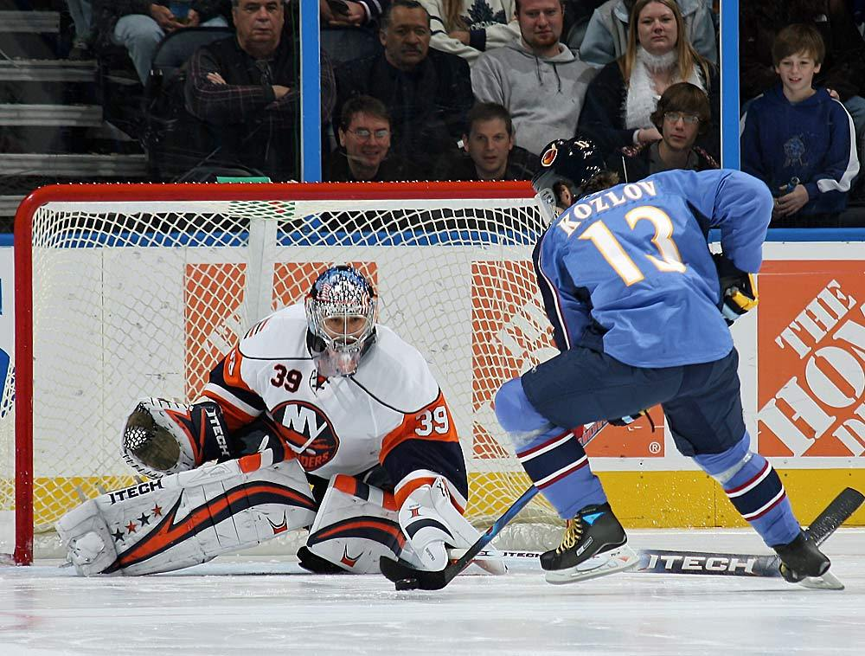
NHL Shootouts
Devin Ensing and James Asimes

Slide 2
What is a Shootout?
First instituted in the NHL after the lockout, in the 2005-06 season
Used as a way to end games that are tied after overtime
Each team takes three attempts with three separate players, and the team with more goals at the end of the three shooters wins. If the teams are still tied, there is sudden death with new shooters until a winner is determined.
Many criticisms of the shootout, including that it no longer makes hockey a team game. Also many purists object to the implementation of the shootout.
Previously used in the Olympics, most notably deciding the 1994 gold medal game in Lillehammer, Norway.

Slide 3
Average Shootout Statistics Through Friday, March 20, 2009
 | 2005-06 | 2006-07 | 2007-08 | 2008-09 | TOTAL
Games | 1,230 | 1,230 | 1,230 | 1,069 | 4,759
Overtime (OT) | 281 | 281 | 272 | 248 | 1,082
Shootouts (SO) | 145 | 164 | 156 | 140 | 605
OT / Games (%) | 22.8 | 22.8 | 22.1 | 23.2 | 22.7
SO / OT (%) | 51.6 | 58.4 | 57.4 | 56.5 | 55.9
SO / Games (%) | 11.8 | 13.3 | 12.7 | 13.1 | 12.7
Goals | 330 | 398 | 344 | 315 | 1,387
Shots | 981 | 1,215 | 1,058 | 925 | 4,179
Shooting Pct | 33.64 | 32.76 | 32.51 | 34.05 | 33.19
Save Pct | 0.664 | 0.672 | 0.675 | 0.659 | 0.668
Avg Shots per Shootout | 6.8 | 7.4 | 6.8 | 6.6 | 6.9
Winning Pct of Home Teams | 51.72 | 48.17 | 49.36 | 48.57 | 49.42
Winning Pct of Teams That Shoot First | 48.28 | 52.44 | 50.64 | 47.14 | 49.75
Winning Pct of Teams That Score First | 80.00 | 80.49 | 81.41 | 81.43 | 80.83

Slide 4
Best Shooters: Highest Shooting Percentage
League Scoring Average: 33.91%
Minimum 10 Shots
Petteri Nummelin 8/10 = 80.00
Wojtek Wolski 16/24 = 66.67
Patrick Kane 9/15 = 60.00
Jeremy Roenick 6/10 = 60.00
Joe Pavelski 13/22 = 59.09
Trevor Linden 7/12 = 58.33
Vyacheslav Kozlov 22/38 = 57.89
Erik Christensen 17/31 = 54.84
Tuomo Ruutu 6/11 = 54.55
Jussi Jokinen 22/41 = 53.66

Slide 5
Worst Shooters: Lowest Shooting Percentage
League Scoring Average: 33.91%
Minimum 10 Shots
Marian Gaborik 1/13 = 7.69
Taylor Pyatt 1/12 = 8.33
Alexei Ponikarovsky 1/12 = 8.33
Mark Recchi 1/10 = 10.00
Stephen Weiss 2/14 = 14.29
Marc Savard 2/13 = 15.38
Dany Heatley 3/19 = 15.79
Michael Ryder 2/12 = 16.67
Sergei Brylin 2/12 = 16.67

Slide 6
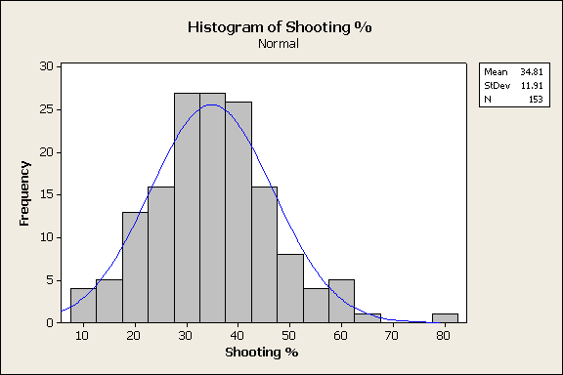
Shootout Goal Percentage Minimum 10 Attempts League Average: 33.91%

Slide 7
Best Goalies: Highest Save Percentage
League Save Average: 0.668
Minimum 30 Shots
Johan Holmqvist 32/37 = 0.865
Marc Denis 35/41 = 0.854
Mathieu Garon 56/69 = 0.812
Jose Theodore 47/59 = 0.797
Johan Hedberg 41/52 = 0.788
Henrik Lundqvist 128/169 = 0.757
Mikael Tellqvist 34/45 = 0.756
Jonas Hiller 27/36 = 0.750
Rick DiPietro 79/106 = 0.745
Kari Lehtonen 67/90 = 0.744

Slide 8
Worst Goalies: Lowest Save Percentage
League Save Average: 0.668
Minimum 30 Attempts
Jason LaBarbera 15/31 = 0.484
Martin Biron 25/49 = 0.510
Curtis Sanford 18/35 = 0.514
Sean Burke 17/33 = 0.515
Vesa Toskala 31/59 = 0.525
Ray Emery 22/39 = 0.564
Evgeni Nabokov 51/90 = 0.567
Niklas Backstrom 42/74 = 0.568
Ty Conklin 20/35 = 0.571
Peter Budaj 46/79 = 0.582

Slide 9
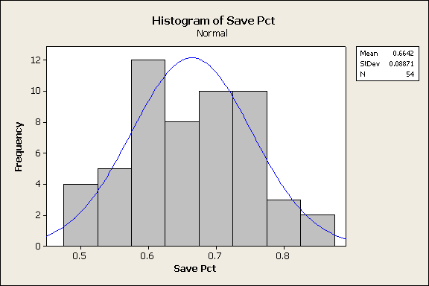
Shootout Save Percentage Minimum 30 Attempts League Average: 0.668

Slide 10
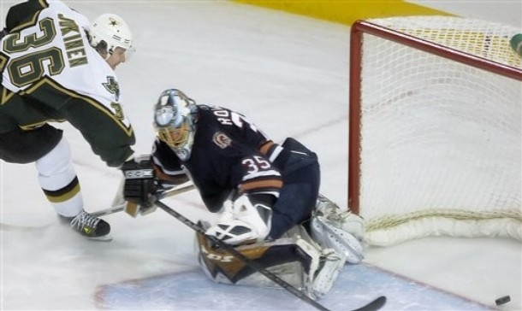
Longest Scoring Streak
Jussi Jokinen
Left Wing, CAR Hurricanes
Scoring Streak: 9
(Nov. 05, 2005 - Mar. 07, 2006)
Career Shootout Stats:
22/41 = 53.66%

Slide 11
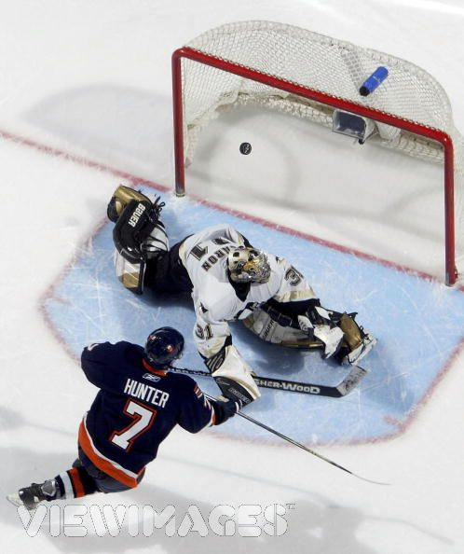
Longest Scoreless Streak
Trent Hunter
Right Wing, NY Islanders
Scoreless Streak: 13
(Mar. 10, 2006 - Current)
Career Shootout Stats:
5/20 = 25.0 %

Slide 12
Unlikely Streaks?
How likely is it that Jussi Jokinen, with a career shooting percentage of 53.66%, would score on nine straight shootout attempts?
P(Jokinen 9 consecutive goals) = 0.0036886
How likely is it that Trent Hunter, with a career shooting percentage of 25.0%, would not score on 13 straight shootout attempts?
P(Hunter 13 consecutive misses) < 0.0000001

Slide 13
“All-Star” Shootout Analysis
League Goal Average in the shootout is .3319
The Western Conference’s avg is .379032
The Eastern Conference’s avg is only .289634
Why could this be?
Pierre LeBrun article on ESPN
League Save Average in the shootout is .668
The Western Conference’s avg is .662461
The Eastern Conference’s avg is .740525

Slide 14
Class Activity
All Star Shootouts!
Open NHLAllStarShootouts.MPJ on P:\Data\MATH\Hartlaub\SportsStats

Slide 15
References
NHL.com
nhlshootouts.com
ESPN.com
Jussi Jokinen: Shootout Specialist Article
http://sports.espn.go.com/nhl/columns/story?columnist=lebrun_pierre&id=3996052

