Slide 1
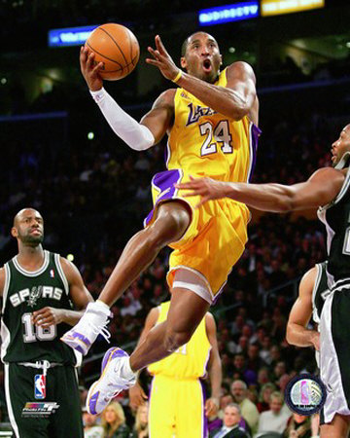
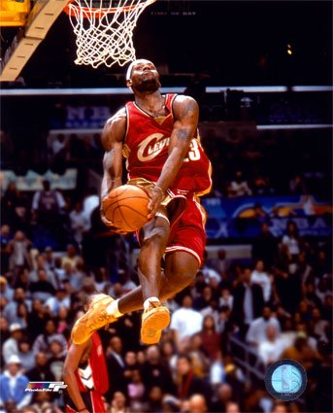
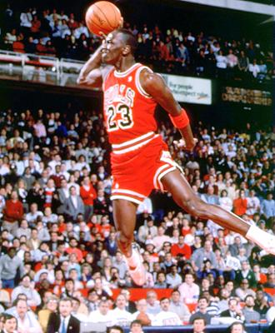
Comparing the Early Careers of Michael Jordan, Kobe Bryant, and Lebron James

Slide 2
Introduction
A good estimate of a player’s performance is shown in statistics (points, rebounds, & assists)
Presuming that Michael Jordan is the best basketball player of the three during his early career, we expected his values to be higher than Kobe Bryant’s or Lebron James’
We also chose to analyze big game statistics, looking into playoffs performances

Slide 3
Sample Size
We looked at the first five seasons of each player as a full-time starter (Kobe didn’t start his first two seasons)
Michael Jordan’s second season was excluded as he broke his foot and missed most of the season
All statistics were examined game-by-game over the five year period and not season averages

Slide 4
Point Production
Variable N Mean SE Mean StDev Minimum Q1 Median Q3
Jordan 409 33.271 0.466 9.417 11.000 27.000 33.000 39.000
Kobe 346 25.720 0.481 8.950 0.000 19.000 25.000 31.000
Lebron 391 27.338 0.444 8.781 3.000 21.000 27.000 33.000
Variable Maximum
Jordan 69.000
Kobe 56.000
Lebron 56.000

Slide 7
Assist Production
Variable N Mean SE Mean StDev Minimum Q1 Median Q3 Maximum
Jordan 409 6.142 0.143 2.882 1.000 4.000 6.000 8.000 17.000
Kobe 346 5.113 0.146 2.716 0.000 3.000 5.000 7.000 15.000
Lebron 391 6.578 0.131 2.592 1.000 5.000 6.000 8.000 15.000

Slide 10
Rebound Production
Variable N Mean SE Mean StDev Minimum Q1 Median Q3 Maximum
Jordan 409 6.430 0.155 3.142 0.000 4.000 6.000 8.000 18.000
Kobe 346 6.023 0.158 2.942 0.000 4.000 6.000 8.000 15.000
Lebron 391 6.890 0.154 3.053 0.000 5.000 7.000 9.000 19.000

Slide 13
Regular Season Conclusions
Jordan clearly scores more points
Lebron leads in rebounds and assists, yet does not dominate the competition like Jordan does in points

Slide 17
Conclusions & Further Considerations
Michael Jordan clearly scores more points
Lebron leads in assists and rebounds during the regular season and playoffs
Overall Jordan’s offensive production still appears to outweigh the other two players
We did not examine any defensive statistics (they were unavailable)
We did not consider strength of team
Jordan played in college, was older and may have been more prepared

Slide 18
References
www.nba.com
www.basketball-reference.com
www.michaeljordansworld.com
Google Image Search

