Slide 1
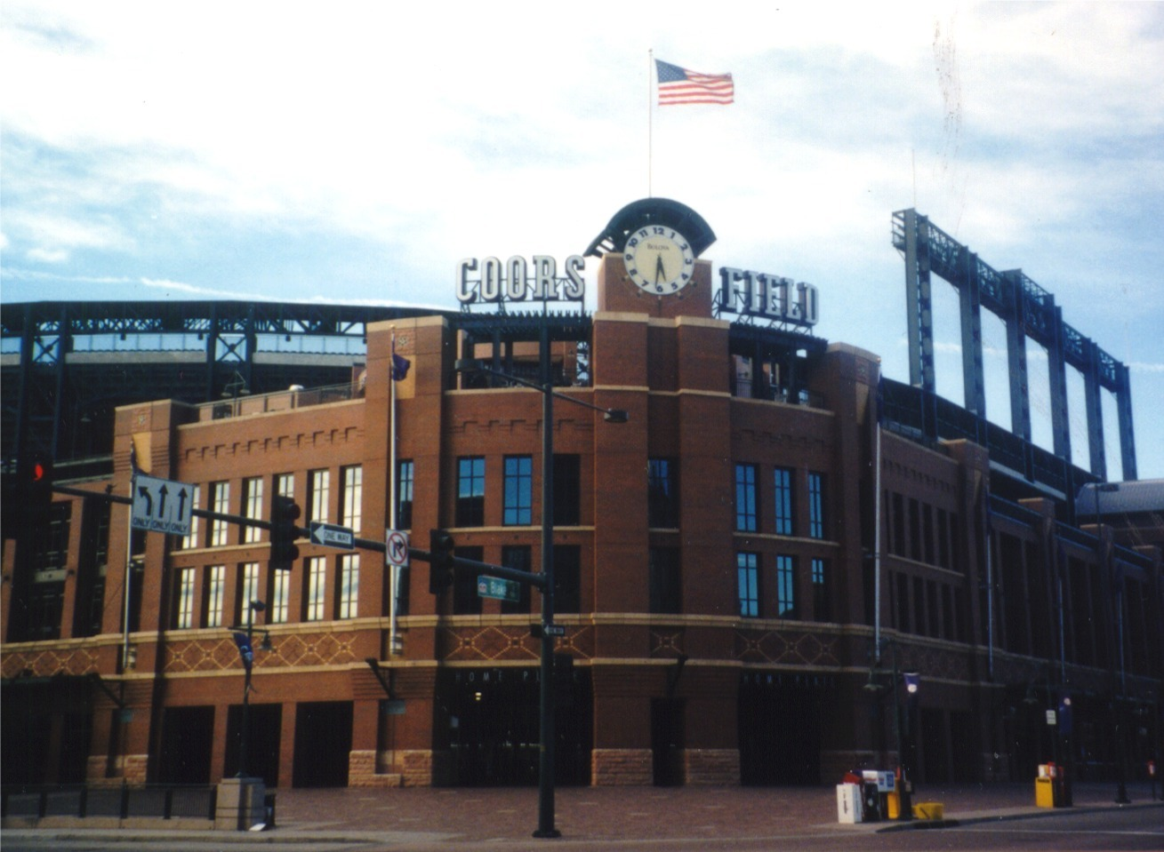
Coors Field
Presented by:
Nate Fedor, Dan Gajewski, Joseph S. Hultzen III

Slide 2
“Coors Canaveral” the Hitter friendly park
Reference to Cape Canaveral, place where NASA launches spacecraft
The stadium is 5,200 ft, or 1,580 m, above sea level meaning the air is thinner meaning there are less molecules for the ball to travel through.

Slide 3
Humidity
Relative humidity is around 30% at the stadium’s altitude
Rawlings manufacturer stores balls at 50% RH
Denver's dry air tended to dry out baseballs, which made them harder, lighter, and smaller causing them to travel farther when hit
A 400 foot home run might be expected to go 420/430 feet at the altitude of Denver’s stadium

Slide 4
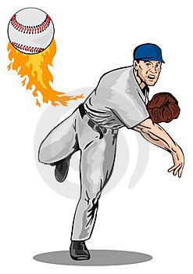
“Pitcher's Purgatory”
Thin air is also blamed for less break on curveballs and sliders when thrown
Also a dry ball is harder to grip causing less spin to be given to certain pitches
“Its like throwing a cue ball”
Fewer effective pitches for pitchers to use leads to fewer strikeouts

Slide 5
Field Design
Stadium designers knew beforehand that Coors Field would give up a disproportionate number of home runs because of its high elevation and dry air
As a result they placed the outfield fences unusually far away from home plate; thus creating one of the largest outfields in baseball today
Having a large outfield allows for more doubles and triples because there is more space for the outfielders to cover

Slide 6
Humidor
Introduced in 2002
Holds 400 dozen balls
Maintained at 70℉ with 50% RH
Kept right next to the keg refrigerators full of refreshing Coors adult beverages

Slide 7
Data : 1993 through 2008 seasons, excluding 1994
Descriptive Statistics: Total HR hit at Coors Field by visiting team
Variable Period Mean SE Mean StDev Minimum Q1 Median Q3
Total HR AH 110.14 3.64 9.63 100.00 104.00 109.00 112.00
BH 130.13 2.68 7.57 121.00 122.75 129.50 136.50
Variable Period Maximum
Total HR AH 130.00
BH 142.00

Slide 8
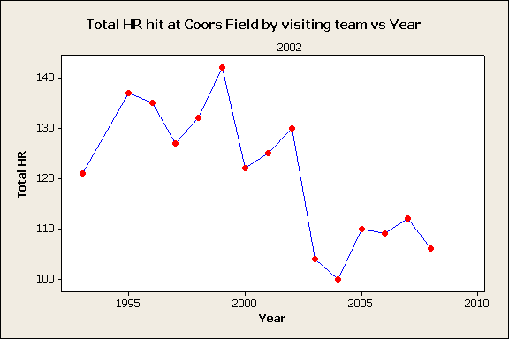

Slide 9
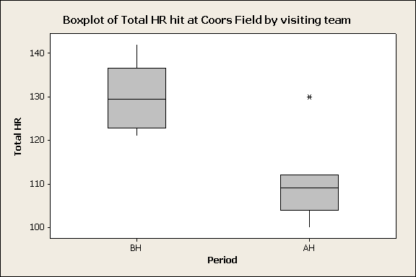

Slide 10
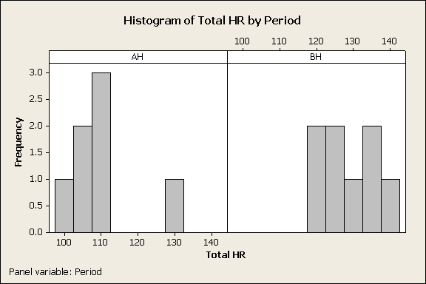

Slide 11
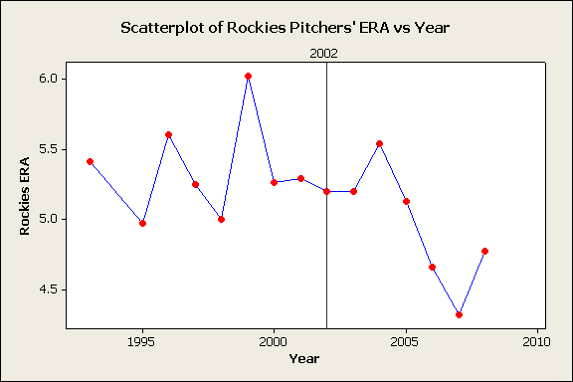

Slide 12
Conclusion
Homeruns did decrease after the introduction of the humidor
Tests of statistical significance should be conducted
We did not control for many factors (ability, steroids, etc.)
Multiple regression model
HR_{i} = β₀ + β₁Humidor_{i} + β₂X_{i} +…+ β_{n}X_{i} + µ

Slide 13
References
http://www.iht.com/articles/2006/08/17/sports/ROCKIES.php
http://www.usatoday.com/sports/baseball/2007-10-26-3457255919_x.htm
http://www.sciencedaily.com/videos/2006/1201-home_runs_amp_holeinone.htm
http://www.citebase.org/fulltext?format=application%2Fpdf&identifier=oai%3AarXiv.org%3A0712.0380
http://www.coloradoconfidential.com/showDiary.do?diaryId=3294
http://www.baseball-reference.com/

