Slide 1
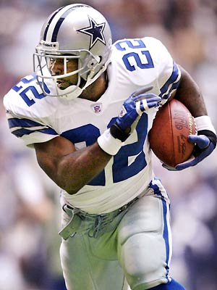
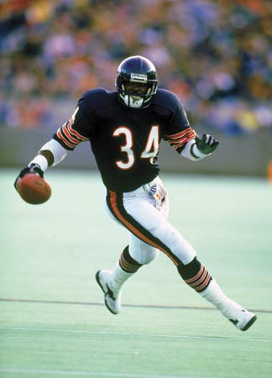
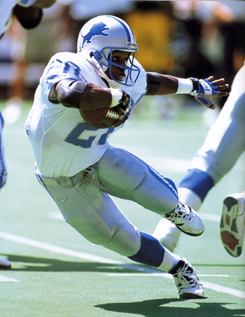
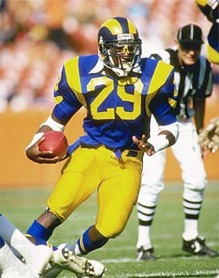
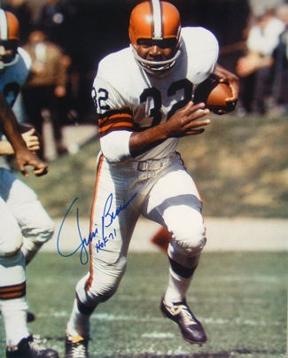
Comparing Great NFL Running Backs Against Their Peers
AJ Clair, Catherine Norbeck, Tommy Durand
Emmitt Smith Walter Payton Barry Sanders Eric Dickerson Jim Brown

Slide 2
What Makes A Running Back Great?
Yards
A running back’s ability to move the ball
TDs
A running back’s ability to score points
Fumbles
A running back’s ability to retain possession of the football

Slide 3
Method
Each running back’s 5 best years
Top 20 running backs from each year selected (all based on yardage)
Examined Yds/Game, TD/Game, Fmb/Att
We had 5 statistical values vs. 95 (19 players for 5 years)
Used 2-sample t-test to compare each running back with his peers

Slide 4
2-sample t-test
Used to analyze whether the difference in means between two independent groups of data is statistically significant
1-sample t-tests are for measuring the difference in mean for a single group versus a hypothesized mean

Slide 5
Minitab
Open Barry Sanders.MTW

Slide 6
Your Turn

Slide 7
Yards/Game
Sanders p = 0.002
Brown p = <0.000
Dickerson p = 0.003
Payton p = 0.004
Smith p = <0.000

Slide 8
TD/Game
Sanders p = 0.039
Brown p = 0.010
Dickerson p = 0.028
Payton p = 0.061
Smith p = 0.012

Slide 9
Fumble/Attempt
Sanders p = 0.081
Brown p = 0.065
Dickerson p = 0.874
Payton p = 0.132
Smith p = 0.283

Slide 10
Conclusions
With the exception of fumbles, the five players we have indicated as being “great” are statistically significantly better than their peers in Yds/Game and TDs/Game except…
Walter Payton was the only player who was not statistically significantly better than his peers in TD/Game
In conclusion, there does appear to be a clear statistically significant separation in performance between great running backs and their peers

Slide 11
Tommy’s Approved* Method (Tommy Test)
Tommy modified well-known quarterback rating methods to account for the historical means in important running back statistics
Formula:

Slide 12
Tommy Test Results
Barry Sanders RBstat = .941380
Jim Brown RBstat = 1.96347
Eric Dickerson RBstat = .435718
Walter Payton RBstat = .865737
Emmitt Smith RBstat = 1.292

Slide 13
Compared to NBC rating
NBC
Brown
Sanders
Smith
Payton
Dickerson
Tommy Test
Brown
Smith
Sanders
Payton
Dickerson

Slide 14
References
www.Pro-football-reference.com
www.nbcsports.msnbc.com/id/6907909/page/5/
http://books.google.com/books?hl=en&lr=&id=P2Hg1Tv1ZboC&oi=fnd&pg=PA15&dq=whos+the+best+nfl&ots=4PO3Clv42T&sig=URt7jCFpdt1QQjfT14XYe0ghphA

