Slide 1
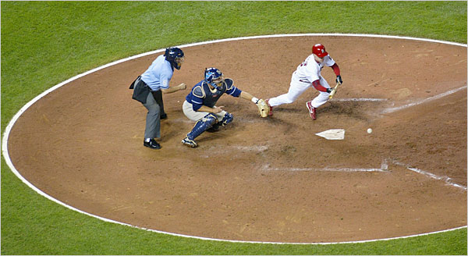
Bunting and Sacrificing in MLB
Lauren McNulty and Drew Jack

Slide 2
Our Question:

Slide 3
Sacrificing
The purpose of the sacrifice is to move a runner or runners over into scoring position at the cost of an out. The hope is that a stronger batter following the bunter will be able to more easily score the runner with a hit.
Hypothesis: Teams that have a higher success rate of bunting or that use bunting more often have a better chance of scoring runs, and thus, of winning.

Slide 4
Sacrificing Over the Years (AL vs. NL)

Slide 5
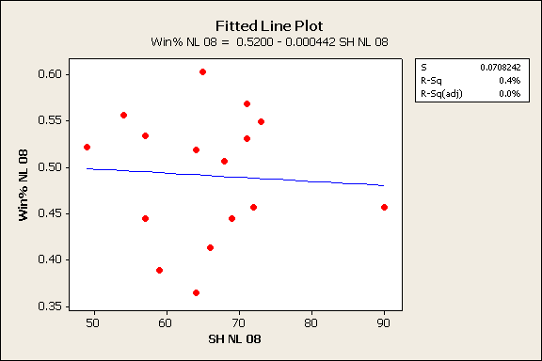
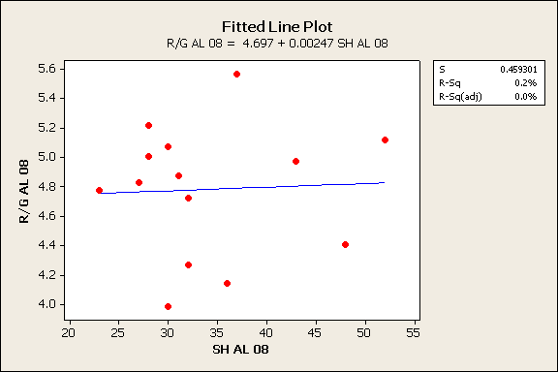
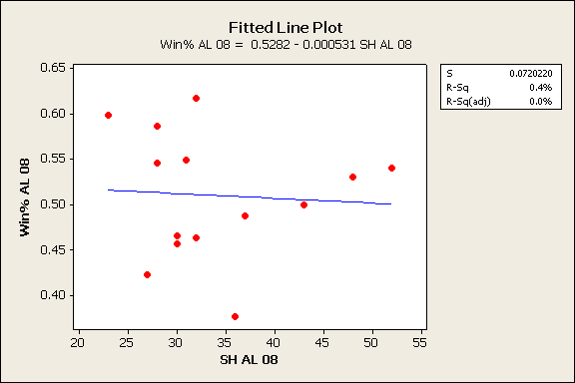
Correlation with 2008 Season

Slide 6
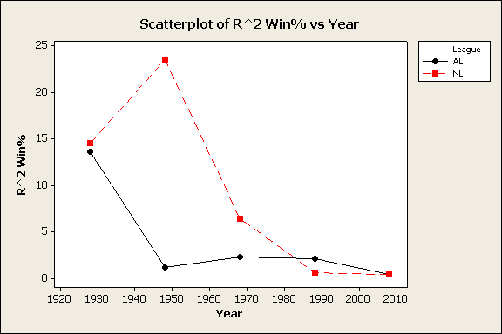
AL NL
0.0 Min 1.4
0.1 Q1 3.35
0.4 Median 6.3
18.6 Q3 13.0
32.6 Max 18.0
7.56 Mean 7.8
AL NL
0.4 Min 0.4
0.8 Q1 0.5
2.1 Median 6.4
7.95 Q3 19.0
13.6 Max 23.5
3.92 Mean 9.08

Slide 7
Winning Percentage vs. Success Rate of Bunting

Slide 8
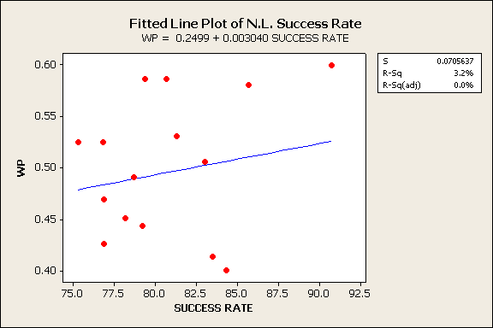

Slide 9
Adding Sac Flies to Sacrifice Hits

Slide 10
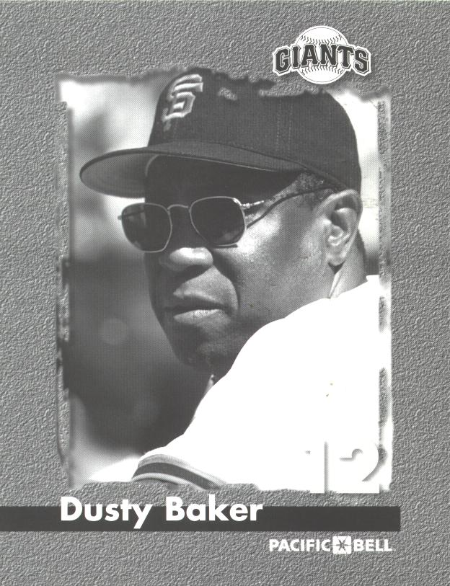
Year 2000
Winning
Percentage:
.599
Success Rate: 90.7 %
For 2000, the Giants had the highest success rate of bunts and the highest winning percentage.

Slide 11
Conclusion
According to our data, sacrifice hits appear to have little influence over the amount of total runs scored throughout the year and the winning percentage of a team.
The amount of sacrifice hits has decreased over time, which has also led to a slight decrease in the influence that sacrificing has on a game.

Slide 12
Further Research
Missing Variable
Situational use of the sacrifice bunt
Number of sacrifice hits was used instead of success rate for some of the data
Looked at whole season rather than particular innings in which a sacrifice occurred

Slide 13
Sources
Albert, Jim. Teaching Statistics Using Baseball. Washington D.C.: The Mathematical Association of America, 2003.
baseball-reference.com
http://baseballanalysts.com/archives/2006/07/empirical_analy_1.php
http://graphics8.nytimes.com/images/2006/10/10/sports/10cardinals.1_600x328.jpg

