Slide 1
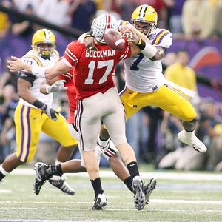
Big Ten Football: Lack of BCS success due to speed?
Luke Ivey and Riley McCracken

Slide 2
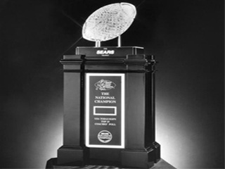
Background On The Topic
Many have claimed that the Big Ten Conference’s perceived lack of success in BCS and bowl games is due to a lack of speed
It has been said recently that Big Ten football teams are too big and too slow to compete on the national stage, especially with teams from southern conferences like the SEC and the Big 12
We decided to test this using the standard measurement of football speed, the 40 yard dash

Slide 3
Background On The Topic
A player runs 40 yards, and is timed from start to finish, with either electronic timing systems or a stopwatch
The 40 yard dash is a great measure of a player’s overall straight line speed
Using posted 40 yard dash times from football websites Rivals.com and Scout.com, we decided to compare Ohio State with LSU and Florida, and 2 teams each from the Big Ten and SEC

Slide 4
BCS Records
Conference with most BCS bowl appearances Big Ten (19)
Conference with most BCS bowl game wins SEC (12)
Conference with most championships SEC (5)
3 -8 in BCS bowl games
Haven’t won a BCS game since January 3, 2006 - FedEx Orange Bowl: #3 Penn State (10-1, Big Ten champion) 26, Florida State (ACC champion) 23 (3 OT)
Big Ten – Last 5 seasons in BCS

Slide 5
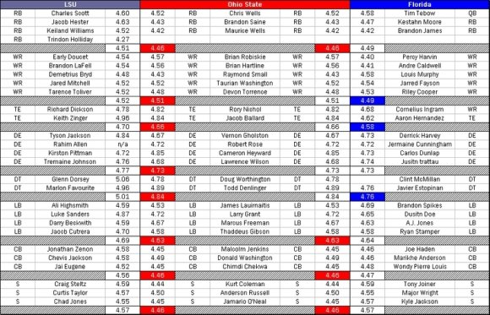
LSU
Ohio State
Florida

Slide 6
Defense Comparison

Slide 7
Offense Comparison

Slide 8
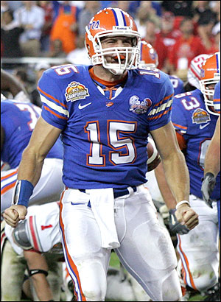
T- Value Test for OSU/Florida Offense
Two-sample T for Ohio State Offense vs Florida Offense
N Mean StDev SE Mean
Ohio State Offense 3 4.543 0.104 0.060
Florida Offense 3 4.5200 0.0520 0.030
Difference = mu (Ohio State Offense) - mu (Florida Offense)
Estimate for difference: 0.0233
95% CI for difference: (-0.2657, 0.3123)
T-Test of difference = 0 (vs not =): T-Value = 0.35 P-Value = 0.761 DF = 2
No significant difference

Slide 9
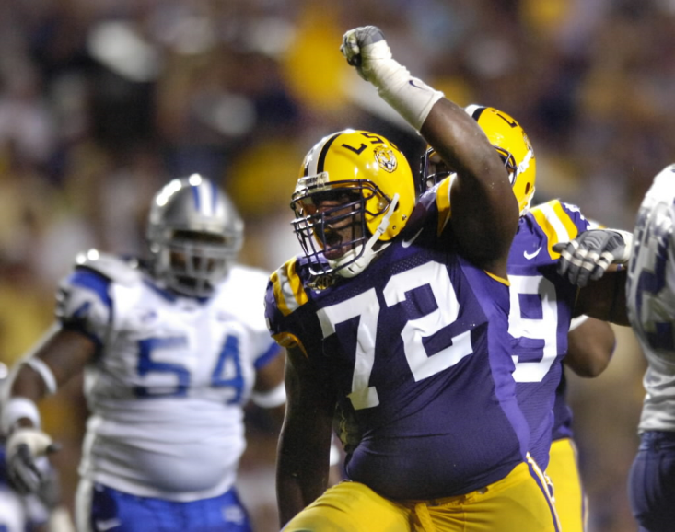
T-Value Test for OSU/LSU Defense
Two-sample T for Ohio State Defense vs LSU Defense
N Mean StDev SE Mean
Ohio State Defense 5 4.624 0.167 0.075
LSU Defense 5 4.720 0.184 0.082
Difference = mu (Ohio State Defense) - mu (LSU Defense)
Estimate for difference: -0.096
95% CI for difference: (-0.359, 0.167)
T-Test of difference = 0 (vs not =): T-Value = -0.86 P-Value = 0.417 DF = 7
No significant difference

Slide 10
More Testing: Mediocre Teams
Our tests proved that there was no statistically significant difference between Ohio State and LSU / Florida, when they played in the BCS National Championship
It’s been said that the SEC is a faster conference from top to bottom, so we decided to take two teams from the Big Ten and SEC who had similar records, and compare them side by side. These teams are Michigan State and Ole Miss, and Northwestern and South Carolina

Slide 11
Northwestern vs. South Carolina
NW QBs NW RB NW OL NW WRs
4.6 4.44 4.80 4.6
4.90 4.6
4.80 4.4
4.85
5.20
SC QB SC RB SC WR SC OL
4.65 4.4 4.45 4.80
4.40 5.00
4.71 5.19
4.90
4.91
Michigan State vs. Ole Miss
MSU QB MSU RB MSU WR MSU OL
4.8 4.4 4.51 5.25
4.6 4.40 5.30
4.89 5.74
5.10
5.28
Miss QB Miss RB Miss WR Miss OL
4.62 4.5 4.69 5.60
4.5 4.50 5.20
4.70 5.05
5.11
5.25

Slide 12
South Carolina / Ole Miss
QB AVG 4.63
RB AVG 4.46
WR AVG 4.57
OL AVG 5.1
Northwestern/ Michigan State
QB AVG 4.7
RB AVG 4.48
WR AVG 4.56
OL AVG 5.12
No significant difference
N Mean StDev SE Mean
Big Ten QB 2 4.700 0.141 0.10
SEC QB 2 4.6350 0.0212 0.015
Difference = mu (Big Ten QB) - mu (SEC QB)
Estimate for difference: 0.065
95% CI for difference: (-1.220, 1.350)
T-Test of difference = 0 (vs not =): T-Value = 0.64 P-Value = 0.636 DF = 1

Slide 13
Going Further…
After testing and de-bunking the myth of a significant SEC speed advantage as the reason for their recent bowl success, we decided to look at how height and weight may have factored into the equation
The Big Ten has been known as a “power football” conference, and as such is geared more towards larger players, especially in the trenches. So we decided to look at the 2009 Fiesta Bowl game between Ohio State and Texas, to see if there was a big difference between the size of OSU’s players and Texas’ players.

Slide 14
Minitab Project
The following is a set of four two sample t-tests regarding the difference in average height and weight between Buckeye and Longhorn Offensive and Defensive linemen from the Fiesta Bowl
We decided to find the difference between Texas and Ohio State in that order (Tex-OSU) because Texas won the game and if all other factors could be controlled should be statistically bigger

Slide 15
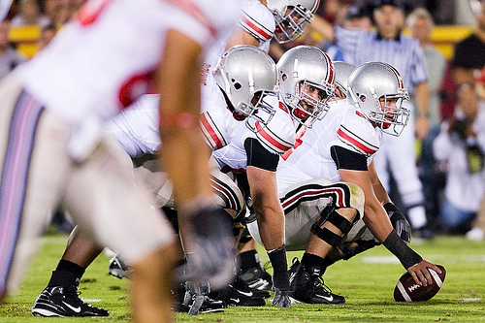
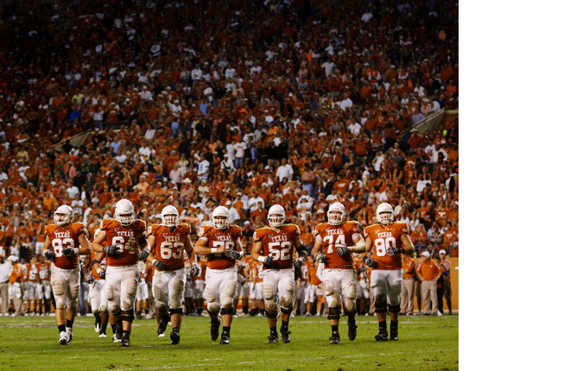
O-Line
Two-sample T for TexHtOL vs OSUHtOL
N Mean StDev SE Mean
TexHtOL 14 77.07 1.44 0.38
OSUHtOL 9 76.44 2.30 0.77
Difference = mu (TexHtOL) - mu (OSUHtOL)
Estimate for difference: 0.627
95% CI for difference: (-1.240, 2.494)
T-Test of difference = 0 (vs not =): T-Value = 0.73 P-Value = 0.478 DF = 12
Two-sample T for TexWtOL vs OSUWtOL
N Mean StDev SE Mean
TexWtOL 14 298.9 15.3 4.1
OSUWtOL 9 294.9 18.4 6.1
Difference = mu (TexWtOL) - mu (OSUWtOL)
Estimate for difference: 3.97
95% CI for difference: (-11.88, 19.82)
T-Test of difference = 0 (vs not =): T-Value = 0.54 P-Value = 0.600 DF = 14

Slide 16
D-Line
Two-sample T for TexHtDL vs OSUHtDL
N Mean StDev SE Mean
TexHtDL 17 74.65 1.32 0.32
OSUHtDL 8 75.25 1.58 0.56
Difference = mu (TexHtDL) - mu (OSUHtDL)
Estimate for difference: -0.603
95% CI for difference: (-2.021, 0.815)
T-Test of difference = 0 (vs not =): T-Value = -0.94 P-Value = 0.369 DF = 11
Two-sample T for TexWtDL vs OSUWtDL
N Mean StDev SE Mean
TexWtDL 17 262.4 25.0 6.1
OSUWtDL 8 278.4 23.8 8.4
Difference = mu (TexWtDL) - mu (OSUWtDL)
Estimate for difference: -16.0
95% CI for difference: (-38.3, 6.2)
T-Test of difference = 0 (vs not =): T-Value = -1.54 P-Value = 0.145 DF = 14

Slide 17
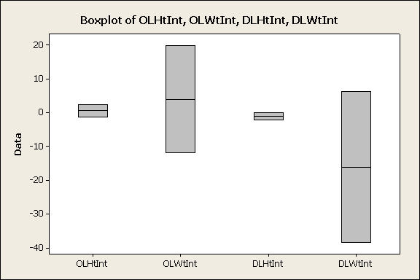
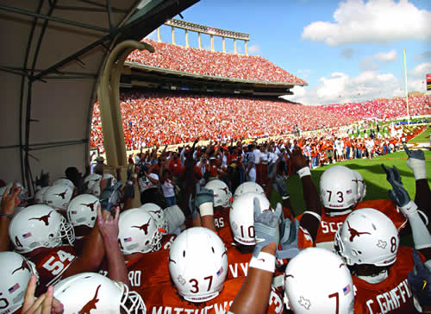
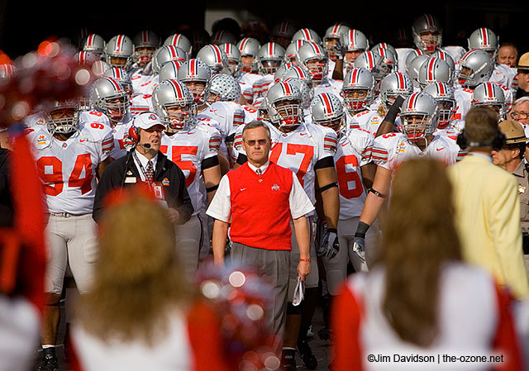
Findings
All of the confidence intervals capture a difference of zero and no p-values are statistically significant
So, let’s look at the intervals graphically.

Slide 18
So…
Neither the speed nor size myths seem to hold much statistical significance…
It must be something else…

Slide 19
Possible Explanations
The methods of weight-training (power lifting vs. “explosive” lifting) and agility training (plyometrics, ladder drills, cone drills and shuttle runs) may be a possible explanation
Players outside of the Big Ten may simply have a better understanding of the offensive and defensive schemes
Coaching methods in the Big Ten may be too conservative and not creative enough to match up with coaches from the Big 12 and the SEC
There may be no real explanation, and in a few years the tables will have turned, and the Big Ten will once again be winning BCS games.

Slide 20
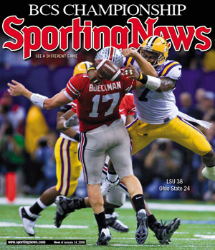
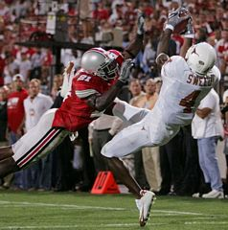
Sources
http://www.elevenwarriors.com/2007/12/ali-baba-and-the-40-time-thieves.html
www.Scout.com
www.Rivals.com
http://www.sportingnews.com/yourturn/viewtopic.php?t=426992
http://www.crimsonandcreammachine.com/2009/3/12/794513/the-sec-speed-myth-debunke
http://en.wikipedia.org/wiki/Bowl_Championship_Series

