Slide 1
A probability Model for Golf Putting
AJ Clair, Tommy Durand, & Jeremy Polster

Slide 2
Golf Background
Golf is hard!
Some view putting as the most difficult part of golf
A study examining professional golfers showed that they were successful on less than 60% of their five-foot putts.

Slide 3
Putting Data
Berry, D. Statistics: A Bayesian Perspective. Belmont, CA. 1995: Duxbury Press
Distance (ft) Tried Success % Made
2 1443 1346 93.2800
3 694 577 83.1400
4 455 337 74.0700
5 353 208 58.9200
6 272 149 54.7800
7 256 136 53.1200
8 240 111 46.2500
9 217 69 31.8000
10 200 67 33.5000
11 237 75 31.6500
12 202 52 25.7400
13 192 46 23.9600
14 174 54 31.0300
15 167 28 16.7700
16 201 27 13.4300
17 195 31 15.9000
18 191 33 17.2800
19 147 20 13.6100
20 152 24 15.7900

Slide 4
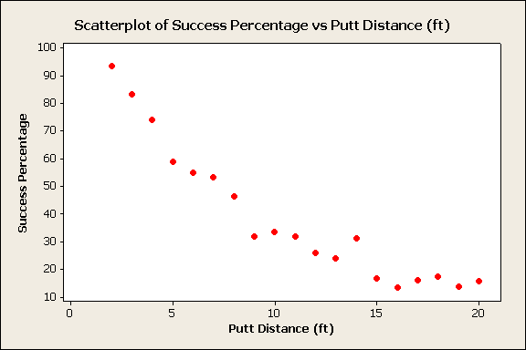

Slide 5
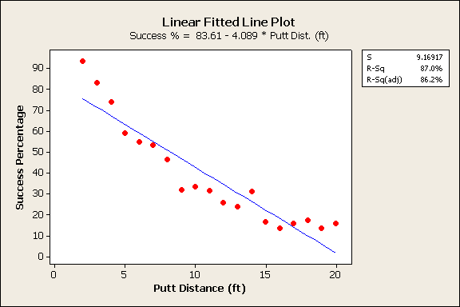

Slide 6
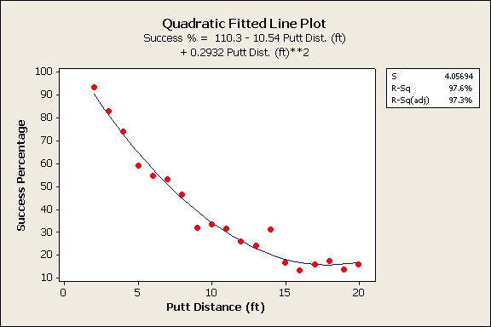

Slide 7
Looking at an Appropriate Putting Model
We can view this as a trigonometric model
When Ө is less than the “threshold angle” the ball will go in the hole.
Threshold angle = arcsin[(R-r)/x]

Slide 8
Can the Model Be Used to Estimate Probability of Successful Putts?
We can imagine a normal distribution to represent the random variable, Ө

Slide 9
Probability Model
Using this normal distribution, the probability of a successful putt is:
Φ represents the standard normal distribution function and σ is the standard deviation
The hole diameter, 2R = 4.25 inches and the ball diameter, 2r = 1.68 inches

Slide 10
Using several mathematical properties including the small angle approximation for the arcsin, we can simplify the equation to:
Using this approximation we calculate the probabilities of a putt at all the given distances. We do this using the estimated value for σ = 0.026 (1.5 degrees)

Slide 11
Distance (ft) | Success Probability (Estimated)
6 | 0.547676
7 | 0.469437
8 | 0.410757
9 | 0.365117
10 | 0.328606
11 | 0.298732
12 | 0.273838
13 | 0.252774
14 | 0.234718
15 | 0.21907
16 | 0.205379
17 | 0.193297
18 | 0.182559
19 | 0.17295
20 | 0.164303

Slide 14
Problems with Linear and Quadratic Models
Linear
2 to 3 ft change is not the same as 19 to 20 ft change
Probability model will show probabilities not bound between 0 and 1
Quadratic
Might have larger R-sq yet an increasing probability at higher distance is not likely
Also, can show probabilities not bound between 0 and 1

Slide 15
Alternative Probability Model
One common estimator for probability models is a d-probit estimator
This is a logistic function which is bound between 0 and 1

Slide 16
Our Experiment
Using the actual probabilities for putting given by Berry, we simulated 100 putts for each distance using binomial random data
We then ran a d-probit regression on the data

Slide 17
Our Results
The coefficient for distance in our d-probit regression was -.026567
This is interpreted as a one foot increase in distance results in a 2.66% decrease in the probability of success for a putt
The 95% confidence interval for the coefficient was (-.031888, -.021246)

Slide 18
Discussion
Note both linear regressions for the actual probabilities and the equation estimated probabilities have slopes included in the confidence interval for our experiment’s coefficient
These slopes are interpreted the same way as the coefficient

Slide 19
Problems With Model
The model only accounts for the angle at which the ball is hit
Does not account for putts that are too short and balls which partly cover the hole and go in
Also it only accounts for distance not terrain, playing conditions, or golfer ability

Slide 20
Conclusion
We can conclude that for our data range, our linear probability models are quite accurate at predicting the change in probability from the change in distance.
Also, the equation for estimating the probabilities appears to be a good estimate for the actual probabilities
However with a larger range of data the linear probability model may not be suitable

Slide 21
References
Berry, D. Statistics: A Bayesian Perspective. Belmont, CA. 1995: Duxbury Press
http://godplaysdice.blogspot.com/2008/06/probability-of-making-putt.html
Gelman, A., Nolan D. “A Probability Model for Golf Putting.” Teaching Statistics Vol. 24 No. 3 pg. 93-95

