Slide 1
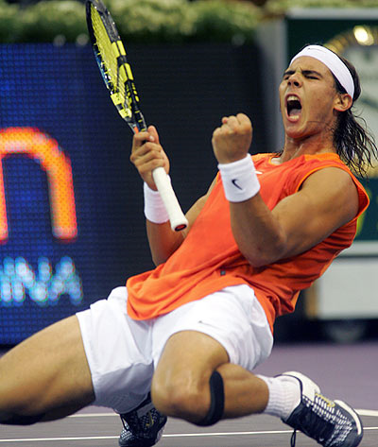
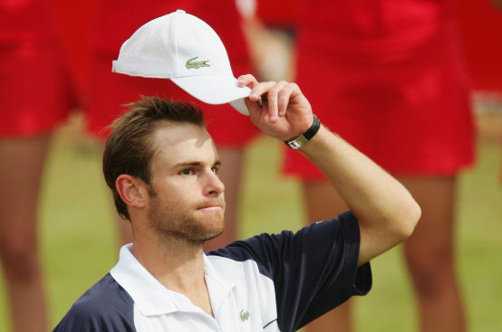
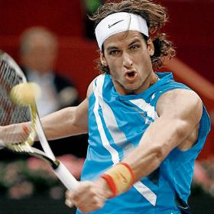
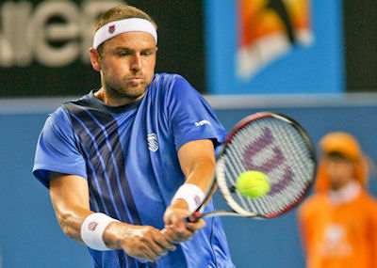
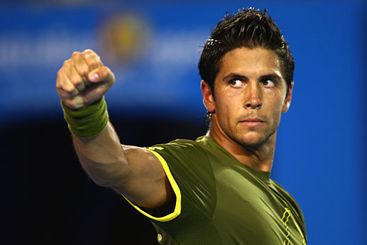
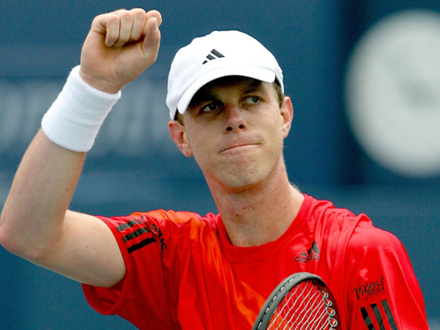
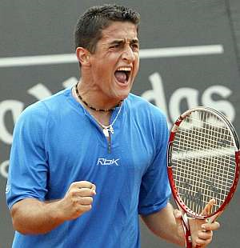
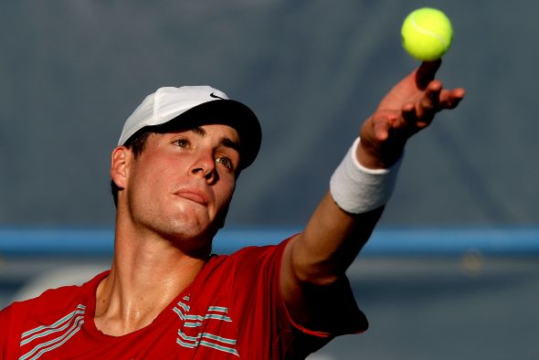
American vs. Spanish Tennis
Josh Stiles, Mark Motheral, and Jake Fishbein

Slide 2
Introduction
Top ten American vs. Top ten Spanish Tennis Players
Analysis of present Spanish dominance vs. the drop in American performance
A European dominated sport
Are the Spanish dominating because of their experience and training on clay courts?
Notes:
We are comparing the top ten us to top ten sp players today. Took top ten sp and us players. Wanted to see differences of winning pcts in different circumstances in an overall comparison. We wanted to get stats containing information regarding forehand/backhand/volley/aces but tennis does not keep significant records of stats other than winning pcts. Tennis does not have stats like the other major professional sports. We were interested in seeing why the sp players are dominating so much at this time while us players are lacking at this time considering that they had been winning a lot in the past. Between 1991 and 2000, 21 and 36 grand slams were won by and American, while in the past 10 years there has only been one grand slam victory by an american. What has happened to american tennis?

Slide 3
The Analysis
In depth look at winning percentages of Spanish and American players on different surfaces and situations
Took into account wide ranges of causes and effects
Notes:
We did an analysis by looking at overall winning pcts, clay winning pct, and hard winning pct. Spanish play mostly on clay while the american game has become transfixed on hard court tennis. We also looked specifically at losing first set and winning the match winning pcts. Most matches are best of three while Grand Slams are best of five. We expected, before taking the data, for the spanish to have a much higher winning pct in this situation based on the endurance built up by playing the longer games that take place on clay courts.

Slide 4
The Players
Americans
8 Roddick, Andy
17 Fish, Mardy
18 Querrey, Sam
24 Isner, John
107 Russell, Michael
110 Kendrick, Robert
118 Sweeting, Ryan
134 Dent, Taylor ^{t}
139 Young, Donald
Harrison, Ryan
James Blake*^{t}
^{t} Usually in top 30 but has been injured
*Not included in Data
Spanish
1 Nadal, Rafael
6 Ferrer, David
9 Verdasco, Fernando
13 Almagro, Nicolas
25 Montanes, Albert
26 Garcia-Lopez, Guillermo
27 Ferrero, Juan Carlos
32 Robredo, Tommy
41 Lopez, Feliciano
52 Granollers, Marcel
Notes:
We can see already the issues regarding the rankings and how much higher ranked the Spanish are than the Americans. Note that a lower ranking means that a player is better.

Slide 5
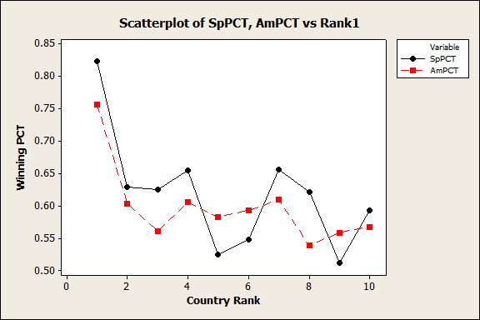
American vs. Spanish Overall Winning PCT
Variable N N* Mean SE Mean StDev Minimum Q1 Median Q3
Spanish 10 0 0.6185 0.0280 0.0885 0.5110 0.5423 0.6230 0.6545
American 10 0 0.5972 0.0191 0.0605 0.5380 0.5603 0.5875 0.6060
Variable Maximum
Spanish 0.8230
American 0.7560
Notes:
Looking at the scatter plot for overall winning pct we can see a lot of similarities between the sp and us players. 3 Spanish players actually have the lowest winning pct of all the players looked at. Winning % do not show what tournaments the players are playing in. The cut of for grand slams is a ranking of 128. So many of the American players have easier opponents to face. And for masters it is the top 64. All the top spanish players are playing in much more challenging draws so they are going to suffer more losses. It is also interesting to note that both Andy Roddick and Rafael Nadal are outliers in their respective winning pct groups. They are both in the top 10 in the world.

Slide 6
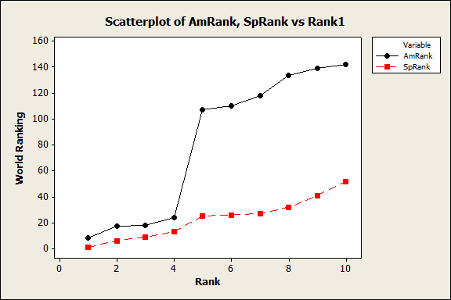
Notes:
Higher numbers are worse! James Blake is normally is top 25 but has been injured/ill and so is not a factor in our analysis. Taylor Dent was between top 25 and 40 in 2001 – 2006. obviously there is a big drop in american rankings after the top 4: the top 4 are within the top 25 but following that, none are within the top 100, while all the spanish players are in the top 55. This is a huge difference and has definitely shown that the spanish are better.

Slide 7
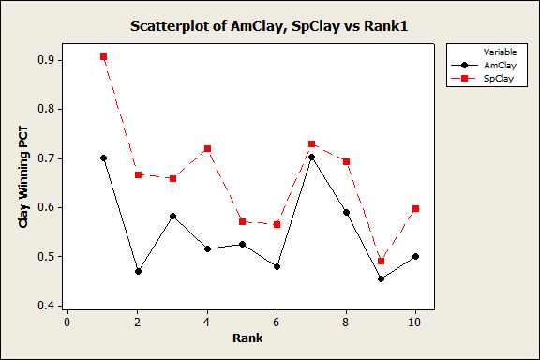
American vs. Spanish Clay Winning PCT
Variable N N* Mean SE Mean StDev Minimum Q1 Median Q3
Spanish 10 0 0.6600 0.0365 0.1154 0.4910 0.5695 0.6630 0.7215
American 10 0 0.5517 0.0286 0.0904 0.4550 0.4758 0.5200 0.6170
Variable Maximum
Spanish 0.9070
American 0.7020
Notes:
We wanted to look at the diffs in winning pct of americans and spanish on clay courts to see if the sp are significantly better on clay than the americans. And they are! However, it is interesting that the graphs are almost identical images of each other with only the americans being at a much lower level. The americans have the lowest pct at 45% while the spanish have the highest at 91%. The overall mean is 11% difference in favor of the spanish. The variation in the results is clear in the box plot.

Slide 8
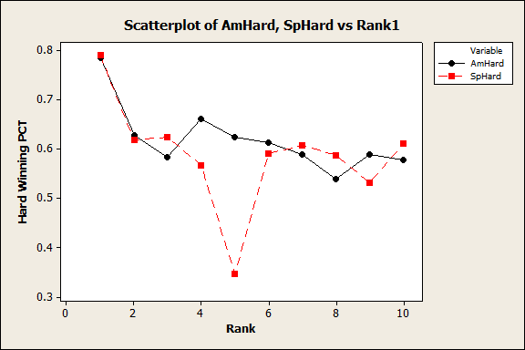
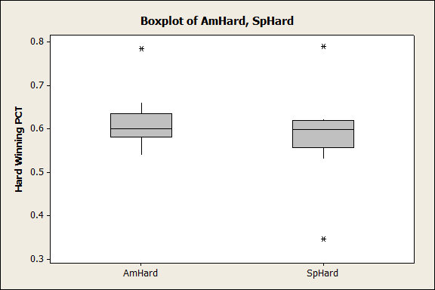
American Hard vs. Spanish Hard Winning PCT
Variable N N* Mean SE Mean StDev Minimum Q1 Median Q3
Spanish 10 0 0.5867 0.0343 0.1083 0.3460 0.5573 0.5985 0.6193
American 10 0 0.6187 0.0212 0.0672 0.5390 0.5817 0.6005 0.6355
Variable Maximum
Spanish 0.7890
American 0.7850
Notes:
MONTANES!!! #5. Thought that there would be more SP players much worse on hard court, but this was not the case overall. This may be due to the Spanish collective ranking being much higher than the americans (Spanish mean: 23.2; American mean: 81.7) When removing the lowest values for both there was an increase in Spanish mean winning pct on hard court. (.58 to .61) American’s went from .618 to .627.

Slide 9
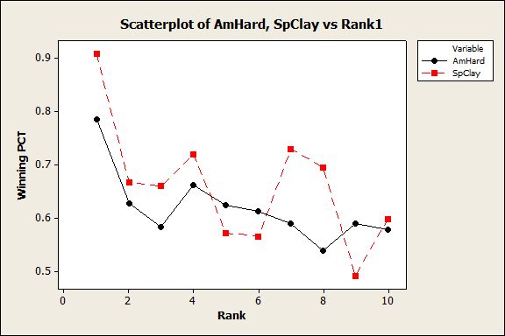
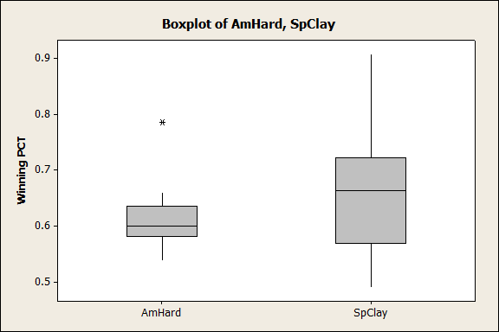
American Hard vs. Spanish Clay Winning PCT
Spanish Clay Mean: 0.6600
American Hard Mean: 0.6187
Notes:
US Open in Hard Court and American tennis is known for hard court tennis while the French Open is on clay and the Spanish are more prone to play on red clay. Andy Roddick is an outlier on American Hard Court play. Its almost a 15% difference is his winning pct. And it is interesting that Nadal is not an outlier for the Spanish. This means that the rest of the Spanish and also very successful on clay.

Slide 10
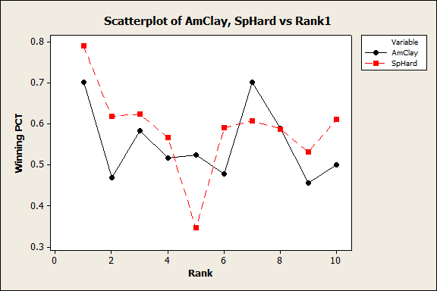
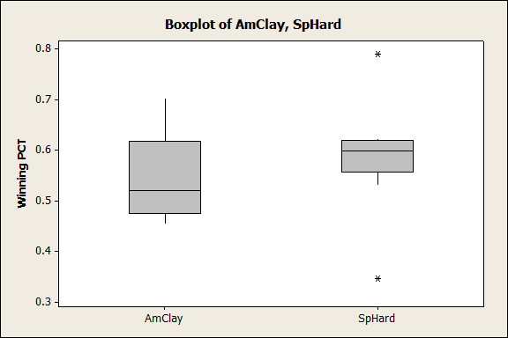
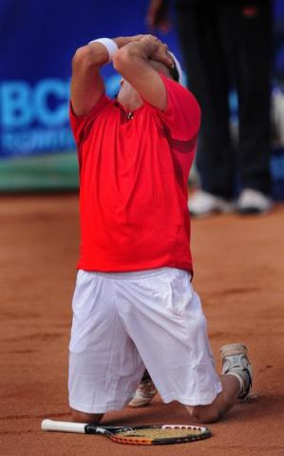
American Clay vs. Spanish Hard Winning PCT
Spanish Hard Mean: 0.5867
American Clay Mean: 0.5517
MONTANES- THE WORST OUTLIER
Notes:
2 outliers for the Spanish, Nadal and Montanes. Montanes is a clay courts specialist and we were expecting more Spanish players to have results similar to his. Montanes is 5’9’’ and weighs 155 lbs. He is SHORT! But there is much less spread for Spanish players even on hard court tennis, whereas there is a much larger spread for the Americans on clay court tennis. Could be due to the range of their rankings.

Slide 11
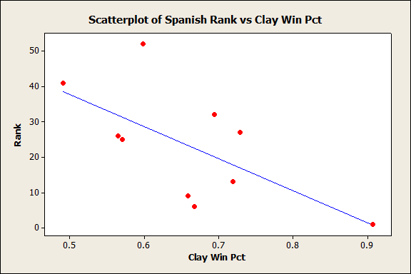
R-Squared: 41.9%
Rank = 82.97 – 90.56 (Clay Winning PCT)
Notes:
There is no correlation between how well the Spanish play on clay and their overall world ranking. The r-squared is really bad. There is a very weak relationship for variable rank caused by variable clay winning pct.

Slide 12
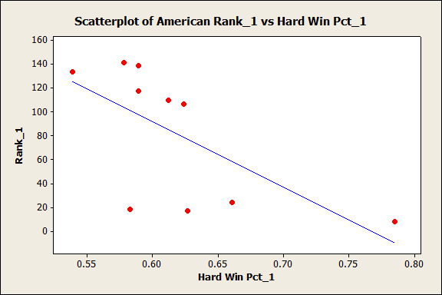
R-Squared: 42%
Rank = 423 – 551.7 (Hard Winning PCT)
Notes:
Same thing as seen in the previous slide. The r-squared is almost identical and there is a very weak correlation between rank and hard court winning pct for the americans.

Slide 13
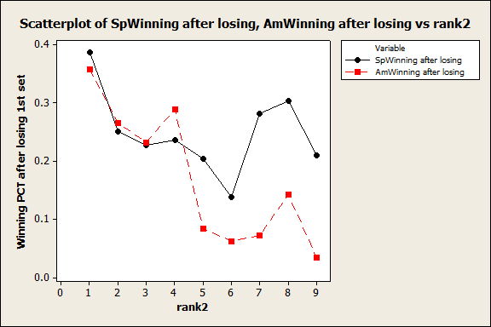
Winning PCT of Matches Won after Losing First Set
Notes:
We would think that the Spanish would have a higher winning pct because they are clay court players they have better endurance and are used to playing longer matches and will probably do better in 4th and 5th set matches than Americans. We did not get these results. There is a much bigger range for the Americans.

Slide 14
Conclusion
Tennis has lost its dominance as a sport in America
This is clear from Spanish positions in world rankings and ability to play on both hard and clay courts.
Tennis has become more competitive on a international level
American tennis has become all about the hard court
Even so, there is a stark similarity between the graphs of top ten players in Spain and the United States
Notes:
Roddick, Blake, Sampras, Agassi, McEnroe. Mean rankings: Spain = 23.20 and America = 81.7 (mean of top ten players in each country). Sam Querry knocked out of first round at Wimbleton by Ferrero. Between 1992 and 2000, Americans won 21 of the 36 Grand Slams. Roddick last won one in 2003, and since then no American has won one.
We analyzed one last essential factor. Unfortunately data for this factor was even more impossible to find than forehand winners. But we have come to the conclusion that…

Slide 15
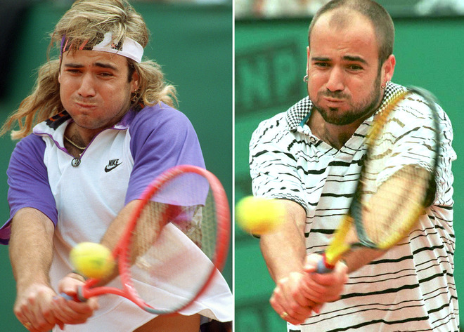
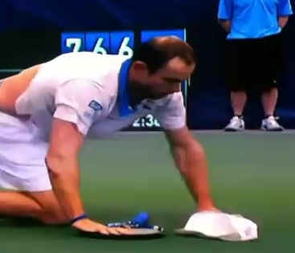
Clearly lack of baldness is leading to the faltering of American Tennis.
http://www.youtube.com/watch?v=z9kFtG367ww
Start at 4:00
James Blake has left. Agassi is retired. Pete Sampras is retired. John McEnroe has long been retired. Who’s left?
Notes:
…lack of baldness is the main cause of American downfall in tennis.

Slide 16
Sources
http://www.atpworldtour.com
http://www.itftennis.com
http://www.sportingo.com

