Slide 1
Paying for Performance:
A Study of Salary and Performance Statistics in the MLB
(During 2010)

Slide 2
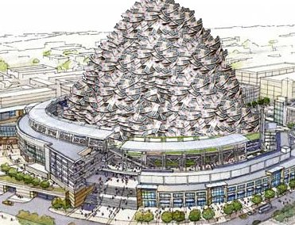
Topic Questions
How does Team Salary correlate with performance in Major League Baseball?
Which Performance Statistics have the strongest correlation to Team Salary?
  (What are you paying for?)

Slide 3
Statistics Examined
Offense
Defense
  PCT
  HR
  R
  AVG
  OPS
PCT
SO
BB
Team ERA

Slide 4
Team Salary: Boxplot

Slide 5
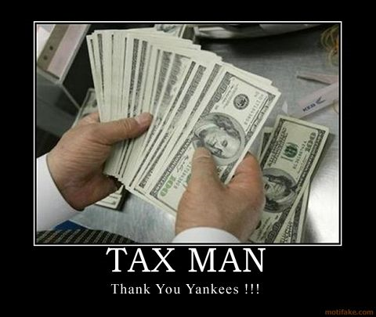
Team Salary: Descriptive Stats
N=30
Mean= 91,020,056
Median= 84,325,334
Standard Deviation= 38,258,046
Minimum= 34,943,000
  Pittsburgh Pirates
Maximum= 206,333,389
  New York Yankees

Slide 6
Winning Percentage: Boxplot

Slide 7

Winning Percentage: Descriptive Stats
N=30
Mean=.501
Median=.500
Standard Deviation=.0679
Minimum=.3520
  Pittsburgh Pirates
Maximum=.5990
  Philadelphia Phillies

Slide 8
Offensive Stats: HR and AVG

Slide 9
Offensive Stats: R and OPS

Slide 10
Winning Percentage

Slide 11
Defensive Stats: BB, SO and Team ERA

Slide 12
Rankings
Offense
  OPS=12.3%
  PCT=12.1%
  AVG=8.8%
  HR=6.9%
  R=5.9%
Defense
  PCT=12.1%
  SO=2.8%
  Team ERA=2.1%
  BB=0.0%

Slide 13
Conclusion
In 2010, Team Salary had a very weak correlation with PCT and most other performance statics
Overall, Team Salary had a stronger correlation with offensive stats than defensive stats
Things to Consider:
  How would this study change over multiple years?
  Could Team Salary better predict other performance stats?
  If money isn’t helping them win, why do most baseball fans hate the Yankees?

Slide 14
Sources
mlb.com
cbssports.com
espn.go.com

