Slide 1
William Lowell Putnam Mathematical Competition
When?
5th of December
How can I prepare for it?
Solve lots of problems.
Why should I spent six hours on a Saturday?
Because it is fun and challenging.

Slide 2
Some suggestions!
Try small cases and search for pattern
Draw a figure
Formulate an equivalent problem
Modify the problem
Choose effective notation
Work backwards
Argue by contradiction
Divide into cases
Generalize ………

Slide 3
1.
P2
P3
r
P4
P1
P8
P5
P7
P6

Slide 4
1.
and
[P1P3P5P7]=5
P2
P3
r=√(5/2)
r²=a²/4+b²/4
and
a
r
P4
P1
ab=4
P8
P5
b= √2
a= 2√2
b
P7
P6
Area of the octagon=[P2P4P6P8]+2[P4P5P6]+2[P2P3P4]
The answer is 3 √5.

Slide 5
2.
y=ax²
Assume a>1/2.
x²+(y-1)²=1
-((2a-1)/a²)^1/2
((2a-1)/a²)^1/2
Use arclegth formula, and some crazy algebraic trick to conclude
that the answer is YES!!!

Slide 6
Basketball star Shanille O’Keal’s team statistician keeps track of the
number, S(n), of successful free throws she made in her first N attempts
of the season.
Early in season, S(N) was less than 80% of N, but by the end of the
season, S(N) was more than 80% of N. Was there necessarily a moment
in between when S(N) was exactly 80% of N?
Answer: Yes!
Suppose otherwise. Then there exists an N such that
S(N)<80% and S(N+1)>80%
Let m be the number of throws she made in the first N attempts, then
m/N<4/5 and m+1/N+1>4/5
This implies 5m <4N<5m+1
CONTRADICTION!!!

Slide 7
4. Alan and Barbara play a game in which they take turns filling entries
of an initially empty 2008x2008 array. Alan plays first. At each turn,
a player chooses a real number and places it in a vacant entry.
The game ends when all the entries are filled. Alan wins if the determinant
of the resulting matrix is nonzero; Barbara wins if it is zero.
Which player has a winning strategy?
Answer: Barbara wins using the following strategies:
Pair each entry of the first row with the entry directly below it in the
second row. If Alan ever writes a number in of the first two rows,
Barbara writes the same number in the other entry in the pair.
If he writes somewhere else Barbara repeats her strategy.
At the end the resulting matrix will have two identical rows,
so its determinant will be zero.
OR
Whenever Alan writes a number x, Barbara writes –x in some entry
in the same row. At the end all the rows will add up to zero, so the
determinant will be 0.

Slide 8
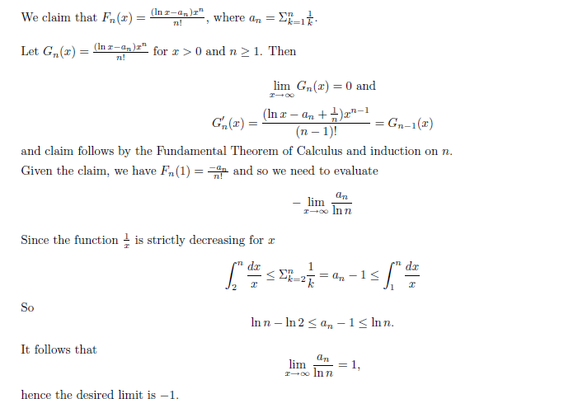
5. Answer:

Slide 9

6. Let f be a nonconstant polynomial with positive integer coefficients.
Prove that if n is a positive integer, then f(n) divides f(f(n)+1)
if and only if n=1.
Answer: Write
If n=1, then this implies that f(f(n)+1) is divisible by f(n).
Otherwise, 0<f(1)<f(n) since f is nonconstant and has positive coefficients,
so f(f(n)+1) cannot be divisible by f(n).

Slide 10
7. Answer: 2499
In general, the highest power of p in n! is given by the finite sum
8. Answer: 756680642578126
Let’s look at all the numbers up to 999999999. 1000000000 contributes
1 to the sum that we can add later. Now each digit will take values from
0 to 9, including the first one since we represent 1 as 000000001.
So each digit will contribute 1+2+…+9 to the sum and there are 9 digits.
Hence we compute the following
= 756680642578126

Slide 11
9. Answer:1/5
A
B
B
A
A+B
B
A
B
A

Slide 12
10. Answer:
This is the sequence of numbers that are starting with the letter “t”.
You can say it, I know you hate me ☺.

Slide 13
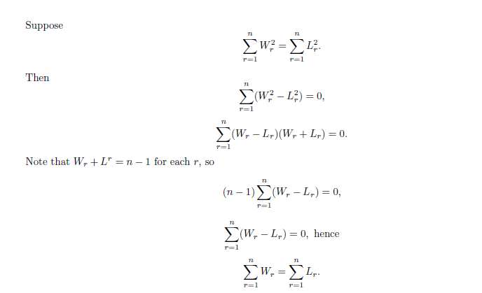
11. Answer: Work backwards.

Slide 14
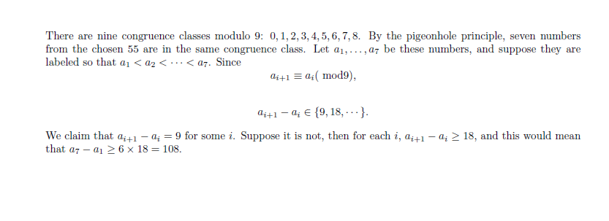
12. Answer:

Slide 15
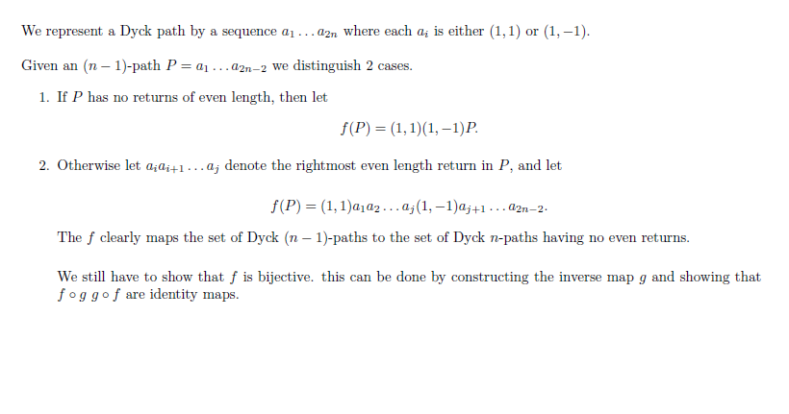
13.
Show that there is a one-to-one correspondence between the Dyck
n-paths with no return of even length and the Dyck (n-1)-paths.
O

Slide 16
Surprise Question:
It is easy to see that a cake in the shape of a cylinder can be cut
into eight identical pieces with 4 straight cuts.
Can this be done with only three straight cuts?

Slide 17
It is easy to see that a cake in the shape of a cylinder can be cut into
eight identical pieces with 4 straight cuts.
Can this be done with only three straight cuts?
PICTURES ALWAYS HELP!

Slide 18
What is a better way than pictures?

Slide 19

Bonus Question: While you enjoy your cake…..
What about a torus (doughnut)? What is the most number of pieces
into which a solid torus can be cut by three straight cuts?
Or more generally by n cuts?
(Note: Rearranging the pieces are not allowed.)

Slide 20
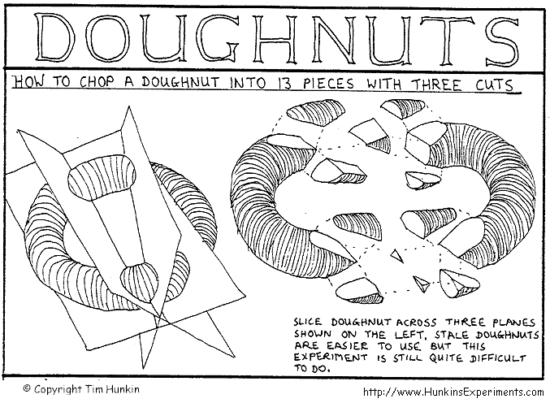
Here is the answer:

