Slide 1
Winning the World Series: Wild Card vs. 1st Ranked Teams

Slide 2
How MLB Playoffs Work
Eight teams make the playoffs
Four each in the American and National Leagues
There are three division champs and one wild card – the team with the best record that does not win a division

Slide 3
Division Series (ALDS and NLDS)
The first round is the Division Series—best of five series
The team with the best overall record gets the top seed and home-field advantage in the playoffs. It hosts Games 1, 2 and 5 in the Division Series round. The team with the second-best record will hosts Games 1, 2 and 5 in its series.

Slide 4
Wild Card Teams
The wild-card team plays the team with the best overall record
If those teams are in the same division, then the wild-card team will face the team with the second-best record

Slide 5
League Championship Series (ALCS and NLCS)
The winners of the Division Series advance to the best-of-seven American League and National League Championship Series
The team with the best record of the remaining teams will have home-field advantage

Slide 6
World Series
The winners of the ALCS and NLCS advance to the World Series
Home-field advantage in the World Series is determined by the winning league in the All-Star Game

Slide 7
Our Goal
The addition of the wild card dramatically changed baseball
We are trying to find a way to predict the probabilities that wild card teams have in advancing to the next round of the playoffs and ultimately winning the World Series

Slide 8
Facts about the Wild Card
- The Florida Marlins were the first Wild Card team to make it to the World Series
- The Florida Marlins were also the first Wild Card team to win the World Series.
- The Boston Red Sox have won six Wild Cards. (Most in MLB)
- The Marlins are the only NL Wild Card team to win the World Series
- Only four times has a Wild Card team won the World Series: Florida Marlins (1997 and 2003), Anaheim Angels(2002), and Boston Red Sox (2004).
- 2002 is the only year that both Wildcards played each other in the World Series. (San Francisco and Anaheim)

Slide 9
NL and AL Wild Card Probabilities
NLDS (5 game series)– 14 times
-Prob: .571
NLCS( 7 Game series)—8 times
-Prob: .75
World Series (7 game series)—6 times
-Prob: .333
ALDS (5 game series)—14 times
-Prob: .571
ALCS (7 game series)—8 times
-Prob: .375
World Series (7 game series)—3 times
-Prob: .666

Slide 10
NL and AL Wild Card Combined
Divisional Series Prob: .571
Championship Series: .5625
World Series: .444

Slide 11
NL and AL Best Records
NLDS—14 times
Prob: .643
NLCS—9 times
-Prob: .444
World Series—4 times
-Prob: .250
ALDS—14 times
Prob: .643
ALCS—9 times
-Prob: .643
World Series—6 times
-Prob: .666

Slide 12
NL and AL Combined
Divisional Series Prob: .643
Championship Series Prob: .555
World Series Prob: .555

Slide 13
Class Exercise
Simulating League Championship Series
AL Wildcard Team Probability: .375
NL Wildcard Team Probability: .75

Slide 14
2008 All Over Again

Slide 15
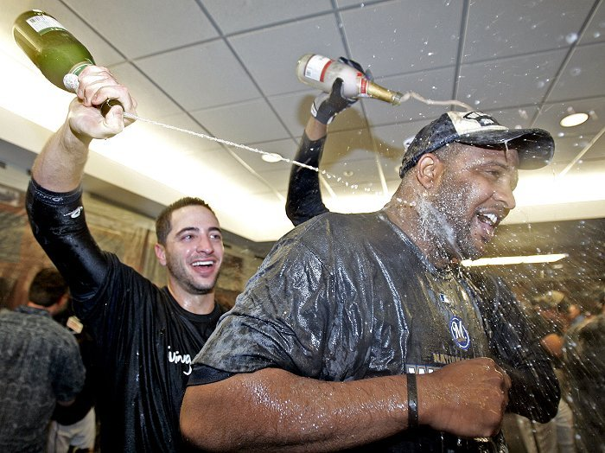
And the winner is….

Slide 16
Possible Reasons for the Wild Card Teams’ Success
Dominant starting Pitching
Ex. 2003 Florida Marlins who had Dontrelle Willis and Josh Beckett
Wild Card does not mean they’re the worst team
Ex. 2004 Boston Red Sox (98-64) had the second best record in the American League but were the Wild Card team finishing behind the New York Yankees (101-61)
Exceptional performance by one player
Ex. Barry Bonds in 2002 and Manny Ramirez in 2008
Rally monkeys http://www.youtube.com/watch?v=aziWSxqGBD4&NR=1

Slide 17
Limitations and Future Research
Look into game by game probabilities instead of series by series
http://www.whowins.com/formulae/probformulae.html
Identify a hot player before playoffs start and see how he and his team does throughout the playoffs to see if he makes a difference
Look at difficulty of road to the playoffs
Ex: Boston cruising into the playoffs in 2004
Ex: Colorado playing a one-game playoff in 2007
There is not as much data available since the wild card was implemented in 1995

Slide 18
Article
http://www.whowins.com/features/comeback.html

Slide 19
References
http://baseball.about.com/od/seasonstructur1/tp/playoffsformat.htm
http://www.baseball-reference.com/postseason/

