Slide 1
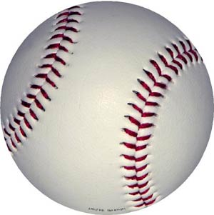
Smartball
Devin Ensing
Dan Gajewski
Craig Wocl

Slide 2
Article
Purpose: attempt to quantify the process that is used to build winning baseball teams
Recognizing talent: minor league performance
Developing talent: years in minor leagues
Integrating talent: years with minor league team
Compensating talent: equitable payroll distribution

Slide 3
Article
The authors compared teams from 2000-2004
We are comparing teams from 2005-2008
Couldn’t replicate everything
e.g. the Gini coefficient = equal payroll distribution
Looking mostly at payrolls and wins

Slide 4
2009 MLB Payrolls
Highest Payroll
New York Yankees
$ 201,449,189
Lowest Payroll
Florida Marlins
$ 36,834,000
The Marlins 6-year “business cycle”
Average Payroll: $88,513,173.13
Payrolls from 2008-09 actually decreased 1.7% - first time that has happened in the last few years

Slide 5
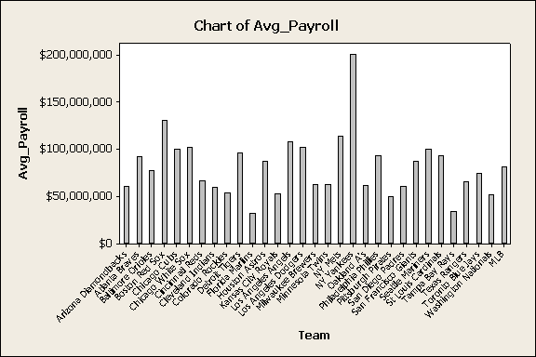
Average Annual Payroll 05-08

Slide 6
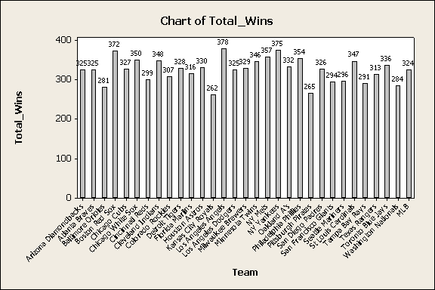
Total Wins 2005-2008

Slide 7
2005
Test and CI for Two Proportions 2005 Top 10 vs. Rest of MLB
Sample X N Sample p
Top 10 869 1620 0.536420
Rest 1561 3240 0.481790
Difference = p (Top 10) - p (Rest)
Estimate for difference: 0.0546296
95% lower bound for difference: 0.0296538
Test for difference = 0 (vs > 0): Z = 3.60 P-Value = 0.000
Fisher's exact test: P-Value = 0.000
Test and CI for Two Proportions 2005 Bottom 10 vs. MLB
Sample X N Sample p
Bottom 10 842 1620 0.519753
Rest 1588 3240 0.490123
Difference = p (Bottom 10) - p (Rest)
Estimate for difference: 0.0296296
95% lower bound for difference: 0.00461863
Test for difference = 0 (vs > 0): Z = 1.95 P-Value = 0.026
Fisher's exact test: P-Value = 0.028

Slide 8
2006
Test and CI for Two Proportions 2006 Top 10 vs. MLB
Sample X N Sample p
Top 10 850 1619 0.525015
Rest 1579 3239 0.487496
Difference = p (Top 10) - p (Rest)
Estimate for difference: 0.0375193
95% lower bound for difference: 0.0125107
Test for difference = 0 (vs > 0): Z = 2.47 P-Value = 0.007
Fisher's exact test: P-Value = 0.007
Test and CI for Two Proportions 2006 Bottom 10 vs. MLB
Sample X N Sample p
Bottom10 817 1620 0.504321
Rest 1613 3238 0.498147
Difference = p (Bottom 10) - p (Rest)
Estimate for difference: 0.00617398
95% lower bound for difference: -0.0188536
Test for difference = 0 (vs > 0): Z = 0.41 P-Value = 0.342
Fisher's exact test: P-Value = 0.354

Slide 9
2007
Test and CI for Two Proportions 2007 Top 10 vs. MLB
Sample X N Sample p
Top 10 856 1618 0.529048
Rest 1572 3238 0.485485
Difference = p (Top 10) - p (Rest)
Estimate for difference: 0.0435633
95% lower bound for difference: 0.0185565
Test for difference = 0 (vs > 0): Z = 2.87 P-Value = 0.002
Fisher's exact test: P-Value = 0.002
Test and CI for Two Proportions 2007 Bottom 10 vs. MLB
Sample X N Sample p
Bottom10 859 1618 0.530902
Rest 1556 3238 0.480544
Difference = p (Bottom 10) - p (Rest)
Estimate for difference: 0.0503588
95% lower bound for difference: 0.0253585
Test for difference = 0 (vs > 0): Z = 3.31 P-Value = 0.000
Fisher's exact test: P-Value = 0.001

Slide 10
2008
Test and CI for Two Proportions 2008 Top 10 vs. MLB
Sample X N Sample p
Top 10 850 1619 0.525015
Rest 1578 3237 0.487488
Difference = p (Top 10) - p (Rest)
Estimate for difference: 0.0375270
95% lower bound for difference: 0.0125159
Test for difference = 0 (vs > 0): Z = 2.47 P-Value = 0.007
Fisher's exact test: P-Value = 0.007
Test and CI for Two Proportions Bottom 10 vs. MLB
Sample X N Sample p
Bottom10 848 1619 0.523780
Rest 1580 3237 0.488106
Difference = p (Bottom 10) - p (Rest)
Estimate for difference: 0.0356738
95% lower bound for difference: 0.0106604
Test for difference = 0 (vs > 0): Z = 2.35 P-Value = 0.009
Fisher's exact test: P-Value = 0.010

Slide 11
$ per Win
Variable | N | N* | Mean | SE Mean | St Dev
08 $/Win | 30 | 0 | 1,107,290 | 79,473 | 435,289
07 $/Win | 30 | 0 | 1,009,634 | 66,821 | 365,995
06 $/Win | 30 | 0 | 946,620 | 60,629 | 332,081
05 $/Win | 30 | 0 | 890,654 | 63,985 | 350,460
Min | Q1 | Med | Q3 | Max
259,661 | 884,676 | 1,048,944 | 1,372,285 | 2,349,231 (NY Yankee)
365,508 | 650,303 | 1,021,994 | 1,225,009 | 2,017,437 (NY Yankees)
192,288 | 750,615 | 879,474 | 1,131,814 | 2,006,836 (NY Yankees)
442,971 | 651,402 | 828,657 | 1,089,529 | 2,192,703 (NY Yankees)

Slide 12
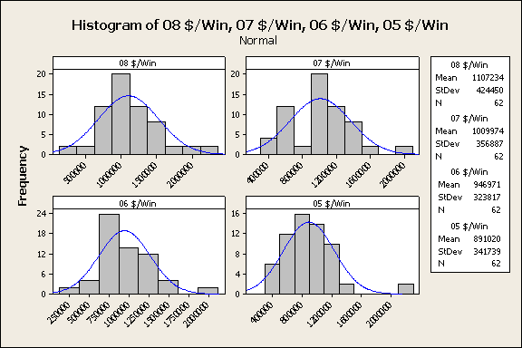

Slide 13
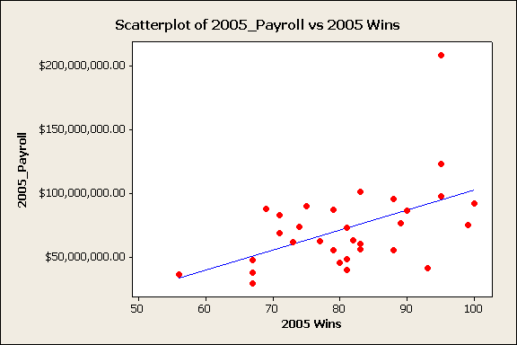
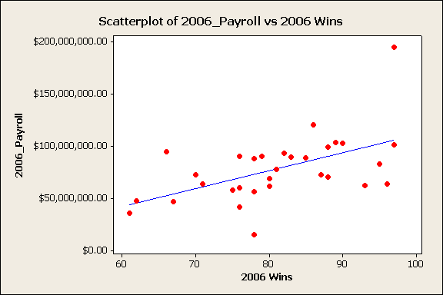

Slide 14
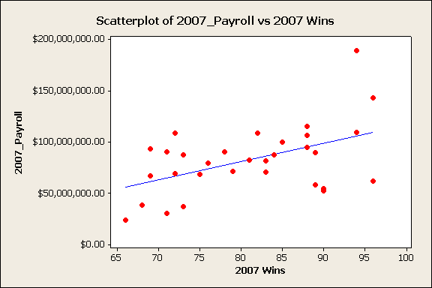
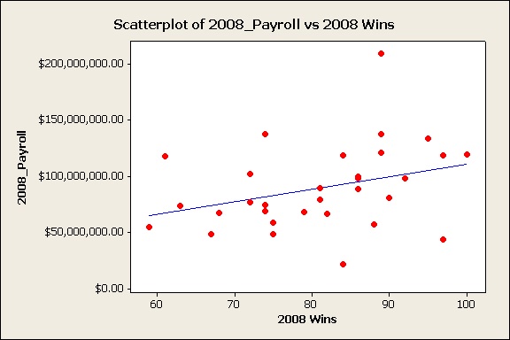

Slide 15
Class Activity
Open P:\temp\0 Smartball and Payrolls.MPJ

Slide 16
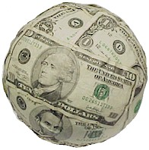
Conclusion
For the most part, teams that spend more money win more games.
Always a positive slope to the regression line within the scatter plots
The New York Yankees have had the highest payroll since 2005, and have had at least 89 wins each year.
Some small market team like the Rays (97 wins, AL Champions) in 2008 and the Indians (93 wins) in 2005 have had success while spending less money.
It all depends on how smart the team’s
management is with the money that they
are given.

Slide 17
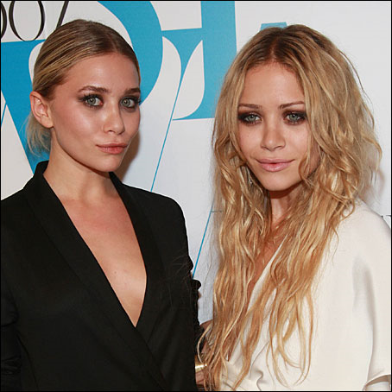
Limitations and Further Research
Explore the Gini coefficient in depth more contemporary data
Look to see if the $/Win decreases this season with the drop in overall payrolls across baseball
Examine more closely teams that spend through free agency or teams that spend on “homegrown” talent (Twins?)

Slide 18
References
http://journals.ohiolink.edu/ejc/pdf.cgi/Sherony_Keith.pdf?issn=15341844&issue=v16i0001&article=21_saltrtmfbt
http://content.usatoday.com/sports/baseball/salaries/totalpayroll.aspx?year=2009
MLB.com

