Slide 1
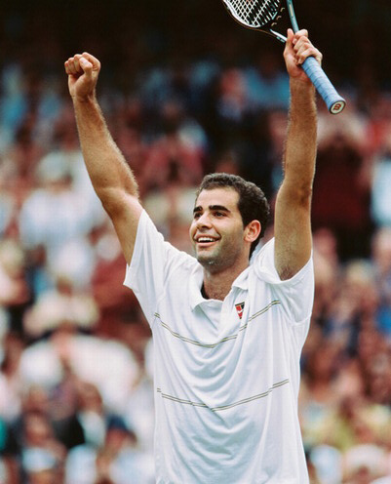
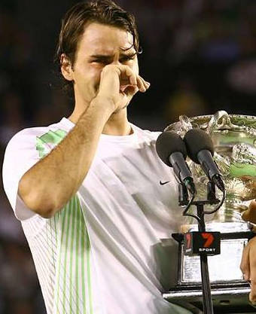
Sampras v. Federer: Who is the best tennis player ever?
Jeremy Polster & Justin Greenlee

Slide 2
History
Sampras
Federer
Career Grand Slam Victories: 14
Career Wins/Losses: 722-222
Career Titles: 64
Total Weeks ranked #1: 286
Consecutive Weeks at #1: 102
Consecutive Years ending at #1: 6
Times lost to GS champion: 10
Best Year Stats: 85–16, 2 GS Titles
Career Grand Slam Victories: 13
Career Wins/Losses: 626/151
Career Titles: 79
Total Weeks ranked #1: 237
Consecutive Weeks at #1: 237
Consecutive Years ending at #1: 4
Times Lost to GS Champion: 7
Best Year Stats: 92 – 5, 3 GS titles

Slide 3
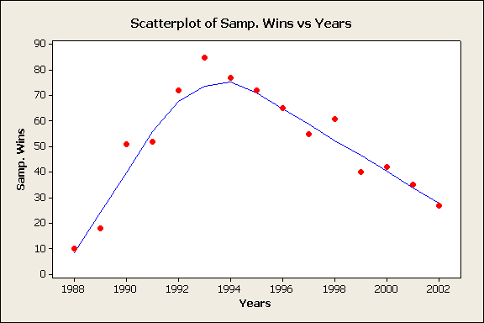
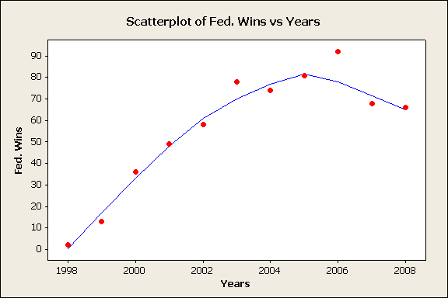
Graphing Their Careers: Wins/Yr. v. Years

Slide 4
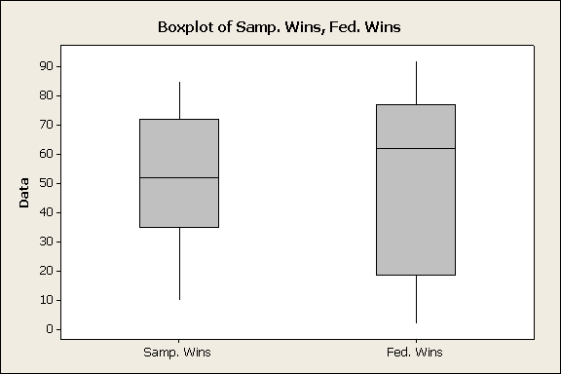
Wins/Yr., Career

Slide 5
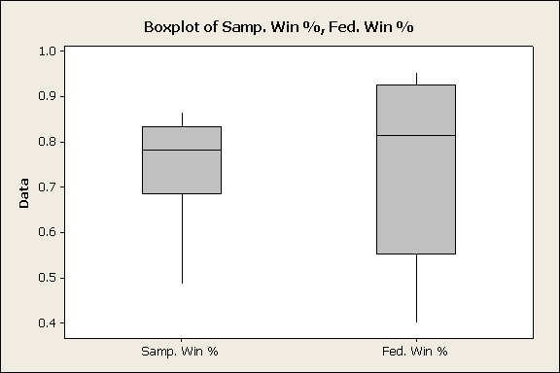
Looking at career wins is helpful, but Fed isn’t finished, so… Winning % Over Career

Slide 6
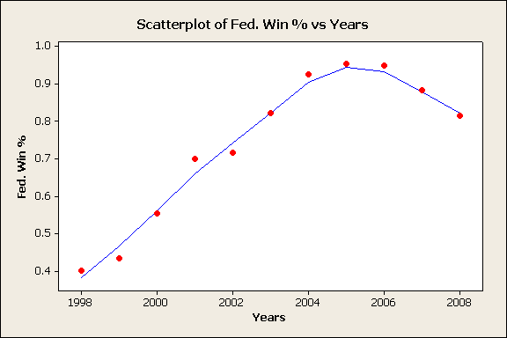
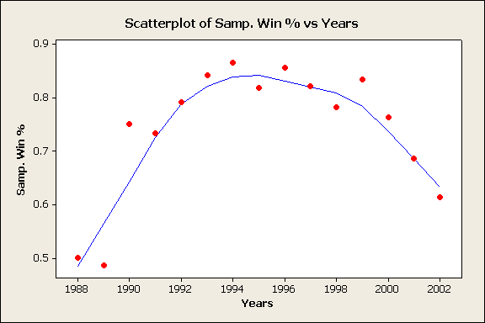
Comparing Graphs: Win % vs. Year

Slide 7
Descriptive Statistics
Descriptive Statistics: Fed. Wins/Yr., Samp. Wins/Yr.
Variable N N* Mean SE Mean StDev Minimum Q1 Median Q3 Maximum
Fed. Wins 11 0 56.09 8.63 28.62 2.00 36.00 66.00 78.00 92.00
Samp. Wins 15 0 50.80 5.70 2 2.09 10.00 35.00 52.00 72.00 85.00
Descriptive Statistics: Fed. Win %, Samp. Win %
Variable N N* Mean SE Mean StDev Minimum Q1 Median Q3 Maximum
Fed. Win % 11 0 0.7408 0.0605 0.2005 0.4000 0.5538 0.8148 0.9250 0.9529
Samp. Win % 15 0 0.7427 0.0313 0.1214 0.4865 0.6863 0.7821 0.8333 0.8652

Slide 8
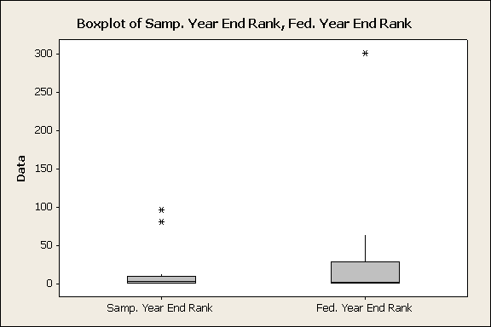
Year End Rank

Slide 9
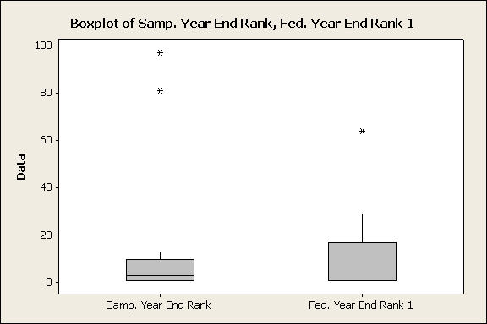
Year End Rank (minus Federer’s First Year)

Slide 10
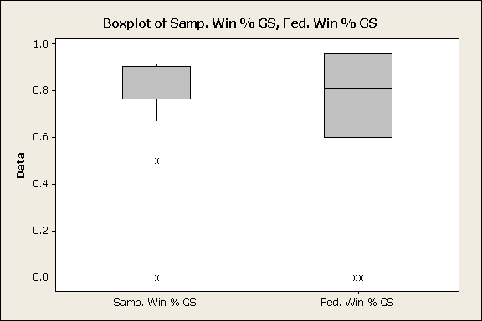
The Big Matches: Winning % in Grand Slam Tournies

Slide 11
Descriptive Statistics
Descriptive Statistics: Fed. Win % GS, Samp. Win % GS
Variable N N* Mean SE Mean StDev Minimum Q1 Median Q3 Maximum
Fed. Win % GS 11 0 0.683 0.109 0.360 0.000 0.600 0.813 0.957 0.964
Samp. Win % GS 15 0 0.7656 0.0617 0.2391 0.0000 0.7647 0.8500 0.9048 0.9200

Slide 12
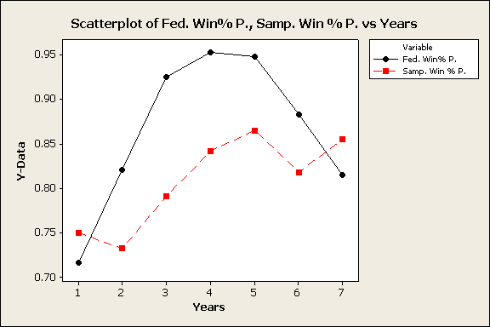
Comparing Prime Years
Sampras: 1990 – 1996, Federer: 2002 - 2008

Slide 13
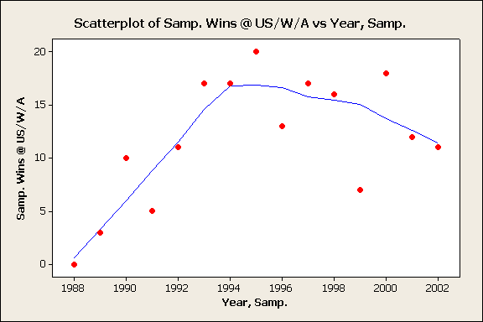
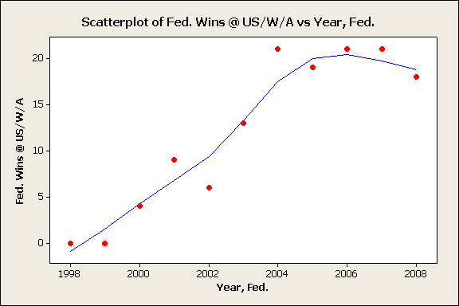
Dividing Up the Grand Slams: Comparing Sampras and Federer’s Wining Percentage in the Australian Open, The US Open, and Wimbledon
Y-axis: Wins Per Year at the US Open, Wimbledon and Australian Open combined

Slide 14
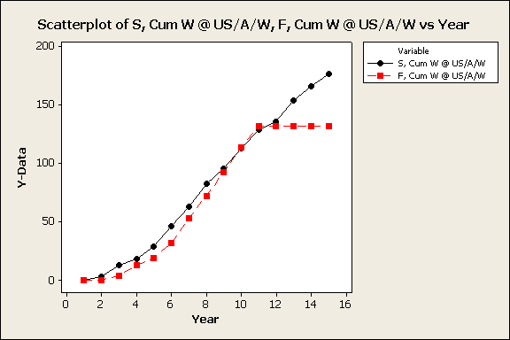
Dividing Up the Grand Slams: Comparing Sampras and Federer’s Total Wins at the Australian Open, The US Open, and Wimbledon
Y-Axis: Cumulative Career Wins at the US Open, Australian Open, and Wimbledon

Slide 15
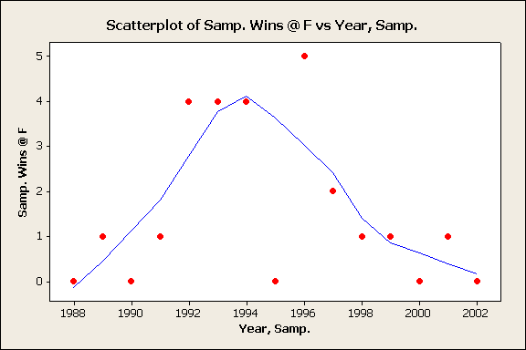
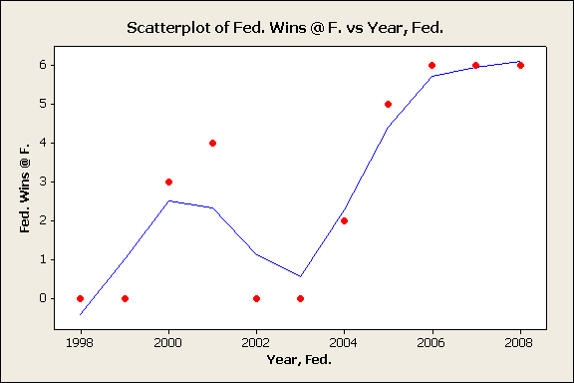
Dividing Up the Grand Slams: Comparing Sampras and Federer at the French Open
Y-axis: Wins/Yr. at the French Open

Slide 16
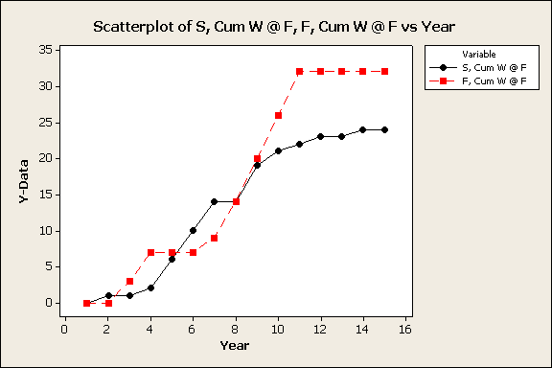
Dividing Up the Grand Slams: Comparing Sampras and Federer at the French Open
Y-Axis: Cumulative Career Wins at the French Open

Slide 17
Limitations
Sampras and Federer played in different eras, against different opponents (Federer’s career started around the time Sampras’ was ending), so we could not account for relative strength of field
Comparing Wins/Yr. was difficult, because the statistic could be inflated by the number of tournaments each player participated in.
More analysis needed to determine statistical significance
Federer’s career is not finished, so his stats cannot be considered final tallies.

Slide 18
Conclusions
Sampras and Federer have comparable AVG W/Yr. (56 for Federer, 51 for Sampras)
They have the same career winning percentage (74%)
Their performances in the US Open, Australian Open, and Wimbledon are very similar
However:
Sampras has more Grand Slam titles than Federer (14 to 13)
Sampras’ winning percentage in Gland Slams is higher (77% for Sampras, 68% for Federer)
Federer has more titles (79 to 64)
Federer has performed much better than Sampras at the French Open (32 career wins for Federer, 24 career wins for Sampras)
So:
It’s too close call. At this point, it all depends on the Grand Slam titles.

Slide 19
References
http://en.wikipedia.org/wiki/Roger_federer
http://www.geocities.com/hovav13/Stats.htm

