Slide 1
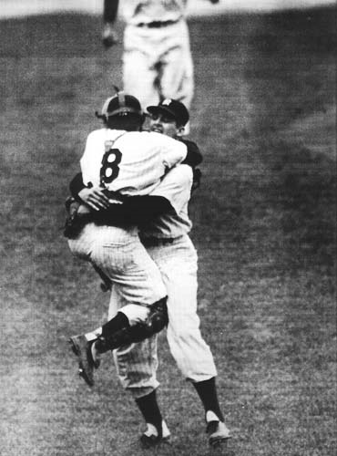
Pitching the PERFECT GAME
“Are you catchin’ what I’m pitchin’?
…27 Up, 27 Down.”
A Nathan Davis Fedor,
Joseph Martin Hultzen, and
Daniel Adam Gajewski Production

Slide 2
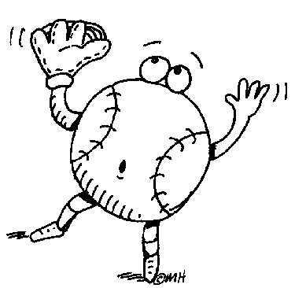
27 Up, 27 Down
A pitcher (or combination of pitchers) pitches a victory that lasts a minimum of 9 innings
By definition it must be both a no-hitter and a shutout
Pitcher(s) cannot allow any:
Hits
Walks
Hit Batsmen
Fielders cannot allow any:
Errors
Therefore, 27 batters come to the plate (up) and 27 batters are retired (down)

Slide 3
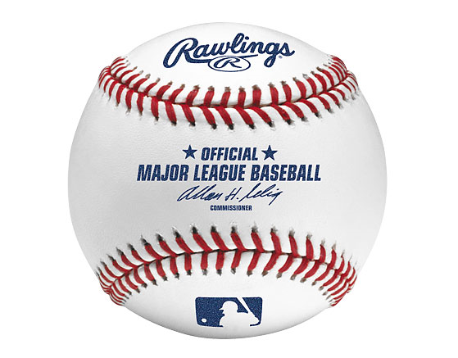
Continued…
An error that does not allow a base runner, such as a misplayed foul ball, does not spoil a perfect game
Weather-shortened games in which a team has no base runners and games in which a team reaches first base only in extra innings do not qualify

Slide 4
History
There have been 385,536 major league games played in MLB history
There have only been 17 perfect games thrown
No pitcher has ever thrown more than one
More people have orbited the moon than have pitched a Major League Baseball perfect game.

Slide 5
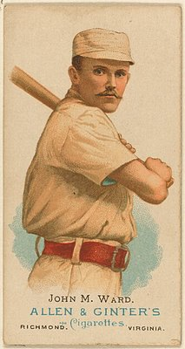
19th Century
John Richmond (Worcester Ruby Legs)
June 12, 1880
LHP
23
5 K
Defeated Cleveland Blues (1-0)
John Ward (Providence Grays)
June 17, 1880
RHP
20
5 K
Defeated Buffalo Bisons (5-0)

Slide 6
Continued…
According to some accounts, Richmond hurled his historic perfect game after staying up all night following a pre-graduation dinner at Brown University, pitching in an early morning class game, and taking a train to Worcester just in time to perform his professional duties
At the age of 20 years, 105 days, Ward is the youngest pitcher ever to throw a perfect game
Games were thrown 5 days apart

Slide 7
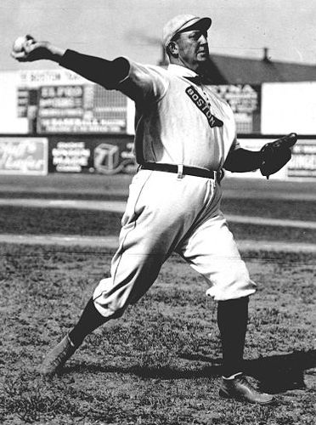
Cy Young
Boston Americans
RHP
37
3 K
May 5, 1904
Defeated Philadelphia A’s (3-0)
Part of a hitless innings streak (24 1/3 straight innings without a hit, still a record) and a scoreless innings streak (45 straight innings)
Pitcher after whom the Cy Young Award is named

Slide 8
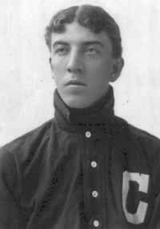
Addie Joss
Cleveland Naps
RHP
28
3 K
74 Pitches
October 2, 1908
Defeated Chicago White Sox (1-0)

Slide 9
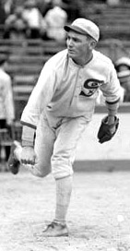
Charlie Robertson
Chicago White Sox
RHP
26
6 K
90 Pitches
April 30, 1922
Defeated Detroit Tigers (2-0) who had the highest OBP (.369)
Robertson's perfect game was only his fifth appearance, and fourth start, in the big leagues.
He finished his career with the fewest wins and lowest winning percentage

Slide 10
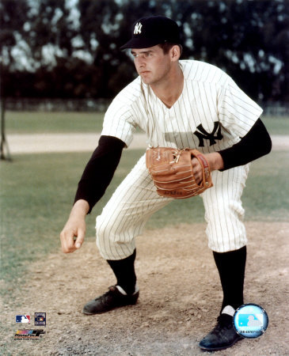
Don Larsen
New York Yankees
RHP
27
7 K
97 Pitches
October 8, 1956
Pitched without a windup
Defeated Brooklyn Dodgers (2-0) in Game 5 of the1956 World Series

Slide 11
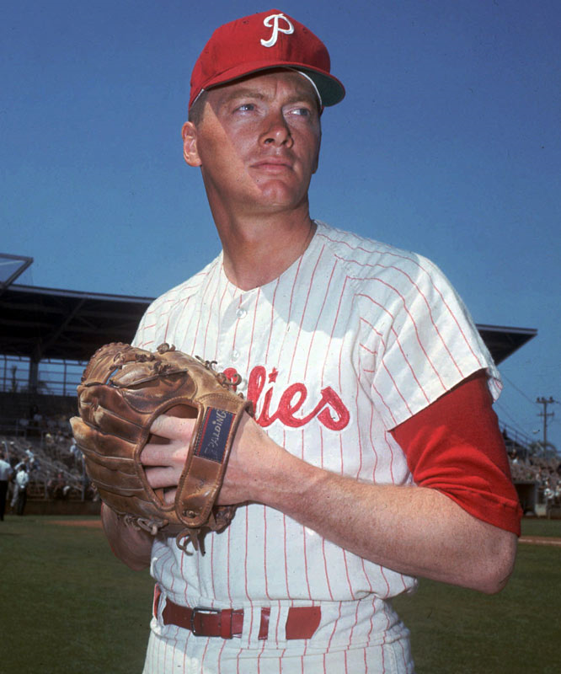
Jim Bunning
Philadelphia Phillies
RHP
32
10 K
90 Pitches
June 21, 1964
Defeated New York Mets (6-0)

Slide 12
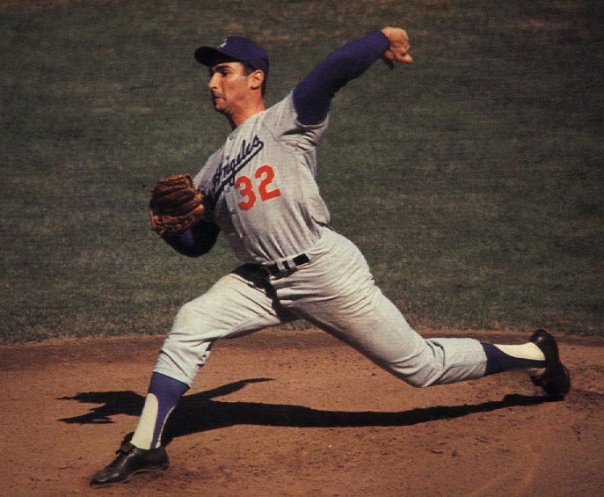
Sandy Koufax
Los Angeles Dodgers
LHP
29
14 K
113 Pitches
September 9, 1965
Defeated Chicago Cubs (2-0)

Slide 13
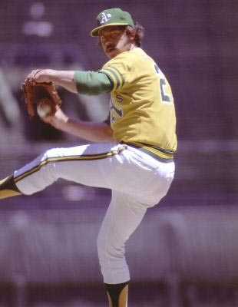
James “Catfish” Hunter
Oakland A’s
RHP
22
11 K
107 Pitches
May 8, 1968
Defeated Minnesota Twins (4-0)
He went 3 for 4 with a double and 3 RBIs—easily the best offensive performance ever by a perfect game pitcher

Slide 14
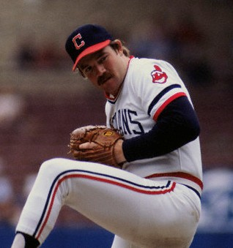
Len Barker
Cleveland Indians
RHP
25
11 K
103 Pitches
May 15, 1981
Defeated Toronto Blue Jays (3-0)
Ron Hassey caught Barker's and Martínez's perfect games

Slide 15
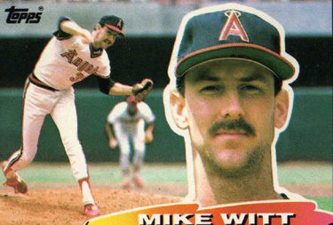
Mike Witt
California Angels
RHP
24
10 K
94 Pitches
September 30, 1984
Defeated Texas Rangers (1-0)
Pitched on the last day of the 1984 season

Slide 16
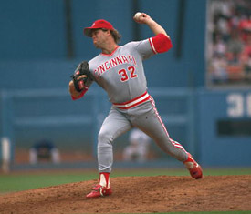
Tom Browning
Cincinnati Reds
LHP
28
7 K
102 Pitches
September 16, 1988
Defeated Los Angeles Dodgers (1-0)

Slide 17
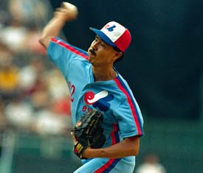
Dennis Martinez
Montreal Expos
RHP
36
5 K
95 Pitches
July 28, 1991
Defeated Los Angeles Dodgers (2-0)
Ron Hassey was also catcher

Slide 18
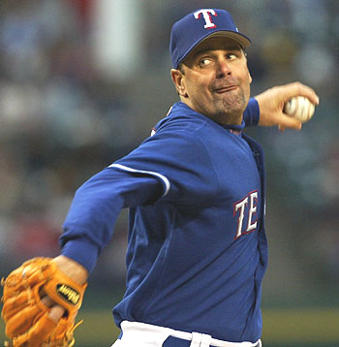
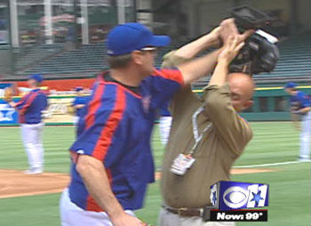
Kenny Rogers
Texas Rangers
LHP
29
8 K
98 Pitches
July 28, 1994
Defeated California Angels (4-0)

Slide 19
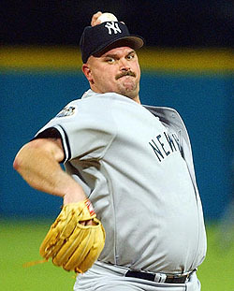
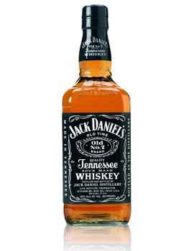
David Wells
New York Yankees
LHP
34
11 K
May 17, 1998
Defeated Minnesota Twins (4-0)
Has claimed to have been "half-drunk" and suffering from a "raging, skull-rattling hangover" during his perfect game

Slide 20
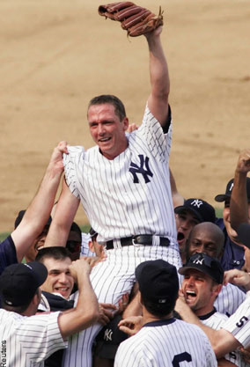
David Cone
New York Yankees
RHP
36
10 K
88 Pitches
July 18, 1999
Defeated Montreal Expos (6-0)
Held on Yogi Berra Day. Don Larsen threw out the ceremonial first pitch to Berra, who had been his catcher during the 1956 World Series perfect game

Slide 21
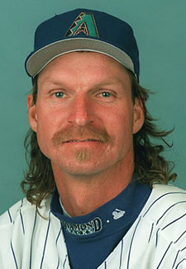
Randy Johnson
Arizona Diamondbacks
LHP
40
13 K
117 Pitches
May 18, 2004
Defeated Atlanta Braves (2-0)

Slide 22
A Closer Look At the 2004…
vs.

Slide 23
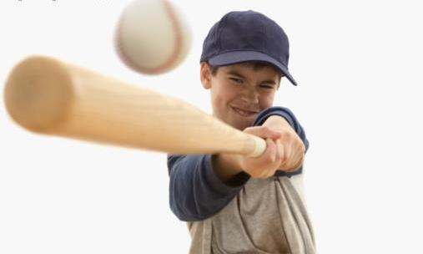
Atlanta Braves Hitting
Name | BA | Prob No Hit | AB (Game) | Total For Game (No Hit)
Jesse Garcia | 0.216 | 0.784 | 3 | 0.481890304
Julio Franco | 0.298 | 0.702 | 3 | 0.345948408
Chipper Jones | 0.310 | 0.69 | 3 | 0.328509
Andrew Jones | 0.259 | 0.741 | 3 | 0.406869021
Johnny Estrada | 0.277 | 0.723 | 3 | 0.377933067
J.D. Drew | 0.284 | 0.716 | 3 | 0.367061696
Mark DeRosa | 0.279 | 0.721 | 3 | 0.374805361
Nick Green | 0.240 | 0.76 | 3 | 0.438976
Mike Hampton | 0.241 | 0.759 | 2 | 0.576081
Eddie Perez | 0.253 | 0.747 | 1 | 0.747

Slide 24
Arizona Diamondbacks Fielding
Name | Pos | Fld. Pct. | Plays For Game | Prob For Game
Chad Tracy | 3B | 0.939 | 1 | 0.939
Matt Kata | 2B | 0.988 | 3 | 0.964430272
Luis Gonzalez | LF | 0.986 | 1 | 0.986
Shea Hillenbrand | 1B | 0.991 | 1 | 0.991
Steve Finley | CF | 0.988 | 3 | 0.964430272
Danny Bautista | RF | 0.985 | 3 | 0.955671625
Alex Cintron | SS | 0.972 | 2 | 0.944784
Robby Hammock | C | 0.996 | 0 | 1
Randy Johnson | P | 0.904 | 0 | 1

Slide 25
Randy Johnson Free Pass Stats
BB | 1466
HBP | 188
Free Passes | 1654
IP | 4039.3
Free Passes/IP | 0.409477
No Free Pass Per 9 Innings | 0.008732

Slide 26
Series of Plays for Randy Johnson’s Perfect Game
Out # | Play | Batter
1 | GB - 1B | Garcia
2 | K | Franco
3 | K | C. Jones
4 | FO - CF | A. Jones
5 | K | Estrada
6 | K | Drew
7 | FO - RF | DeRosa
8 | GO - SS | Green
9 | K | Hampton
10 | K | Garcia
11 | FO - CF | Franco
12 | K | C. Jones
13 | FO - LF | A. Jones
14 | FO - RF | Estrada
Out # | Play | Batter
15 | FO - RF | Drew
16 | GO - 3B | DeRosa
17 | K | Green
18 | GO - SS | Hampton
19 | K | Garcia
20 | GO - 2B | Franco
21 | K | C. Jones
22 | FO - CF | A. Jones
23 | K | Estrada
24 | GO - 2B | Drew
25 | GO - 2B | DeRosa
26 | K | Green
27 | K | Perez

Slide 27
Historical Perfect Game Probability
Total # of MLB Games: 385,536
2 Starting pitchers in every game
771,072 Chances to throw a perfect game
Only 17 perfect games have been thrown
Historical Probability of a perfect game = 2.20472e-05

Slide 28
Collected AVGs For Johnson’s Perfect Game
Not Getting A Hit (Atlanta) | 0.000219
No Errors (In This Set of 14 Plays)(Arizona) | 0.770546
No Free Pass Avg (Johnson) | 0.008732
Probability of Perfect Game Given Above AVGs | 1.47264e-06

Slide 29
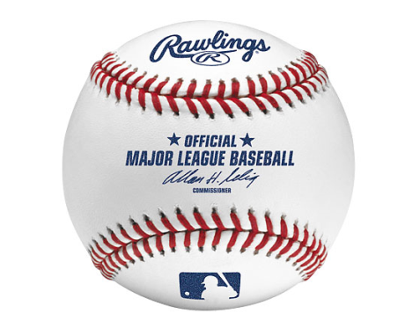
Class Activity: Predicting Perfect Games
Binomial Logistic Regression
Uses a set of predictor variables to predict a discrete outcome
Dependent variable can only have 2 different values
In our example, “1” if pitcher has pitched a perfect game and “0” otherwise
Estimated coefficients are interpreted as probabilities

Slide 30
Conclusion on the Model
Our model is junk
Perfect games are very hard to predict
Factors left out of our model (opponents batting average, limited data set, etc…)

