Slide 1
March madness
by: Jeremy Polster, Nate Spagnola, Justin Greenlee

Slide 2
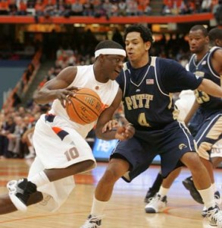
The Tournament
65 teams; 1 play-in
Four regions, 16 seeds in each region
Number 1 seed is the highest seed
6 rounds to win championship

Slide 3
Summary
Variable seed N N* Mean SE Mean StDev Sum Minimum
wins 1 20 0 3.550 0.352 1.572 71.000 1.000
2 20 0 2.400 0.351 1.569 48.000 1.000
3 20 0 2.100 0.332 1.483 42.000 0.000
4 20 0 1.400 0.266 1.188 28.000 0.000
5 20 0 1.200 0.247 1.105 24.000 0.000
6 20 0 1.050 0.198 0.887 21.000 0.000
7 20 0 1.150 0.209 0.933 23.000 0.000
8 20 0 0.600 0.169 0.754 12.000 0.000
9 20 0 0.550 0.135 0.605 11.000 0.000
10 20 0 0.450 0.198 0.887 9.000 0.000
11 20 0 0.450 0.211 0.945 9.000 0.000
12 20 0 0.500 0.170 0.761 10.000 0.000
13 20 0 0.250 0.123 0.550 5.000 0.000
14 20 0 0.1000 0.0688 0.3078 2.0000 0.0000
15 20 0 0.000000 0.000000 0.000000 0.000000 0.000000
16 20 0 0.000000 0.000000 0.000000 0.000000 0.000000

Slide 4
Simulation
Stem-and-leaf of wins seed = 3 N = 20
Leaf Unit = 0.10
2 0 00
7 1 00000
(7) 2 0000000
6 3 0000
2 4
2 5 0
1 6 0
Probability of > 0 wins: 0.9
> 1 win: 0.65
> 2 wins: 0.3
> 3 wins: 0.1
> 4 wins: 0.1
> 5 wins: 0.05

Slide 5
Choosing Probability
Performed the binomial simulation using the probability of the higher seed winning up through the round of 32
Used the probability of a #1 seed winning up through the Sweet 16
Used the difference in seeds to determine the probability of the higher seed winning after the round of 32

Slide 7
Bracket 1

Slide 8
Bracket 2

Slide 9
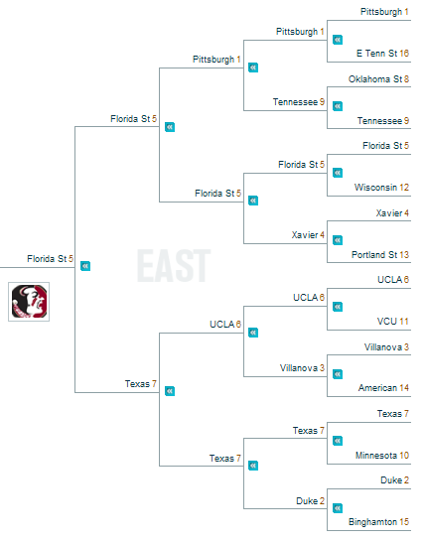
Bracket 3

Slide 10
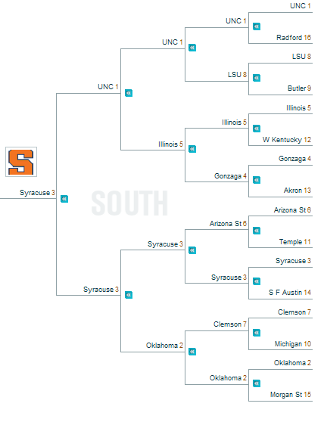
Bracket 4

Slide 11
Final Four

Slide 12
Champion?

Slide 14
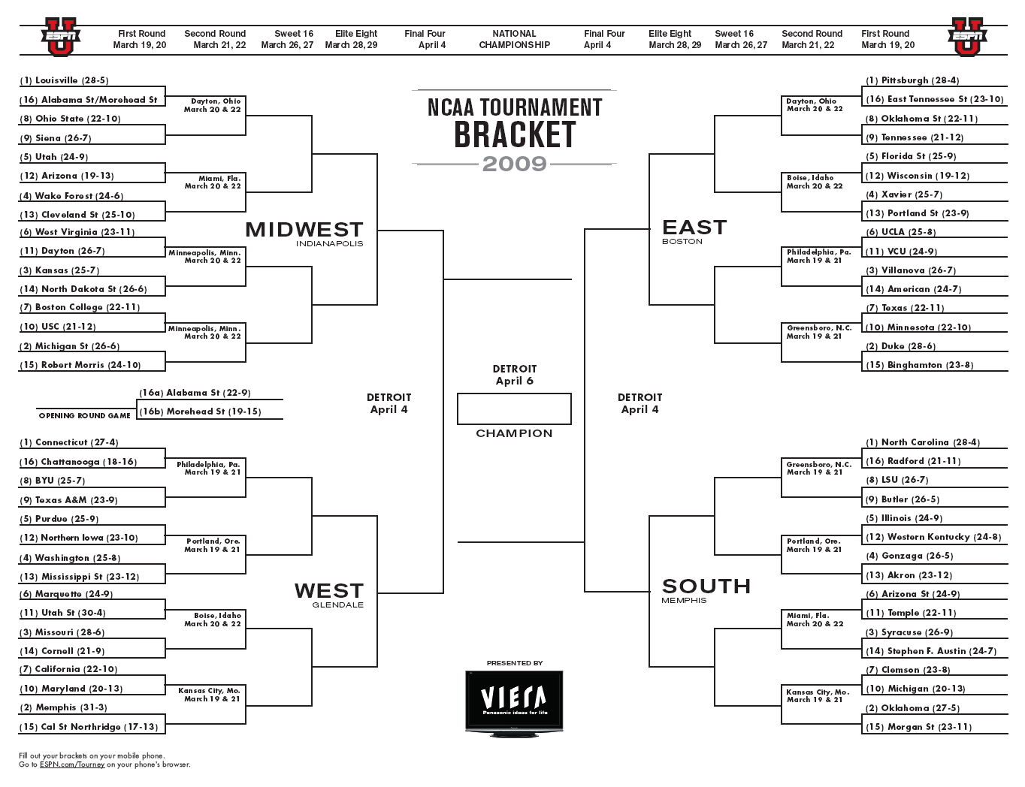
98%
Louisville 72%
Pittsburh 74 %
92%
2%
Louisville 55 %
Tennessee 43%
7%
65%
Ohio St. 27 %
Tennessee 25%
53%
34%
Louisville 55%
Tennessee 39%
46%
57%
Utah 45 %
Wisconsin 30 %
61%
42%
Utah 38 %
Xavier 56%
38%
81%
Wake For. 54 %
Xavier 70%
70%
18%
W. Virginia 41%
Duke 56%
29%
82%
W. Virginia 78 5
UCLA 51%
73%
17%
W. Virginia 60 %
UC LA 55%
26%
77%
N. Dak. St. 21 %
Uconn 60%
Villanova 48%
83%
22%
W. Virginia 44%
Duke 60%
16%
53%
Boston Col. 34 %
Minnesota 24%
73%
46%
Boston Col. 39 %
Duke 44%
26%
83%
Michigan St. 65 %
Duke 75%
94%
16%
5%
Duke
92%
Uconn 75 %
N. Carolina 75%
98%
7%
Uconn 84 %
N. Carolina 60%
1%
63%
Texas AM 24 %
Butler 24%
64%
36%
Uconn 53%
N. Carolina 68%
35%
65%
N. Iowa 47 %
Duke 39%
Illinois 44 %
73%
34%
Miss St. 15%
Gonzaga 39 %
26%
51%
Miss St. 52 %
Gonzaga 55 %
85%
48%
Uconn 58%
Ariz. St. 43%
14%
55%
Utah St. 24 %
Ariz. St. 50%
70%
44%
Missouri 82 %
Ariz. St. 45%
29%
84%
Missouri 75 %
Syracuse 49 %
84%
15%
Missouri 46%
Ariz. St. 31%
15%
51%
Maryland 59 %
Clemson 44%
66%
48%
Maryland 17 %
Clemson 54%
33%
93%
CS Northridge 40 %
Oklahoma 55%
93%
6%
6%
Simulation of NCAA Tournament by AccuScore
(upsets coded in blue)

Slide 15
98%
Play-in
Pittsburgh
92%
2%
Siena
Pittsburgh
7%
65%
Siena
Tennessee
53%
34%
Wake
Pittsburgh
46%
57%
Arizona
Florida St.
61%
42%
Wake
Florida St.
38%
81%
Wake
Xavier
70%
18%
Michigan St.
Pittsburgh
29%
82%
Dayton
UCLA
73%
17%
N. Dak. St.
Villanova
26%
77%
N. Dak. St.
Purdue
Villanova
83%
22%
Michigan St.
Texas
16%
53%
Boston Col.
Texas
73%
46%
Michigan St.
Texas
26%
83%
Michigan St.
Duke
94%
16%
5%
N. Carolina
92%
Uconn
N. Carolina
98%
7%
Uconn
N. Carolina
1%
63%
BYU
Butler
64%
36%
Purdue (5)
N. Carolina
35%
65%
Purdue
N. Carolina
W. Ky
73%
34%
Purdue
Gonzaga
26%
51%
Miss St.
Gonzaga
85%
48%
Purdue
N. Carolina
14%
55%
Utah St.
Ariz. St.
70%
44%
Cornell
Syracuse
29%
84%
Cornell
Syracuse
84%
15%
California (7)
Oklahoma
15%
51%
California
Michigan
66%
48%
California
Oklahoma
33%
93%
CS Northridge
Oklahoma
93%
6%
6%
2nd Simulation of NCAA Tournament by AccuScore
(a bracket buster– look at the early rounds, and Purdue’s run)

Slide 16
Probabilities
Difference in seeds | Prob. Of higher seed winning
0 | .5
1 | .5
2 | .625
3 | .75
4 | .725
5 | .7
6 | .675
7 | .65
8 | .725
9 | .8
10 | .85
11 | .9
12 | .95
13 | .99
14 | .99
15 | .99

Slide 18
Sources
Article:
http://accuscore.com/articles/misc/what-the-heck-is-accuscore?/
Simulator:
http://sports.espn.go.com/ncb/ncaatourney09/bracketcaster

