Slide 1
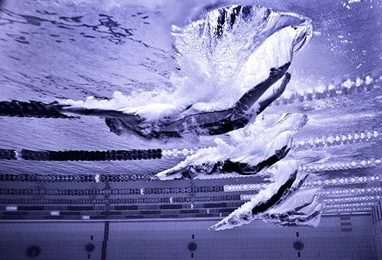
Speedo Fastskin and Swimming
The effect on performance
Luke Ivey, Aaron Manning, Riley McCracken

Slide 2
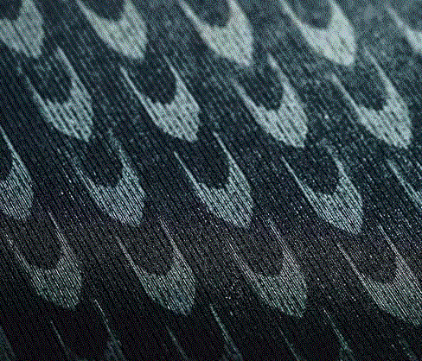
Topic Background
In 1999, Speedo introduced the Fastskin line of swimsuits, designed to reduce drag during swimming
On February 18th, 2008 Speedo introduced the LZR Racer Fastskin suit
In the 2008 Summer Olympics in Beijing, 94% of swimming races were won by competitors in LZR Racer suits.
23 out of the 25 world records broken at the 2008 Olympics were broken in the LZR Racer suit
One of the coaches of Japan's Olympic swim team said "If swimmers don’t wear the LZR Racer, they won’t be able to compete in the Beijing Olympics.“

Slide 3
Background (cont.)
The idea behind the Fastskin line of suits is to reduce drag during swimming by emulating the skin of a shark, using v-shaped ridges to reduce the friction produced as water passes over the body
The suit also is form fitting and compresses the muscles, while still allowing for full range of motion during swimming
http://journals.ohiolink.edu/ejc/pdf.cgi/Benjanuvatra_N.pdf?issn=14402440&issue=v05i0002&article=115_cobpanfbfass
A 2002 study “Comparison of buoyancy, passive and net active drag forces between Fastskin™ and standard swimsuits “ found that Fastskin suits significantly reduce drag
We decided to see if there has been a significant reduction in swimming times since the introduction of the Fastskin suit, compared to before the introduction of the suit

Slide 4
Study/Results
Test subjects were lowered into water and dragged along by a winch at pre-set speeds
They were monitored by video camera for correct form and posture while performing a streamline and a kick in both regular and Fastskin suits
Study used paired sample T-Tests to compare weights of swimmers and ANOVA testing to compare the drag for different velocities and suit material
Results showed that the Fastskin did not increase buoyancy, but significantly lowered water drag by up to 7%

Slide 5
Study/Results

Slide 6
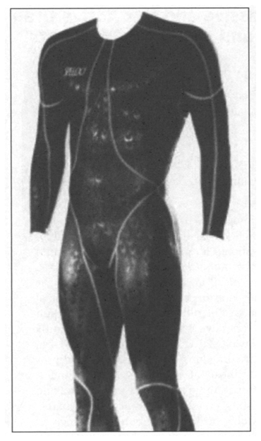
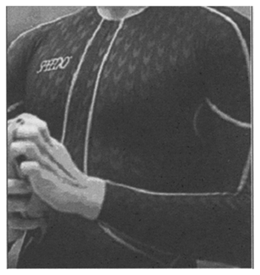
Study/Results
Condition Normal Fastskin Difference Difference %
Surface (gliding) 347.9 328.6 19.3 5.5
Surface(kicking) 306.4 290.2 16.2 5.3
Depth (gliding) 296.9 266.7 30.2 10.2
Depth (kicking) 282.1 268,6 13.5 4.8
Overall 1233.3 1154.1 79.2 6.4

Slide 7
Our hypothesis
We believe that there will be a significant reduction in the speed of swimmers since the introduction of the Fastskin suit, and we believe the suit has something to do with it
We decided to look at 200m freestyle times from 1976 – 1996 Olympic games, and then from 2000 – 2008 Olympics, which took place after the Fastskin had begun to be used competitively.
We also examined 200m world record times from 1967 to 2008, in order to determine if record times have dropped at a faster rate since Fastskin suits came along.
We chose the 200m freestyle since we felt that it was the shortest race where using a Fastskin suit would create a suitable drop in time to warrant study

Slide 8
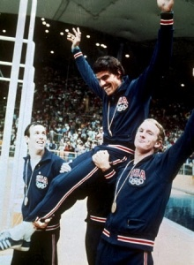
200 Meter Freestyle: Olympic Times
1976 Mean 1980 Mean 1984 Mean 1988 Mean 1992 Mean 1996 Mean 2000 Mean 2004 Mean 2008 Mean
111.376 112.502 117.391 109.713 113.201 110.428 111.046 110.364 108.683
Descriptive Statistics: 2000 times
Variable N N* Mean SE Mean StDev Minimum Q1 Median Q3
2000 times 74 0 111.05 0.370 3.18 105.35 108.77 110.16 113.78
Variable Maximum
2000 times 119.31
Descriptive Statistics: 1996 times
Variable N N* Mean SE Mean StDev Minimum Q1 Median Q3
1996 times 30 0 110.54 0.338 1.85 107.63 108.74 110.54 112.02
Variable Maximum
1996 times 113.84

Slide 9
Descriptive Statistics: Time AS, Time BS
Variable N N* Mean SE Mean StDev Minimum Q1 Median Q3
Time AS 253 0 110.03 0.198 3.14 102.96 107.72 109.49 112.16
Time BS 224 0 112.98 0.386 5.78 106.70 109.34 111.19 114.03
Variable Maximum
Time AS 119.47
Time BS 145.43
Since the suit has been put into use in the Olympics, there has been an average decrease of 1.95 seconds in swimming times.

Slide 10
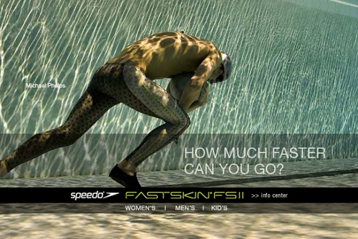
Two-Sample T-Test and CI: Time AS, Time BS
Two-sample T for Time AS vs Time BS
N Mean StDev SE Mean
Time AS 253 110.03 3.14 0.20
Time BS 224 112.98 5.78 0.39
Difference = mu (Time AS) - mu (Time BS)
Estimate for difference: -2.948
95% CI for difference: (-3.801, -2.094)
T-Test of difference = 0 (vs not =): T-Value = -6.79 P-Value = 0.000 DF = 334
We can conclude that there is a significant difference in times before (BS) and after (AS) the swimsuit was in use.

Slide 14
Class Activity
Open P:\temp\Swimming Powerpoint Riley Luke Aaron
Open up Minitab worksheet “200 freestyle times”
Run a 2 sample T-Test for 1992, 1996 and 1996 and 2000
Surprised by the results?

Slide 15
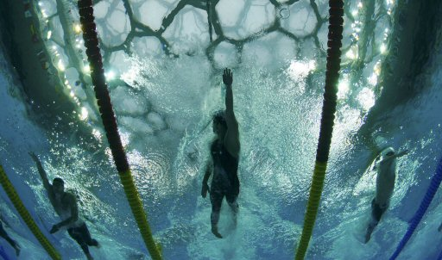
2 sample T tests for 8 year spans
Two-Sample T-Test and CI: 2000 times, 1992 times
Two-sample T for 2000 times vs 1992 times
N Mean StDev SE Mean
2000 times 74 111.05 3.18 0.37
1992 times 70 113.20 5.56 0.66
Difference = mu (2000 times) - mu (1992 times)
Estimate for difference: -2.156
95% CI for difference: (-3.664, -0.648)
T-Test of difference = 0 (vs not =): T-Value = -2.83 P-Value = 0.006 DF = 108
Two-Sample T-Test and CI: 2008 times, 2000 times
Two-sample T for 2008 times vs 2000 times
N Mean StDev SE Mean
2008 times 80 108.68 2.90 0.32
2000 times 74 111.05 3.18 0.37
Difference = mu (2008 times) - mu (2000 times)
Estimate for difference: -2.362
95% CI for difference: (-3.334, -1.391)
T-Test of difference = 0 (vs not =): T-Value = -4.80 P-Value = 0.000 DF = 147

Slide 16
Conclusions
No real conclusive evidence that the Fastskin suit is causing times to drop more quickly than usual
Conflicting data between the world record time drops since Fastskin introduction and 200 meter freestyle times overall
Speedo introduced the Aquablade swimsuit in 1996, the precursor to the Fastskin. Could that explain the sudden drop in times from 1992 to 1996 that we didn’t see from 1996 to 2000?
The quality of swimmers at each games could be of varying quality, thus explaining the 200 freestyle mean times actually increasing from one Olympic to the next
More questions raised by our research than real answers, however while the Fastskin suits and the LZR Racer suit may not be the driving force behind the supposed sudden drop in swimming times, there is no denying that they reduce drag and thus provide some advantage to the wearer
In highly competitive events like World Championships and Olympics, nearly every competitor will be wearing some form of Fastskin or its competitors, making the performance advantage nearly universal and thus no longer a true advantage

Slide 17
Ideas/Homework
Would be interesting to track a swimmers drop in times before and after wearing the suit, and then compare it to their average reduction in time over their swimming career
More data used when evaluating / more advanced statistical techniques used when examining data
How do the professionals feel about it? Is the entire uproar somewhat un-warranted, seeing as the suits have been approved and everyone can use them?
Is it even possible to reach a conclusion on this issue, once you consider differences and changes in training, nutrition, participants, venue and time span?
Homework: Write a few sentences about your interpretation of our work. Is the Fastskin really making a difference? Cite data from our Powerpoint or from our Minitab work, which is found in the P drive, temp folder under “Swimming Powerpoint”

