Slide 1
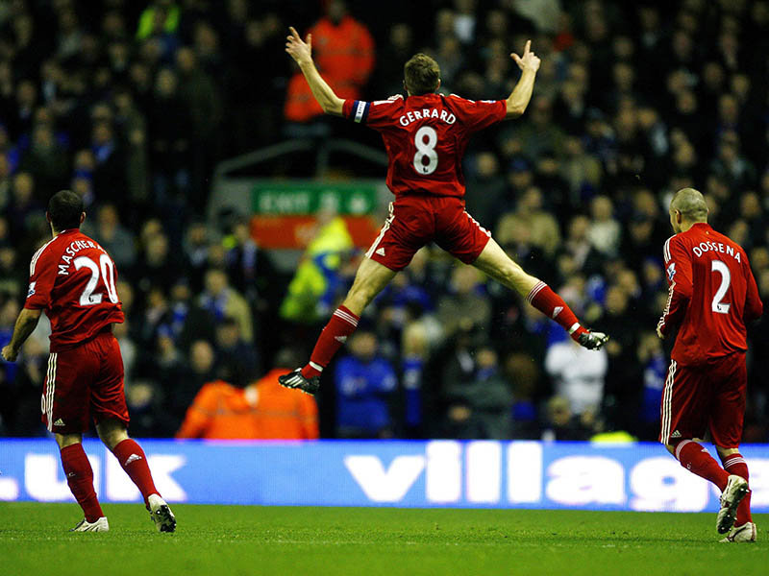
English Premier League 08/09 Comparing Midfielders
Dan Toulson & Aaron Manning

Slide 2
Basic Football Knowledge
Statistics from Week 1 through 20 of Current English Premier League Season
Most frequent starters from each club
Basic Formation 4-4-2
Normally 4 midfielders per team
Left and Right / Two Central

Slide 3
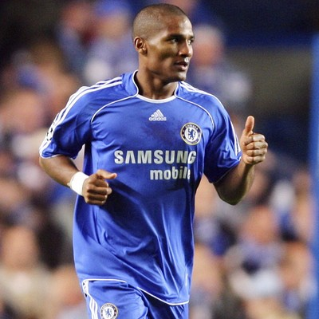
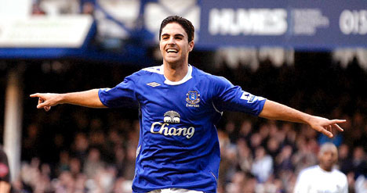
What makes a good Winger?
Passing
Crossing
Goals
Assists
Florent Malouda – Left
Ranked from 1 through 20 on each individual skill then added to give an overall ranking
Mikel Arteta – Right

Slide 4
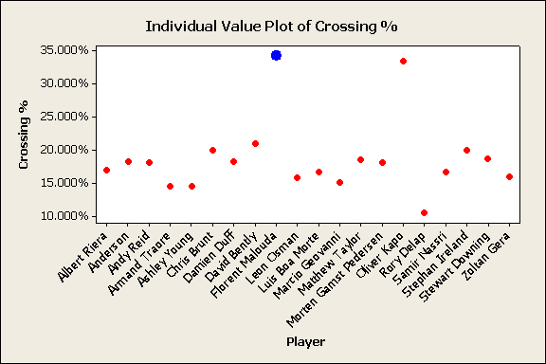

Slide 5
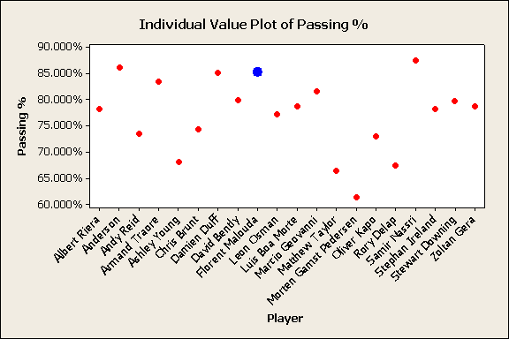

Slide 7
Left Midfielder Rankings
Player Goals Crossing Assists Passing Overall
Samir Nasri 20 7 9 20 56
Ashley Young 16 2 16 4 38
Pedersen 1 10 18 1 30
Matthew Taylor 13 14 5 2 34
Florent Malouda 8 20 20 18 66
Leon Osman 15 5 14 8 42
Zoltan Gera 9 6 1 12 28
Marcio Geovanni 14 4 2 15 35
Albert Riera 12 9 11 9 41
Stephan Ireland 19 16 17 10 62
Stewart Downing 2 15 10 13 40
Anderson 3 12 3 19 37
Damien Duff 18 13 6 17 54
Armand Traore 4 3 4 16 27
Rory Delap 17 1 13 3 34
Andy Reid 10 11 15 6 42
David Bently 7 18 8 14 47
Chris Brunt 11 17 7 7 42
Luis Boa Morte 5 8 19 11 43
Oliver Kapo 6 19 12 5 42

Slide 8
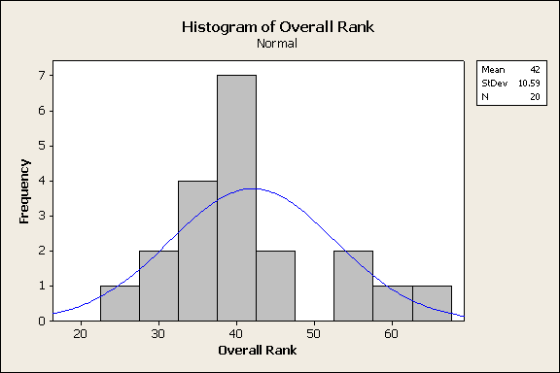
Left Midfielder’s Overall

Slide 9
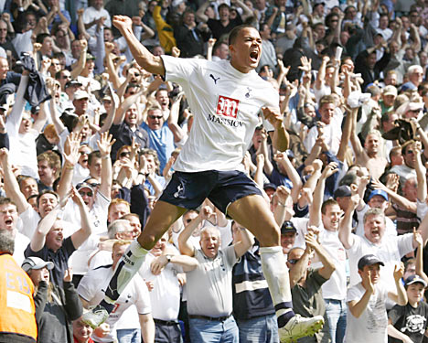
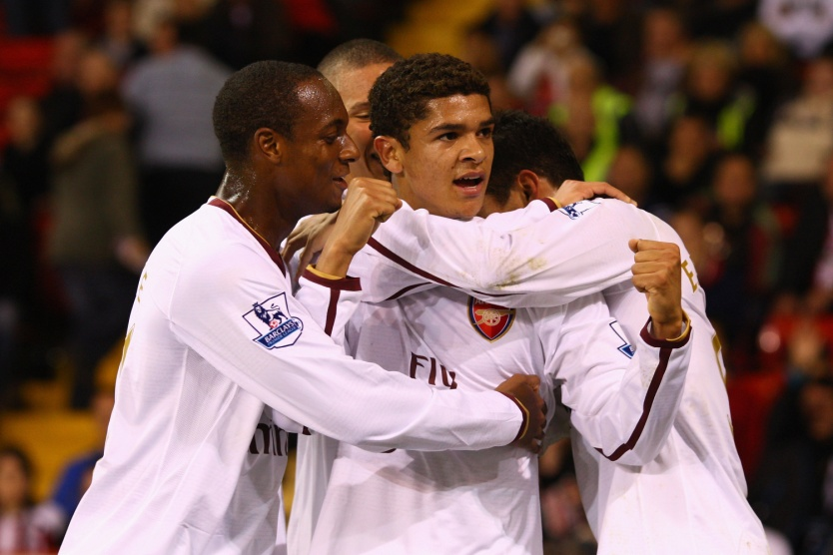
What Makes a good Central Midfielder?
Jermaine Jenas
Passing
Tackles
Goals
Assists
Denilson

Slide 11
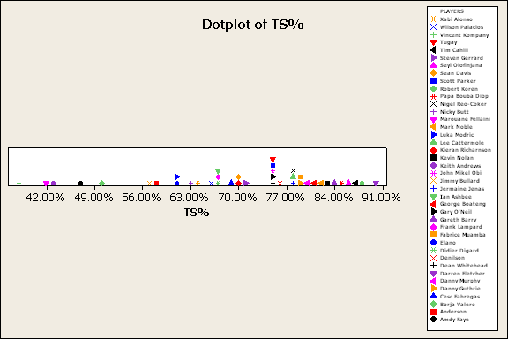

Slide 12
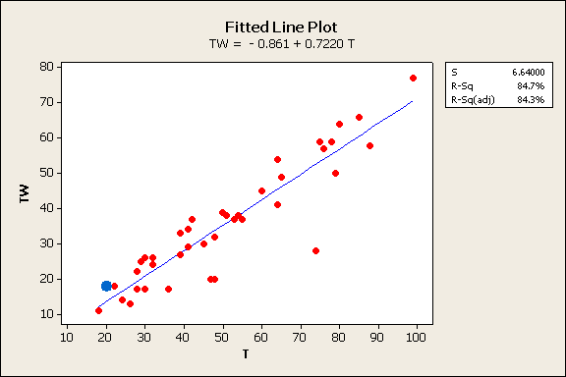

Slide 13
Descriptive Statistics - Tackles
Descriptive Statistics: TS%
Variable N N* Mean SE Mean StDev Minimum Q1 Median Q3
TS% 40 0 0.7043 0.0209 0.1322 0.3784 0.6348 0.7475 0.7967
Variable Maximum
TS% 0.9000
Variable PLAYERS N N* Mean Mean StDev Minimum Q1 Media Darren Fletcher 1 0 0.90000 * * 0.90000 * 0.90000
Q3 Maximum * 0.90000

Slide 14
Problems
Top 3 Left Midfielders come from the so-called richest clubs – Chelsea, Manchester City and Arsenal. Do the best players only perform because they have the have the best players around them?
Some players also played in other competitions (i.e. FA cup, Carling Cup, Champions League, and UEFA Cup) which causes more fatigue and injuries which could affect their stats.

Slide 15
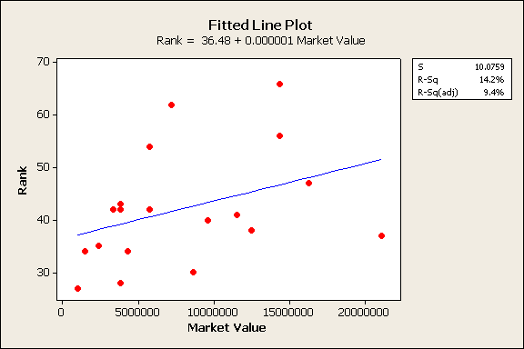

Slide 16
Conclusion
More In-depth analysis is needed with such a broad subject.
Numerous factors contribute to every performance, i.e. how can creativity be statistically rated?
Team performance, such as possession, time in opposition half etc has great influence on even the best players e.g. Robbie Keane – left Liverpool yesterday.

Slide 17
Sources
Pictures :
http://www.skysports.co.uk
http://www.google.com
Statistics:
http://www.starting11.com
http://www.skysports.com

