Slide 1
Performance Statistics in the NHL
Dustin Schneider
Lawrence Mulcahy

Slide 2
The Lockout
Occurred in the 2004-2005 when the NHL and NHLPA failed to reach an agreement on a new Collective Bargaining Agreement.
Several major changes were introduced in the 2005-2006 season.
Stricter enforcement of Penalties
Ties are decided in a shootout
Two-line passing was legalized
Decrease in goaltender equipment size

Slide 3
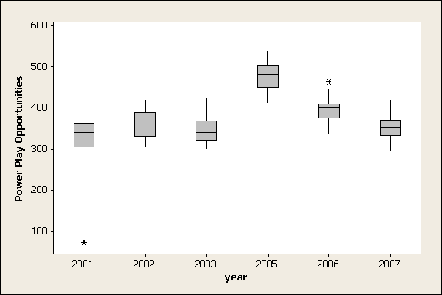
Box Plot of Power Play Opportunities

Slide 4
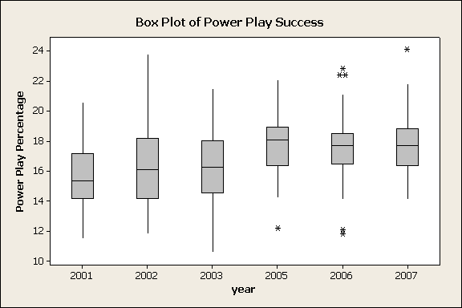

Slide 5
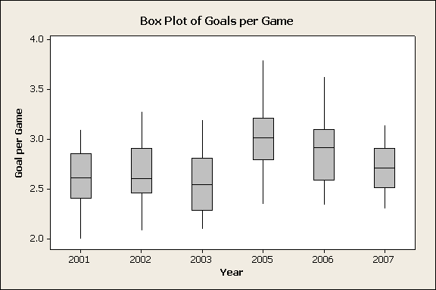
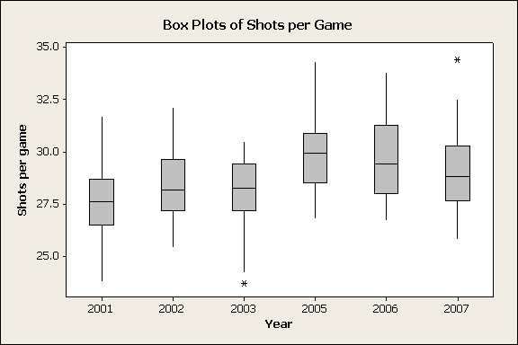
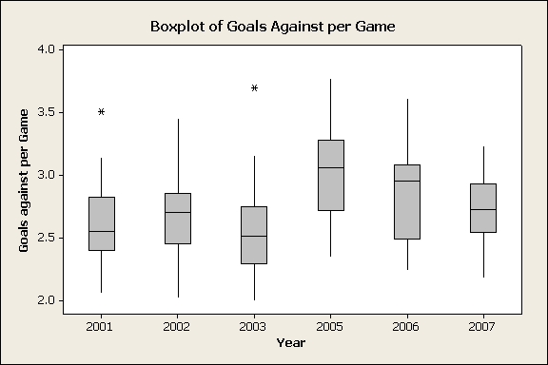
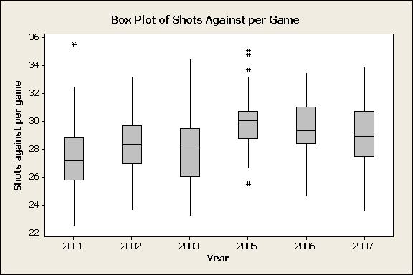

Slide 6
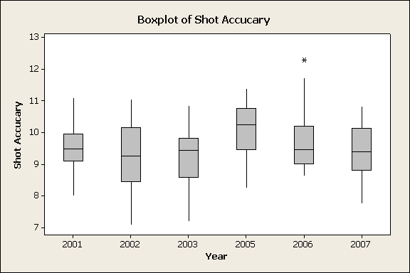
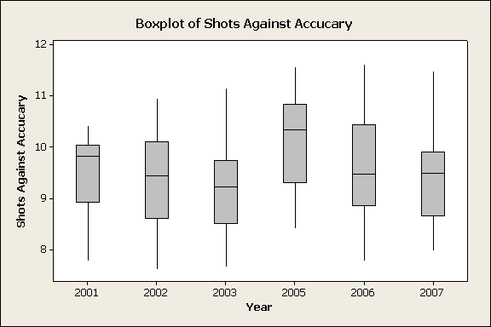

Slide 7
Descriptive Statistics
Variable LO Mean StDev Minimum Q1 Median Q3 Maximum
W 0 35.711 7.911 19.000 28.750 36.000 42.000 52.000
1 41.000 7.654 21.000 35.750 42.000 46.250 58.000
G/G 0 2.6140 0.3028 2.0000 2.3775 2.6000 2.8550 3.2800
1 2.8747 0.3235 2.3000 2.6275 2.8850 3.0725 3.8000
GA/G 0 2.6141 0.3456 2.0000 2.3400 2.5600 2.8275 3.7000
1 2.8741 0.3649 2.1800 2.5775 2.8850 3.1275 3.7800
PP% 0 16.179 2.562 10.600 14.200 15.950 17.925 23.800
1 17.638 2.388 11.800 16.500 17.850 18.800 24.100
S/G 0 28.002 1.818 23.700 26.900 28.050 29.400 32.100
1 29.540 1.919 25.800 28.275 29.400 30.850 34.400
SA/G 0 27.999 2.635 22.500 25.975 28.000 29.425 35.500
1 29.544 2.355 23.500 28.350 29.550 30.825 35.100
Shot Accuracy 0 9.3403 0.9364 7.0748 8.7163 9.4071 9.9629 11.1029
1 9.7358 0.9368 7.7441 9.0066 9.6823 10.4343 12.3051

Slide 8
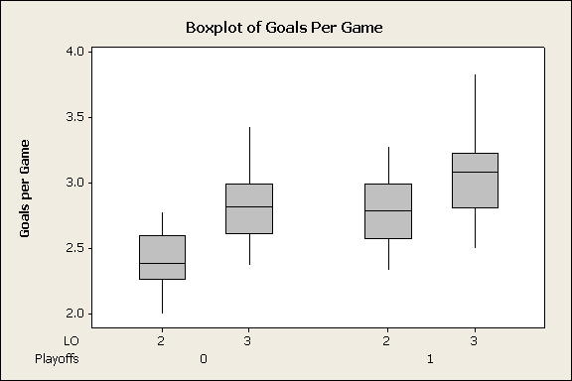

Slide 9
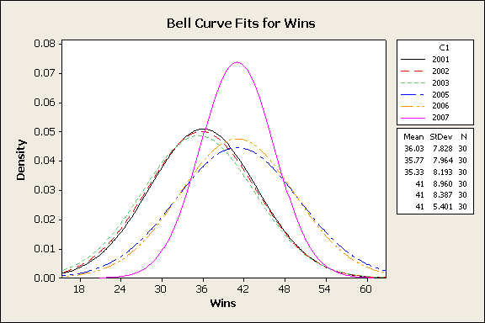

Slide 10
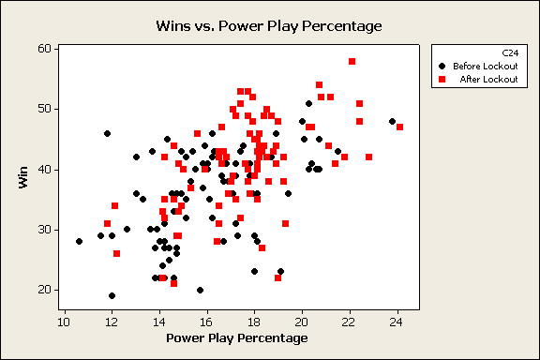
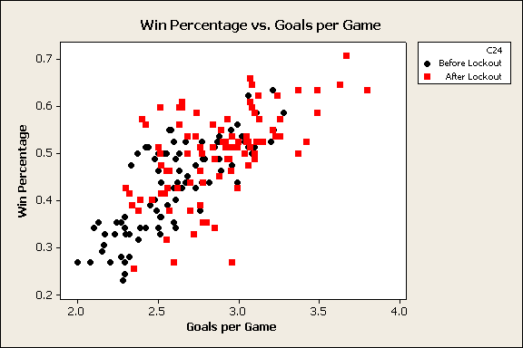

Slide 11
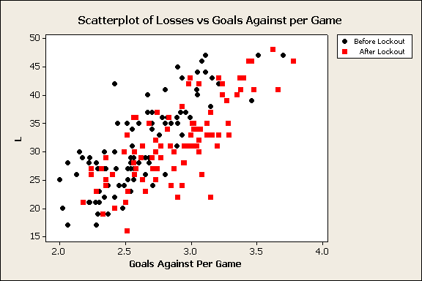
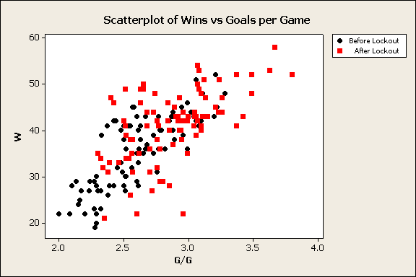

Slide 12
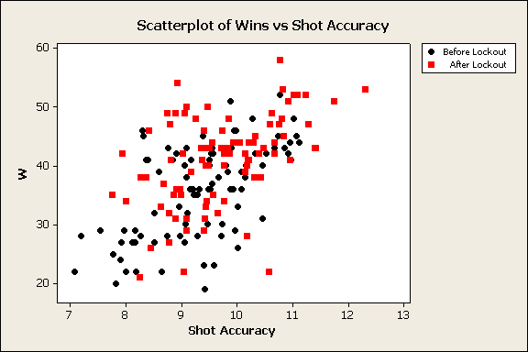

Slide 13
Final Thoughts
The 2004-2005 Lockout had an immediate effect on the game.
The effect has become less drastic since the season following the lockout
Alone, no statistic appeared to be a good predictor of wins (or losses)
This suggests that multiple linear regression may want to be considered

Slide 14
References
Pictures from: http://www.justsportsazonline.com/images/NHL_3078.gif
http://www.tshirtsdesignsandmore.com/Hockey_Player_2.Z02863.gif
Lockout information from: http://proicehockey.about.com/cs/rules/a/04_rule_changes.htm
Team data found on NHL.com

