Slide 1
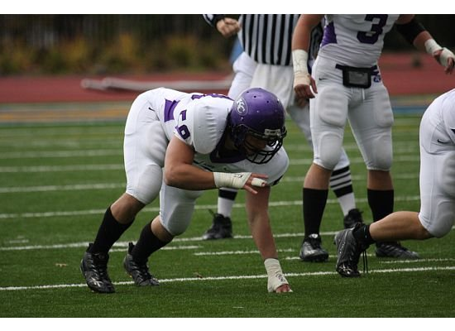
Defense Wins Championships
Luke Ivey, Daniel Levine, Riley McCracken

Slide 2
5 Year NFL Offense Stats vs. Super Bowl Champion Defensive Averages
Year Avg. Avg. Avg. Avg.
Pts Yards Air Ground
2007 21.7 325.2 214.3 110.9
2005 20.6 315.9 203.5 112.5
2003 20.8 318.3 200.4 117.9
2001 20.2 317.6 205.8 111.8
1999 20.8 318.8 212.3 106.5
Super Bowl Defense
17.7 291.99 192.41 99.58

Slide 3
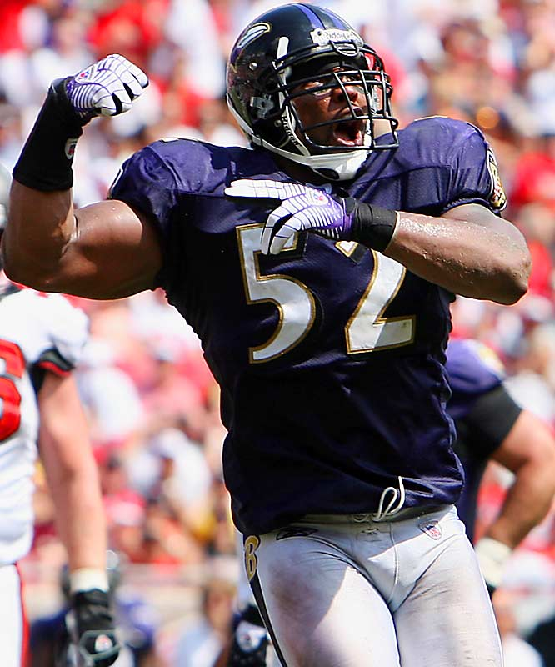
Difference Between Means
Variable N N* Mean SE Mean StDev Minimum Q1 Median
NFL Avg. Pts. Scored 5 0 20.820 0.246 0.550 20.200 20.400 20.800
Variable Q3 Maximum
NFL Avg. Pts. Scored 21.250 21.700
…Remember, the Super Bowl Champion holds their opponent to an average of 17.7 points. If you were to use the standard deviation from the data above, you find that this number is almost six standard deviations below the regular season mean.

Slide 4
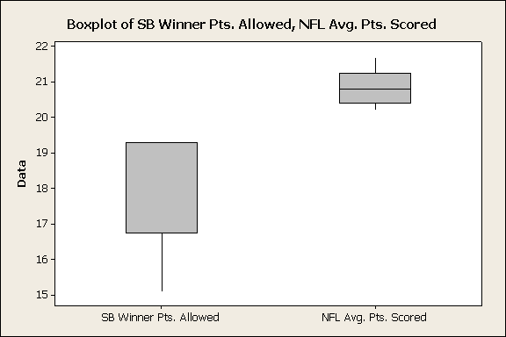
Box Plots

Slide 5
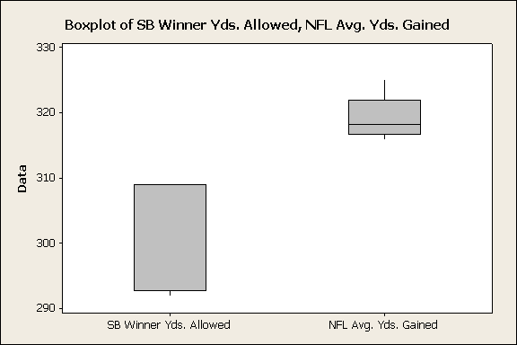

Slide 6
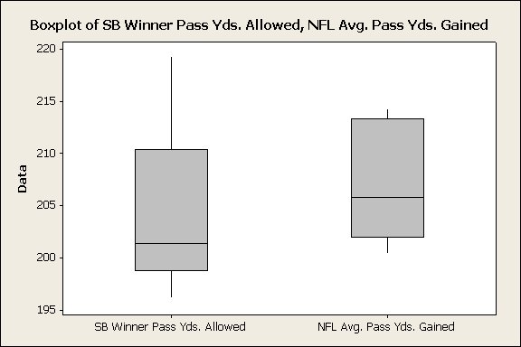

Slide 7
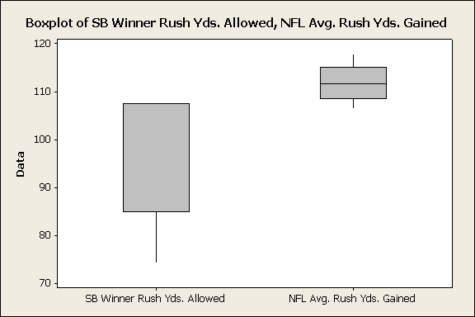

Slide 8
Defensive Team Rankings
YR Team PA YA PYA RYA AVG
Rank Rank Rank Rank Rank
7 NYG 5 5 8 9 6.75
6 IND 7 11 6 24 12.00
5 NE 8 10 11 15 11.00
4 PIT 1 1 1 2 1.25
3 NE 8 10 11 15 11.00
2 TB 10 9 4 19 10.50
1 NE 8 10 11 15 11.00
0 BLT 3 2 2 3 2.50
99 STL 4 6 20 1 7.75

Slide 9
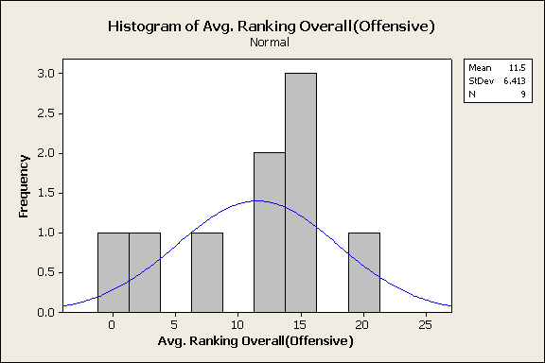
Comparing Overall Rankings
Offense

Slide 10
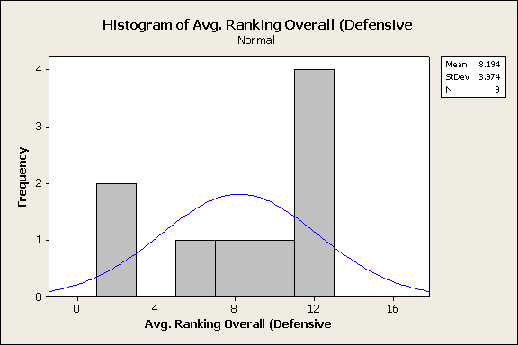
…vs Defense

Slide 11
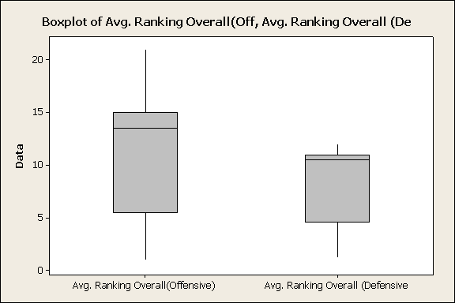

Slide 12
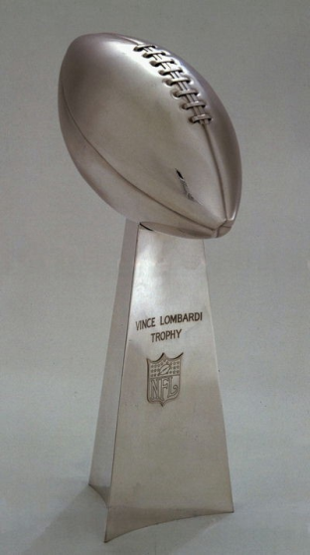
Predicting ‘09
Pittsburgh Steelers
Arizona Cardinals
Points Allowed: 13.9 (1st)
Yards Allowed: 237.2 (1st)
Pass Yards Alwd: 156.9 (1st)
Rush Yards Alwd: 80.2 (2nd)
PA: 26.6 (28th)
YA: 331.5 (19th)
PYA: 221.2 (22nd)
RYA: 110.2 (16th)

