Slide 1
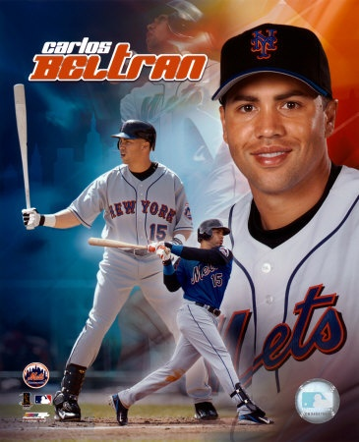
Is Carlos Beltran Overrated?
By Jimmy Wendt, Mike Kalis, and Craig Wocl

Slide 2
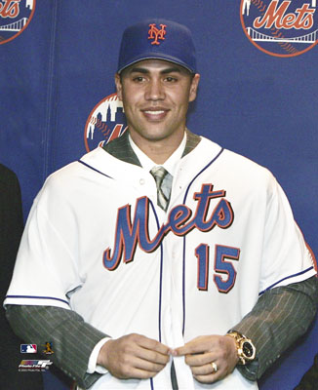
How Criticism Began
In 2005, Carlos Beltran signed a 7 year, $119 million contract to play with the New York Mets
At the time, this was only the 10th $100 million + contract in baseball history

Slide 3
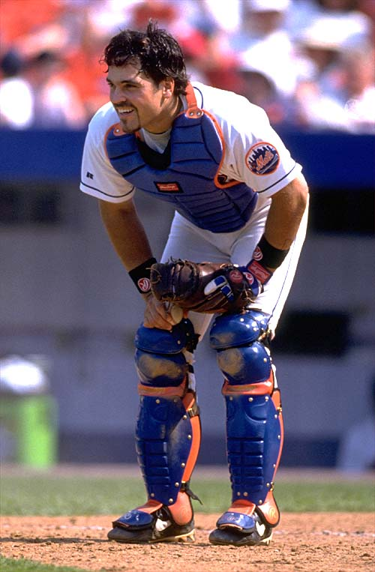
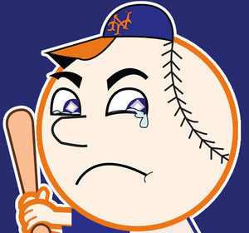
The Mets were bad…
The Mets were coming off of a 71-91 season and a 4th place finish in the division
Beltran was viewed by many as the team’s savior

Slide 4
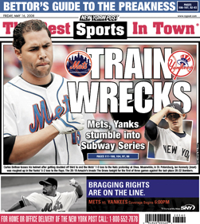
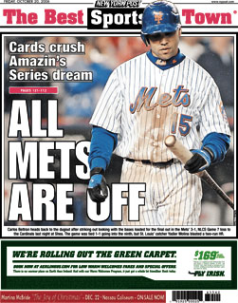
Beltran was bad in his first season
Beltran hit 22 fewer homeruns in his first season with the Mets than he did in the season prior to signing his new contract
The New York media was ferocious

Slide 5
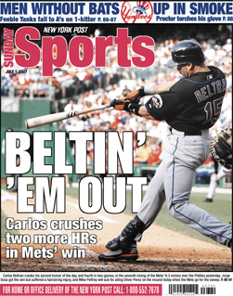
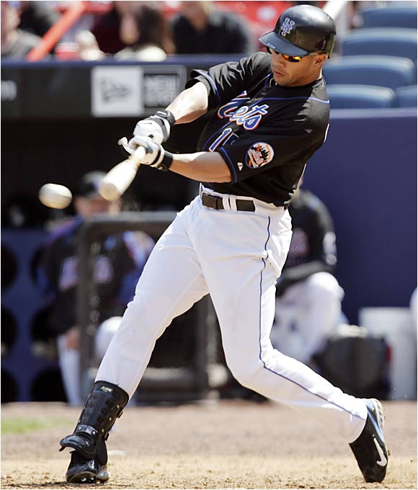
Beltran Rebounded
With the exception of the 2005 season, Beltran has put up stellar numbers for the Mets
Yet to this day, many fans will tell you that Carlos Beltran is “overrated” or “just not that good”
Our goal: To find out if Carlos Beltran is “overrated”

Slide 6
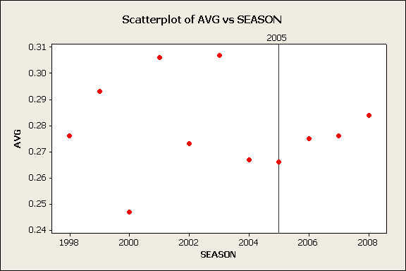
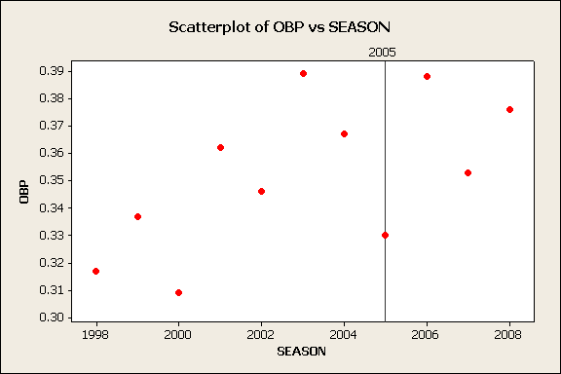
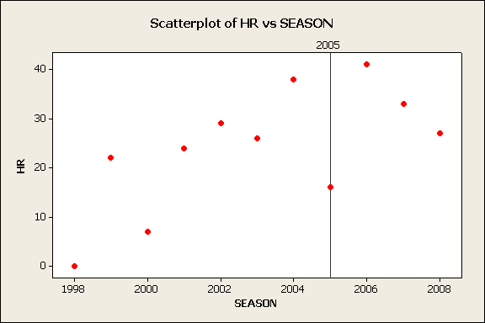
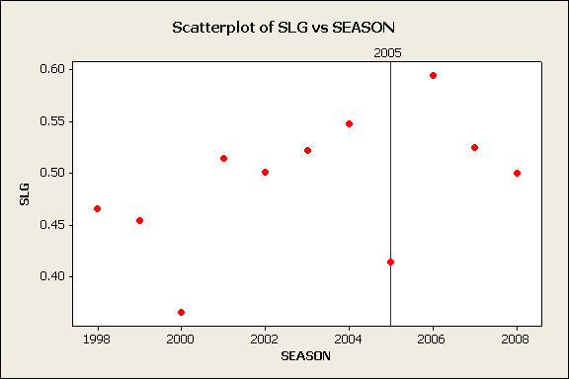
Career Statistics

Slide 7
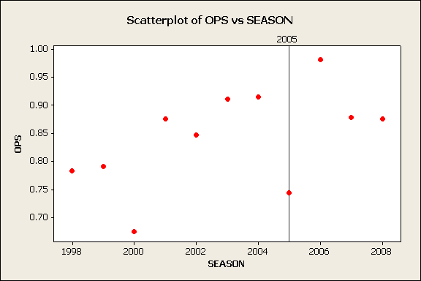
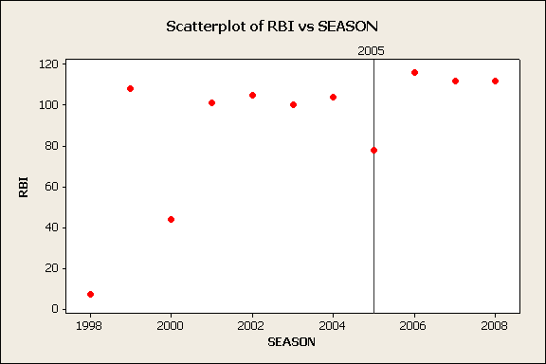
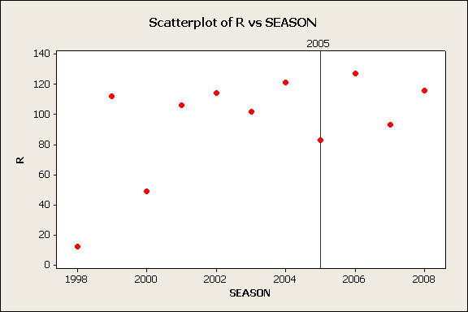
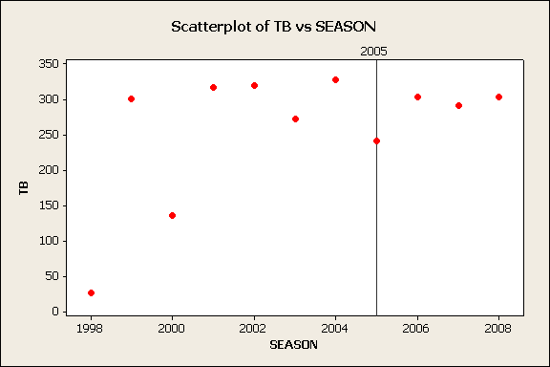
Career Statistics

Slide 8
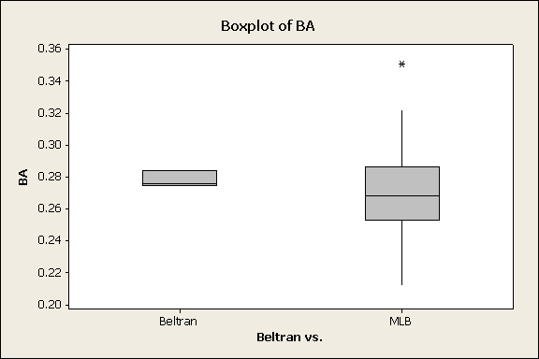
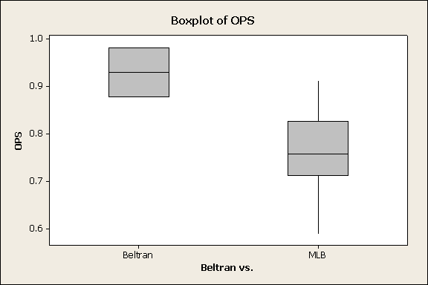
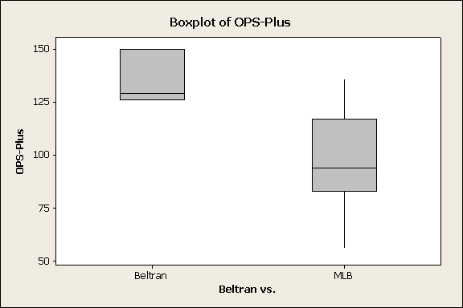
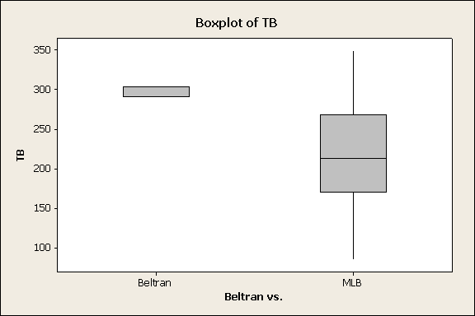
BELTRAN vs. MLB CENTER FIELDERS

Slide 9
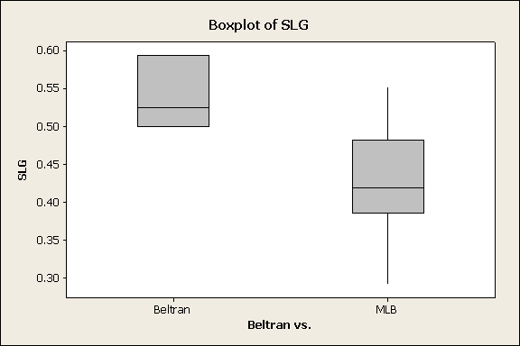
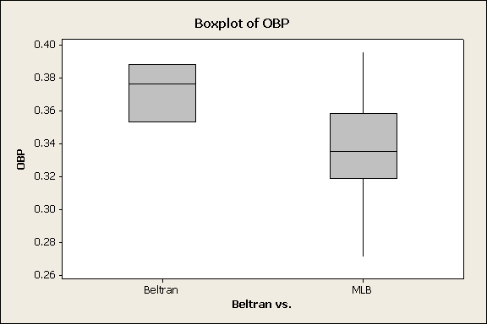
BELTRAN vs. MLB CENTER FIELDERS

Slide 10
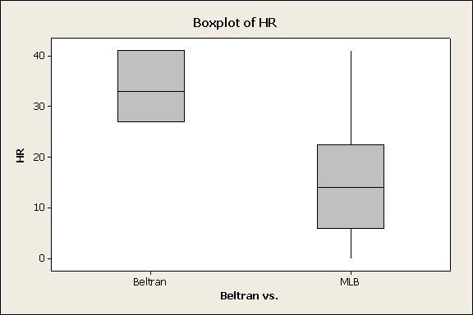
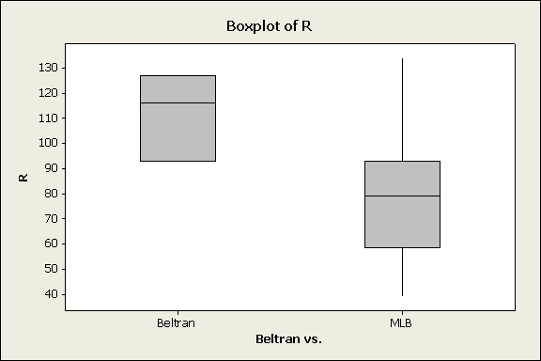
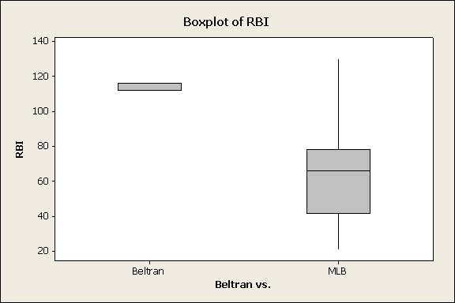
BELTRAN vs. MLB CENTER FIELDERS

Slide 11
Descriptive Statistics: R, HR, RBI, BA, OBP, SLG, OPS-Plus, OPS, TB
Variable Beltran vs. N N* Mean SE Mean StDev Minimum Q1
R Beltran 3 0 112.00 10.00 17.3 93.00 93.00
MLB 77 0 77.09 2.56 22.43 39.00 58.50
HR Beltran 3 0 33.67 4.06 7.02 27.00 27.00
MLB 77 0 14.71 1.15 10.06 0.00 6.00
RBI Beltran 3 0 113.33 1.33 2.31 112.00 112.00
MLB 77 0 62.66 2.67 23.41 21.00 41.50
BA Beltran 3 0 0.278 0.00285 0.00493 0.27500 0.27500
MLB 77 0 0.270 0.00288 0.02524 0.21200 0.25300
OBP Beltran 3 0 0.3723 0.0103 0.0178 0.3530 0.3530
MLB 77 0 0.33710 0.00294 0.02583 0.27100 0.31850
SLG Beltran 3 0 0.5397 0.0281 0.0487 0.5000 0.5000
MLB 77 0 0.42627 0.00727 0.06381 0.29200 0.38550
OPS-Plus Beltran 3 0 135.00 7.55 13.08 126.00 126.00
MLB 77 0 97.86 2.34 20.52 56.00 83.00
OPS Beltran 3 0 0.9120 0.0350 0.0606 0.8760 0.8760
MLB 77 0 0.76338 0.00908 0.07968 0.58800 0.71200
TB Beltran 3 0 299.00 4.00 6.93 291.00 291.00
MLB 77 0 219.79 7.00 61.40 85.00 170.00

Slide 12
Variable Beltran vs. Median Q3 Maximum
R Beltran 116.0 127.0 127.0
MLB 79.00 93.00 134.00
HR Beltran 33.00 41.00 41.00
MLB 14.00 22.50 41.00
RBI Beltran 112.00 116.00 116.00
MLB 66.00 78.00 130.00
BA Beltran 0.27600 0.28400 0.28400
MLB 0.26800 0.28650 0.35100
OBP Beltran 0.3760 0.3880 0.3880
MLB 0.33500 0.35850 0.39600
SLG Beltran 0.5250 0.5940 0.5940
MLB 0.41900 0.48200 0.55200
OPS-Plus Beltran 129.00 150.00 150.00
MLB 94.00 117.00 136.00
OPS Beltran 0.8780 0.9820 0.9820
MLB 0.75700 0.82650 0.91300
TB Beltran 303.00 303.00 303.00
MLB 213.00 268.50 349.00

Slide 13
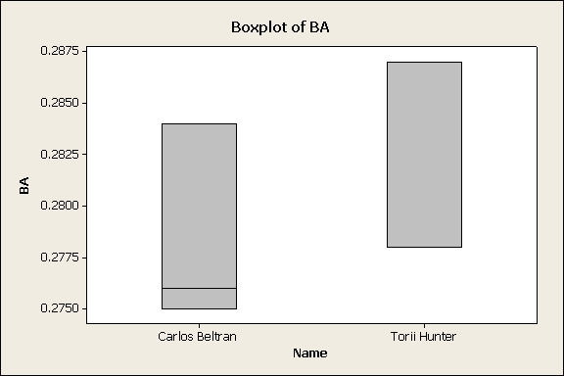
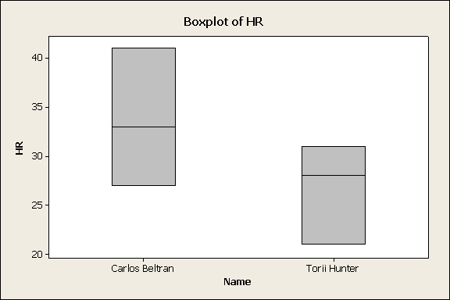
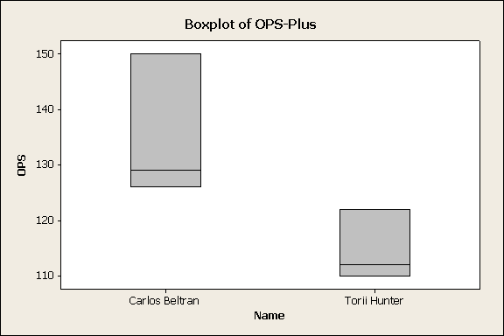
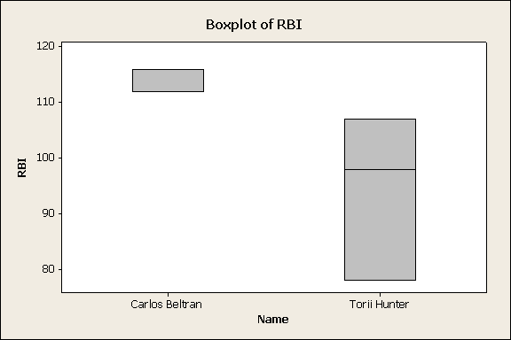
BELTRAN vs. TORI HUNTER

Slide 14
Descriptive Statistics: Beltran vs. Hunter
Variable Name N N* Mean SE Mean StDev Minimum Q1
HR Carlos Beltran 3 0 33.67 4.06 7.02 27.00 27.00
Torii Hunter 3 0 26.67 2.96 5.13 21.00 21.00
RBI Carlos Beltran 3 0 113.33 1.33 2.31 112.00 112.00
Torii Hunter 3 0 94.33 8.57 14.84 78.00 78.00
BA Carlos Beltran 3 0 0.27833 0.00285 0.00493 0.27500 0.27500
Torii Hunter 3 0 0.28100 0.00300 0.00520 0.27800 0.27800
OPS-Plus Carlos Beltran 3 0 135.00 7.55 13.08 126.00 126.00
Torii Hunter 3 0 114.67 3.71 6.43 110.00 110.00
Variable Name Median Q3 Maximum
HR Carlos Beltran 33.00 41.00 41.00
Torii Hunter 28.00 31.00 31.00
RBI Carlos Beltran 112.00 116.00 116.00
Torii Hunter 98.00 107.00 107.00
BA Carlos Beltran 0.27600 0.28400 0.28400
Torii Hunter 0.27800 0.28700 0.28700
OPS-Plus Carlos Beltran 129.00 150.00 150.00
Torii Hunter 112.00 122.00 122.00

Slide 15
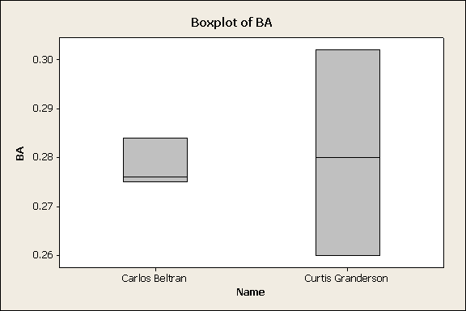
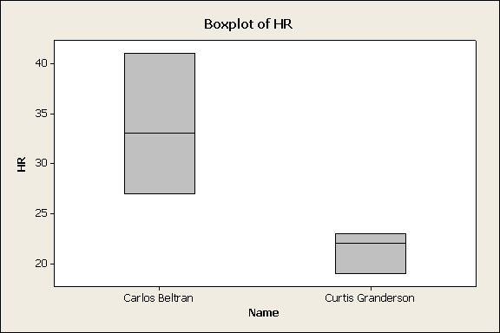
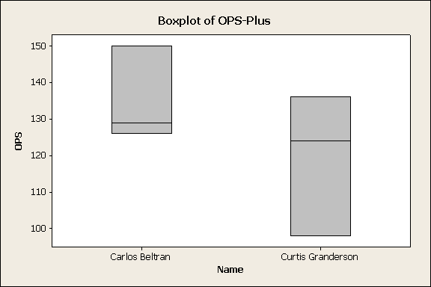
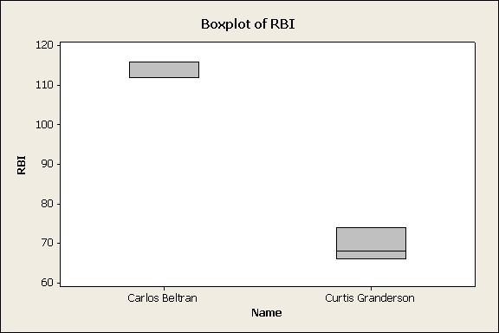
Beltran vs. Curtis Granderson

Slide 16
Descriptive Statistics: Beltran vs. Granderson
Variable Name N N* Mean SE Mean StDev Minimum Q1
HR Carlos Beltran 3 0 33.67 4.06 7.02 27.00 27.00
Curtis Granderson 3 0 21.33 1.20 2.08 19.00 19.00
RBI Carlos Beltran 3 0 113.33 1.33 2.31 112.00 112.00
Curtis Granderson 3 0 69.33 2.40 4.16 66.00 66.00
BA Carlos Beltran 3 0 0.27833 0.00285 0.00493 0.27500 0.27500
Curtis Granderson 3 0 0.2807 0.0121 0.0210 0.2600 0.2600
OPS-Plus Carlos Beltran 3 0 135.00 7.55 13.08 126.00 126.00
Curtis Granderson 3 0 119.3 11.2 19.4 98.0 98.0
Variable Name Median Q3 Maximum
HR Carlos Beltran 33.00 41.00 41.00
Curtis Granderson 22.00 23.00 23.00
RBI Carlos Beltran 112.00 116.00 116.00
Curtis Granderson 68.00 74.00 74.00
BA Carlos Beltran 0.27600 0.28400 0.28400
Curtis Granderson 0.2800 0.3020 0.3020
OPS-Plus Carlos Beltran 129.00 150.00 150.00
Curtis Granderson 124.0 136.0 136.0

Slide 17
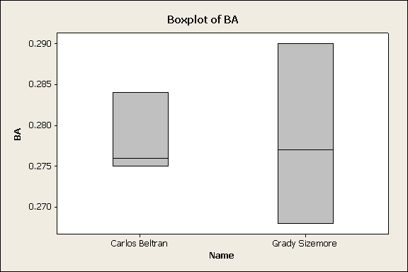
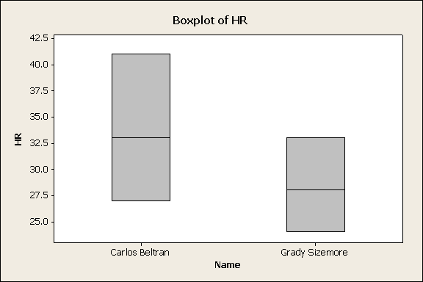
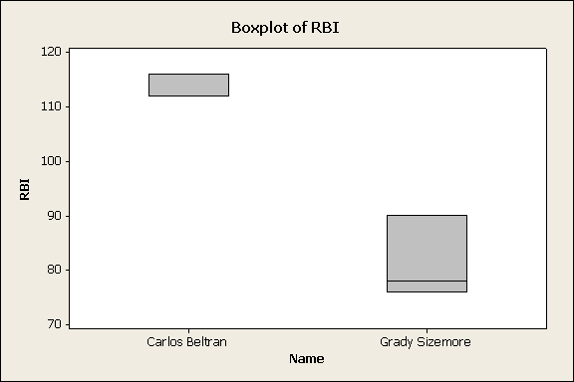
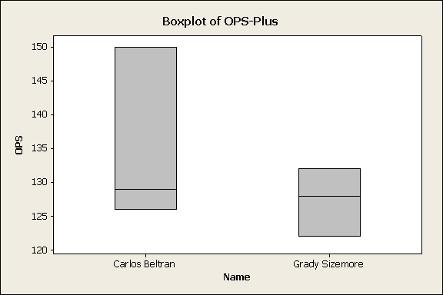
Beltran vs. Grady Sizemore

Slide 18
Descriptive Statistics: Beltran vs. Sizemore
Variable Name N N* Mean SE Mean StDev Minimum Q1
HR Carlos Beltran 3 0 33.67 4.06 7.02 27.00 27.00
Grady Sizemore 3 0 28.33 2.60 4.51 24.00 24.00
RBI Carlos Beltran 3 0 113.33 1.33 2.31 112.00 112.00
Grady Sizemore 3 0 81.33 4.37 7.57 76.00 76.00
BA Carlos Beltran 3 0 0.27833 0.00285 0.00493 0.27500 0.27500
Grady Sizemore 3 0 0.27833 0.00639 0.01106 0.26800 0.26800
OPS -Plus Carlos Beltran 3 0 135.00 7.55 13.08 126.00 126.00
Grady Sizemore 3 0 127.33 2.91 5.03 122.00 122.00
Variable Name Median Q3 Maximum
HR Carlos Beltran 33.00 41.00 41.00
Grady Sizemore 28.00 33.00 33.00
RBI Carlos Beltran 12.00 116.00 116.00
Grady Sizemore 78.00 90.00 90.00
BA Carlos Beltran 0.27600 0.28400 0.28400
Grady Sizemore 0.27700 0.29000 0.29000
OPS-Plus Carlos Beltran 129.00 150.00 150.00
Grady Sizemore 128.00 132.00 132.00

Slide 19
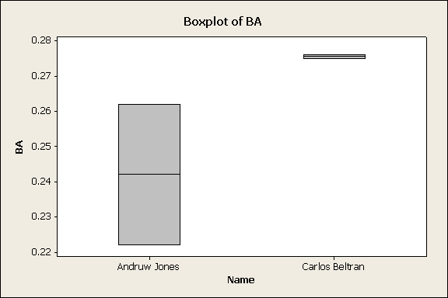
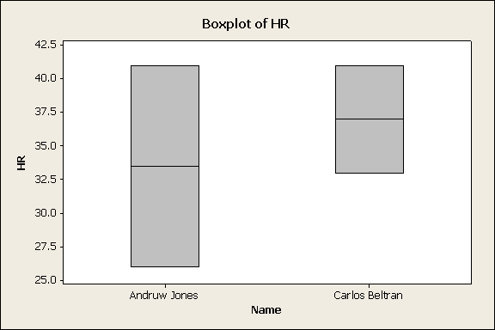
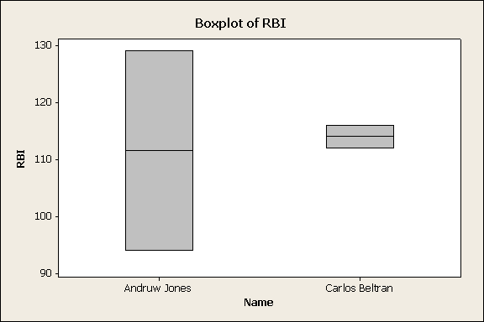
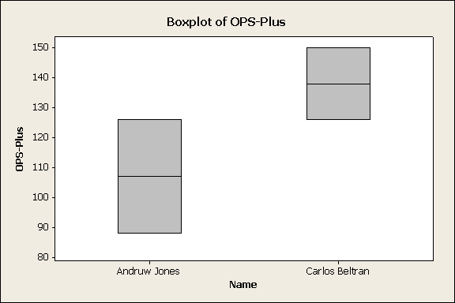
Beltran vs. Andruw Jones

Slide 20
Descriptive Statistics: Beltran vs. Jones
Variable Name N N* Mean SE Mean StDev Minimum Q1
HR Andruw Jones 2 0 33.50 7.50 10.61 26.00 *
Carlos Beltran 2 0 37.00 4.00 5.66 33.00 *
RBI Andruw Jones 2 0 111.5 17.5 24.7 94.0 *
Carlos Beltran 2 0 114.00 2.00 2.83 112.00 *
BA Andruw Jones 2 0 0.2420 0.0200 0.0283 0.2220 *
Carlos Beltran 2 0 0.27550 0.000500 0.000707 0.27500 *
OPS-Plus Andruw Jones 2 0 107.0 19.0 26.9 88.0 *
Carlos Beltran 2 0 138.0 12.0 17.0 126.0 *
Variable Name Median Q3 Maximum
HR Andruw Jones 33.50 * 41.00
Carlos Beltran 37.00 * 41.00
RBI Andruw Jones 111.5 * 129.0
Carlos Beltran 114.00 * 116.00
BA Andruw Jones 0.2420 * 0.2620
Carlos Beltran 0.27550 * 0.27600
OPS-Plus Andruw Jones 107.0 * 126.0
Carlos Beltran 138.0 * 150.0

Slide 21
Conclusions
Relative to his position, Carlos Beltran is not overrated at all
Centerfield is a position that sacrifices offense for defense. To get a good defensive centerfielder who also is good offensively is an asset

Slide 22
Possible Limitations and Future Research
Not every team had a centerfielder who played close to 162 games
We only took account the last 3 years
Further studies should be done taking into account offensive production over a 162 game span for each team out of the centerfield position
Further studies should be done taking into account defensive ability in a quantitative way

Slide 23
References
Baseball-reference.com
Espn.com
Nypost.com
Nydailynews.com

