Slide 1
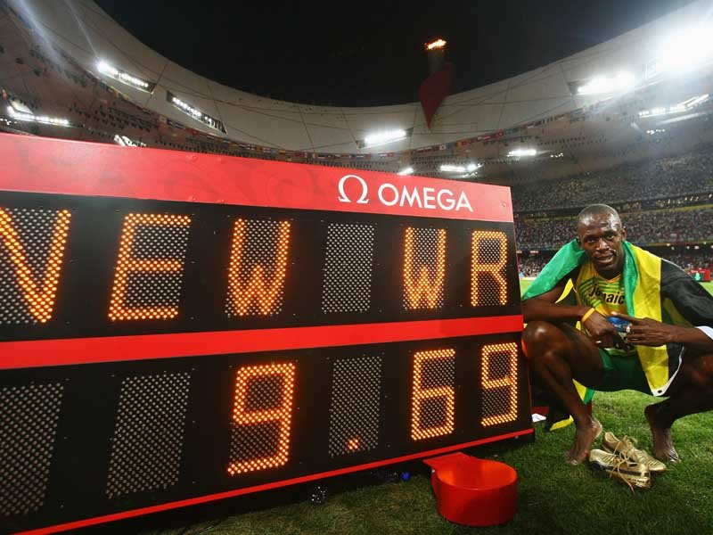
Breaking the 100m Record
Aaron Manning & Dan Toulson

Slide 2
The Big Question: As the 100m world record falls again, how much faster can humans run?
Mike Rowbottom, The Independent (UK)
The days when 100-metre runners used to knock a tenth of a second off the world record – as Jesse Owens did in running 10.2 sec in 1936 – are long gone. The record has been creeping down in hundredths of second since Jim Hines became the first man to break 10 seconds in 1968, winning the Olympic title in 9.95 sec .. Broadly speaking, the average man can manage about 15mph for short periods, while the best sprinters are running, albeit briefly, at about 26-27mph. Not very efficient compared with a cheetah, which can reach speeds of three times that. Dogs and ostriches can also put us to shame. Nevertheless, it is generally agreed that 30mph is the likely limit for humans as things stand

Slide 3
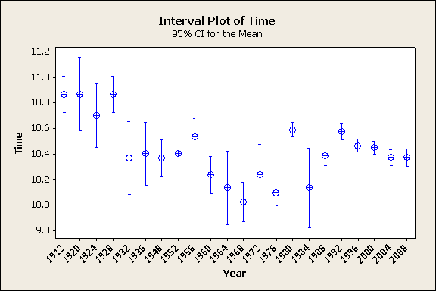
Olympic Progression

Slide 4
Confidence Interval’s
From this we conclude that the mean for Olympic times is dropping and that the variability in times is also decreasing.
This shows that athletes are becoming better, posting times closer to the mean. Overall the 100m dash is becoming more competitive.

Slide 5
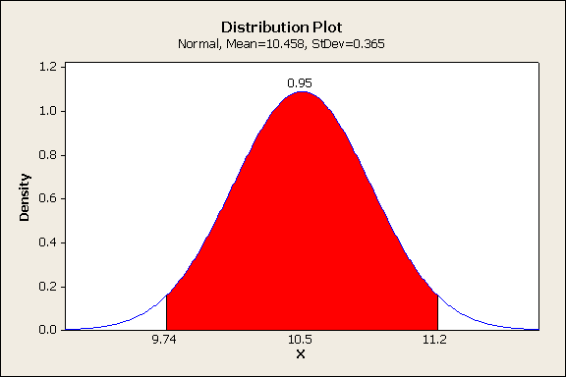
All time Olympic 100m Dash
Range of time in 95% CI =1.46

Slide 6
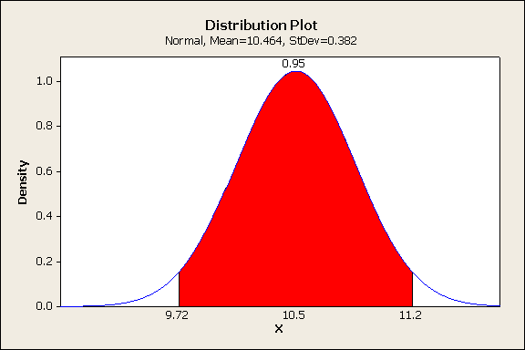
1996 Olympics
Range of time in the 95% CI = 1.48

Slide 7
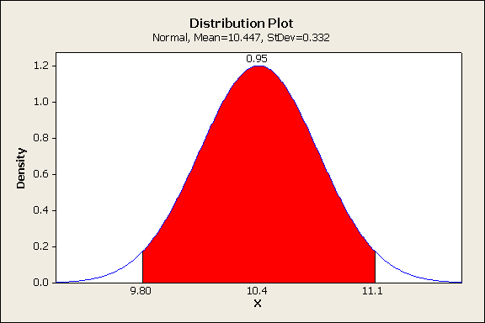
2000 Olympics
Range of time in 95% CI = 1.30

Slide 8
World Record Progression Class Question
Are 100m sprinters statistically significantly better post-1980 in comparison to pre-1980?
Open File - P Drive > Temp folder > Sprinting-Sports Stats > Sprinting > Class activity.
MINITAB > Two sample t test.

Slide 9
Results
Two-Sample T-Test and CI
Sample N Mean StDev SE Mean
1 24 9.9650 0.0260 0.0053
2 42 10.4350 0.0450 0.0069
Difference = mu (1) - mu (2)
Estimate for difference: -0.47000
95% upper bound for difference: -0.45541
T-Test of difference = 0 (vs <): T-Value = -53.78 P-Value = 0.000 DF = 63

Slide 10
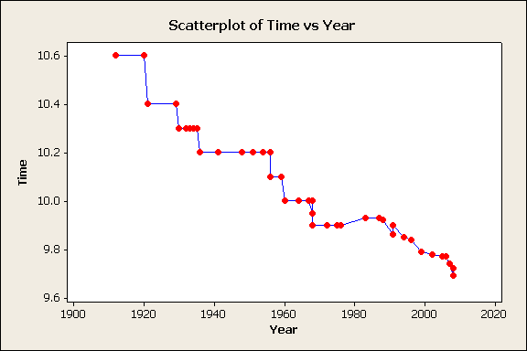
World Record Progression

Slide 11
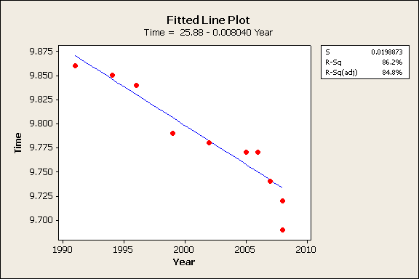
Linear Regression to predict 2012

Slide 12
Does this model work?
Plugging into this model calculates that in 2008 a 9.73 would be the best time run.
Using the same model we would think that in 2012 at the London Olympics, a 9.70 would be run.
Therefore this basic model does not work well as there are many factors that need to be incorporated – wind, individual ability, age etc.

Slide 13
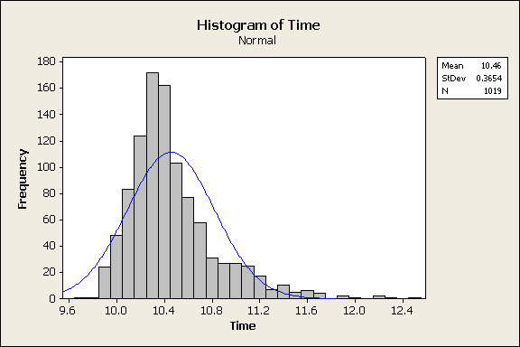
The Normal Distribution

Slide 14
World Record Simulation -Using the Normal Distribution
1520 chances to break a world record each year.
Using the Mean and standard Deviation from all time list of Olympic 100m races (1912-2008).
Over the past 6 years the record has been broken 9 times.
Using the random data > Normal Distribution we simulated that it was broken 8 times in 6 years.
As shown with the linear model, the world record is being broken more regularly, albeit by smaller margins.
Given this, we simulated the world record to be broken 8 times before the 2012 Olympics in London.

Slide 15
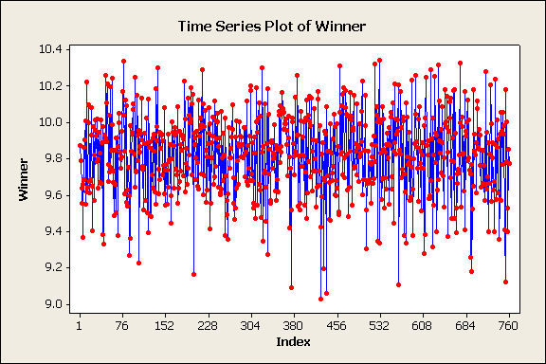

Slide 16
How far can this continue?
Scientists believe the top speed of man is 30 mph
Given that athletes don’t reach their top speed until the 30m mark and remain at top speed for the last 70m.
Our calculation states, In theory that the limit for man is around 8.947.
Using the linear regression model, this wont occur until the year 2100-2105 if progression occurs at a constant rate.

Slide 17
Conclusion
In the past 10-15 years, the world record has been dropping with more regularity, by smaller margins.
As training methods, diet, track conditions continue to be refined we may expect the record to continue to be broken, by smaller margins.
There is a limit to how fast man can run, it is hard to predict when this absolute value will occur as there are many variables (including immeasurable ones) to fit into a model regarding the 100m dash.

Slide 18
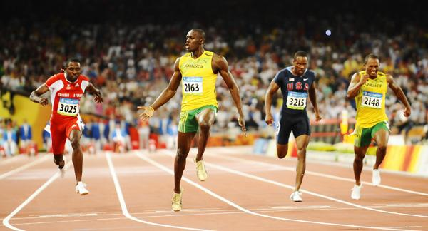
Background Information
http://www.independent.co.uk/extras/big-question/the-big-question-as-the-100m-world-record-falls-again-how-much-faster-can-humans-run-838899.html
http://www.iaaf.org
http://www.wikipedia.org

