Slide 1
A Study of NCAA Football Recruits and Commitment Dates
3/19/2008
?

Slide 2
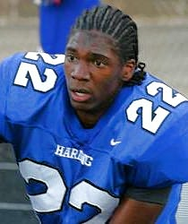
The Process
High school football players are evaluated on skill and potential
College Coaches determine whether they want to offer a scholarship or not
High school football players attend camps, go on visits, talk with coaches
Eventually, the player cuts down their list of schools and then make a final decision

Slide 3
Types of Commitments
-Soft Verbal: Commit is “committed” to the school, but often
changes decision and goes on visits to other schools
-Solid Verbal: Commit had decided to attend the school ( players
Still tend to de-commit)
-LOI: Signed Letter of Intent – the player WILL attend the college

Slide 4
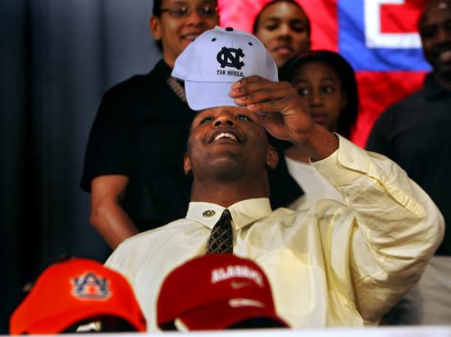
Signing Day
Day in February when high school players choose a school and sign an LOI
(This year it is on February 4th)

Slide 5
Rankings
Football Players are rated nationally, by state, by and by position
They are given stars to represent how good they are
Examples:
5 star recruit
4 star recruit
3 star recruit
Terrelle Pryor
E.J. Manuel
Bret Jefcoat

Slide 6
Hypothesis
Three star recruits will commit to a school earlier than five star recruits
The higher the recruit’s rank, the longer they will wait to commit
-Used national rankings for position
-Used all recruits that signed with the top 25 recruiting schools of 2008
According to scout.com

Slide 7
Top 25 Schools
1. Bama | 6. Michigan | 11. Clemson | 16. Texas | 21. Nebraska
2. ND | 7. LSU | 12. Florida | 17. Arizona State | 22. BC
3. Miami | 8. FSU | 13. Oklahoma | 18. Auburn | 23. Oregon
4. OSU | 9. USC | 14. Washington | 19. Illinois | 24. Arkansas
5. Georgia | 10. UCLA | 15. Texas A&M | 20. VT | 25. Pitt

Slide 9
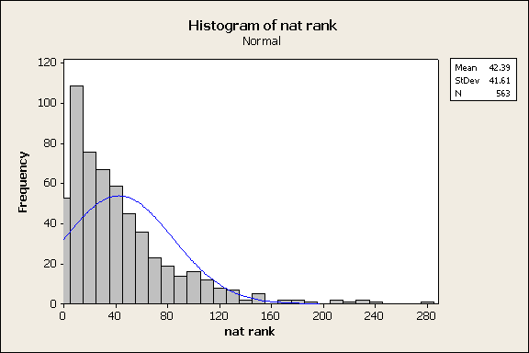

Slide 10
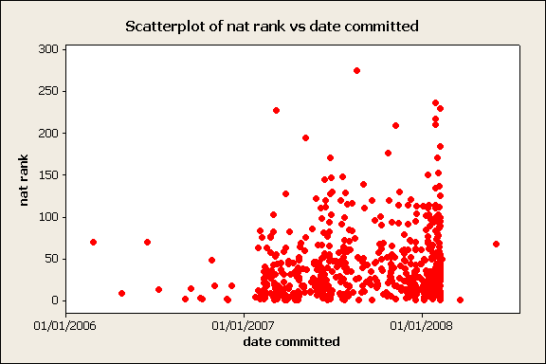

Slide 11
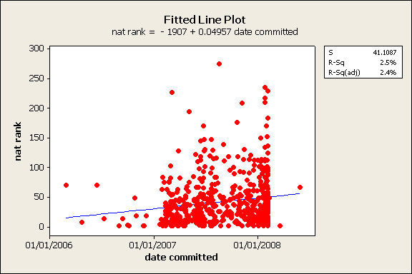
So How Good is Rank as a Predictor of Commitment Date?

