Slide 1
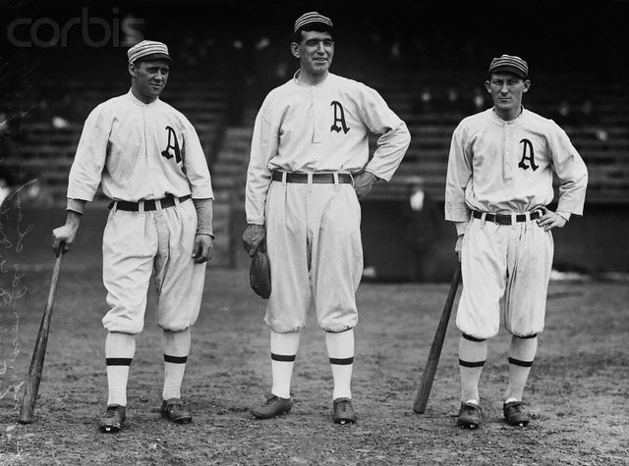
Did The 1914 Athletics
Throw the World Series?

Slide 2
Controversies in Baseball

Slide 3
Steroids

Slide 4
Gambling

Slide 5
The 1919 Black Sox

Slide 6
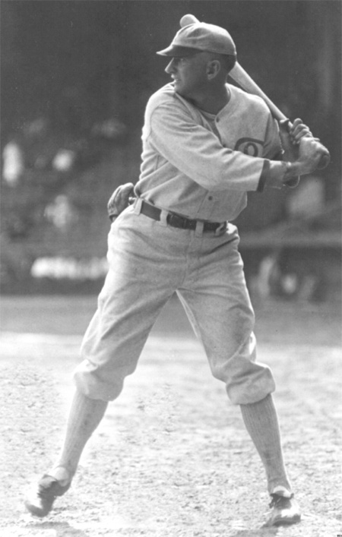
History
The several of the 1919 White Sox took money from gamblers in exchange for throwing the World Series
Afterward, they confessed
One of the confessors was “Shoeless” Joe Jackson

Slide 7
History Cont.
He later denied throwing the series
Some postulate he took money but never performed below his ability
The paper by Jay Bennett uses statistical reference to prove he did not purposely lose

Slide 8
That article you had to read?
Jay Bennett’s Did Joe Jackson Throw the 1919 World Series?
Hinges on a newish statistic devised by Bennett and Flueck known as Player Game Percentage (henceforth known as PGP)

Slide 9
A Lil’ More about PGP
Takes into account Δ WP, or the change in win probabilities caused by a player’s performance on a play
For example, Al Weis increased the Mets’ probability of victory from 51.1% to 84.9% by singling in the top of the ninth inning of Game 2 of the 1969 World Series

Slide 10
STILL MORE on PGP
Δ WP = 84.9 – 51.1 = 33.8
The Mills Brothers multiplied this number by 20 to determine Win Points
Win Points = 676
Equal number of Loss Points are “awarded” to the defender
PGP = (Win Points – Loss Points)/40

Slide 11
Joe Jackson’s PGP
Cumulative PGP over the course of the series was 1.45 (!)
Higher than most of his team and most of the other team
So it’s pure flummery that Jackson threw the series, right?

Slide 12
NOT SO FAST!

Slide 13
Performance in the Clutch?
Traditional Statistics
Performed well in clutch and Late Inning Pressure Situations
Regression Analysis
Plots PGP in terms of Slugging Average
Finds that he had an excellent Slugging Average and a high PGP
Resampling Analysis
A standard sampling Distribution of Batting PGP/Game was created

Slide 14
And for Jackson…
With the mean PGP/Game value for this distribution being 1.56 and the median being 1.59, Jackson’s PGP/Game value of 2.14 puts him in the .686 quantile of the distribution
A hypothesis test at the .10 (or .05) level indicates that we do not reject the null hypothesis and conclude that Joe Jackson batted as well as expected in clutch situations

Slide 15
Application to 1914 World Series
We’ll be using the rationale contained in Bennett’s article to examine whether the Philadelphia Athletics threw the 1914 World Series against the Boston Braves
Although we’re looking primarily at team performance, we’ll also examine individual players’ contributions to their team’s fate

Slide 16
Conclusion of Paper
Jackson was the third most valuable player in the Series for his team
Made a greater contribution to his team’s chances for victory than any other batter in the Series
Positive overall contribution to White Sox victory, while all other Black Sox had negative impacts
High batting stats in clutch situations

Slide 17
Background
The Athletics were heavily favored to win the series based on season performance
They had no history of performing poorly in the clutch
Victories in the 1910, 1911, and 1913 World Series…s

Slide 18
Class Activity
If a player has the following stats, what is his average change in WP?
name | team | WP before | WP after | change in WP
L. Mann | braves | 0 | -2
L. Mann | braves | 1 | -2
L. Mann | braves | -3 | 3
L. Mann | braves | -4 | -2
L. Mann | braves | -19 | 36
L. Mann | braves | 36 | 1

Slide 19
So How Did Each Team Perform?

Slide 20
Winning Team Win Expectancy Plots
-The probability of the eventual winner winning the game at the beginning of a certain play
-Unfortunately only available for the first two games
- Idea came from WP plots in Bennett article

Slide 22
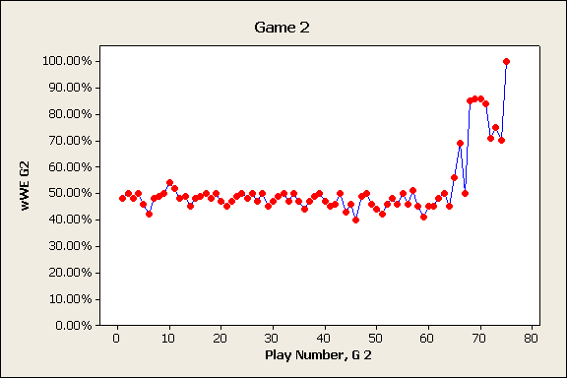

Slide 23
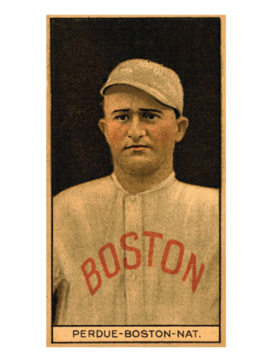
Brave’s BA
H_{o} : BA ≤ BA S
H_{a} : BA > BA S
N Mean StDev SE Mean
BA 9 0.2664 0.1552 0.0517
BA S 9 0.2561 0.0287 0.0096
Difference 9 0.0103 0.1562 0.0521
95% lower bound for mean difference: -0.0865
T-Test of mean difference = 0 (vs > 0): T-Value = 0.20 P-Value = 0.424

Slide 24
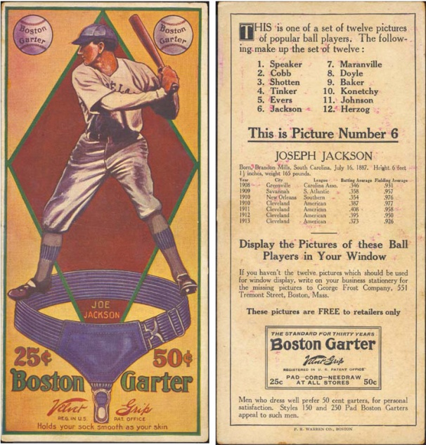
Brave’s OPS
H_{o} : OPS ≤ OPS S
H_{a} : OPS > OPS S
N Mean StDev SE Mean
OPS 9 0.716 0.513 0.171
OPS S 9 0.680 0.094 0.031
Difference 9 0.036 0.522 0.174
95% lower bound for mean difference: -0.288
T-Test of mean difference = 0 (vs > 0): T-Value = 0.20 P-Value = 0.422

Slide 25
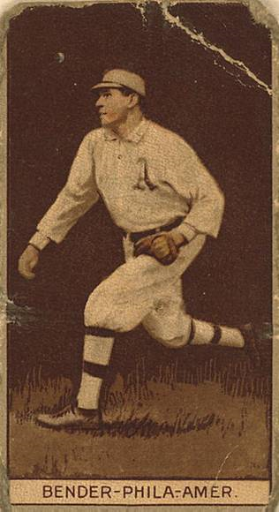
A’s BA
H_{o} : BA ≥ BA S
H_{a} : BA < BA S
N Mean StDev SE Mean
BA 8 0.1791 0.0892 0.0315
BA S 8 0.2842 0.0413 0.0146
Difference 8 -0.1051 0.1002 0.0354
95% upper bound for mean difference: -0.0380
T-Test of mean difference = 0 (vs < 0): T-Value = -2.97 P-Value = 0.010

Slide 26
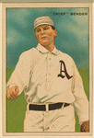
A’s OPS
H_{o} : OPS ≥ OPS S
H_{a} : OPS < OPS S
N Mean StDev SE Mean
OPS 8 0.519 0.284 0.100
OPS S 8 0.735 0.097 0.034
Difference 8 -0.2158 0.2789 0.0986
95% upper bound for mean difference: -0.0289
T-Test of mean difference = 0 (vs < 0): T-Value = -2.19 P-Value = 0.032

Slide 27
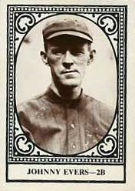
Brave’s WHIP
H_{o} : WHIP≥ WHIP S
H_{a} : WHIP < WHIP S
N Mean StDev SE Mean
WHIP 3 0.905 0.187 0.108
WHIP S 3 1.154 0.123 0.071
Difference 3 -0.2483 0.1436 0.0829
95% upper bound for mean difference: -0.0062
T-Test of mean difference = 0 (vs < 0): T-Value = -2.99 P-Value = 0.048

Slide 28
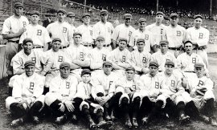
Brave’s SO/IP
H_{o} : SO/IP ≤ SO/IP S
H_{a} : SO/IP > SO/IP S
N Mean StDev SE Mean
SO W 3 0.684 0.246 0.142
SO S 3 0.466 0.053 0.031
Difference 3 0.218 0.292 0.169
95% lower bound for mean difference: -0.274
T-Test of mean difference = 0 (vs > 0): T-Value = 1.29 P-Value = 0.163

Slide 29
A’s SO/IP
H_{o} : SO/IP ≥ SO/IP S
H_{a} : SO/IP < SO/IP S
N Mean StDev SE Mean
SO W 4 0.405 0.299 0.149
SO S 4 0.524 0.104 0.052
Difference 4 -0.1195 0.1971 0.0986
95% upper bound for mean difference: 0.1124
T-Test of mean difference = 0 (vs < 0): T-Value = -1.21 P-Value = 0.156

Slide 30
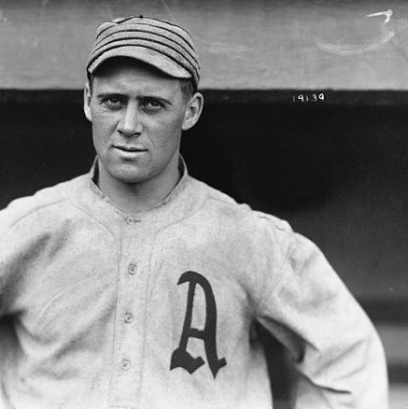
A’s WHIP
H_{o} : WHIP ≥ WHIP S
H_{a} : WHIP < WHIP S
N Mean StDev SE Mean
WHIP 4 1.370 0.337 0.169
WHIP S 4 1.232 0.048 0.024
Difference 4 0.138 0.365 0.183
95% lower bound for mean difference: -0.291
T-Test of mean difference = 0 (vs > 0): T-Value = 0.76 P-Value = 0.252

Slide 31
So Using The Paper as a Reference
Did the Athletics Throw the Series?

Slide 32
name | team | ave | OPS (PO) | OPS (SEA)
A. Strunk | athletics | 2 | 0.571 | 0.706
E. Collins | athletics | 1.571 | 0.508 | 0.904
E. Murphy | athletics | -6.75 | 0.59 | 0.72
F. Baker | athletics | -4.75 | 0.669 | 0.822
J. Barry | athletics | -4.57 | 0.205 | 0.592
R. Oldring | athletics | -0.88 | 0.133 | 0.679
S. McInnis | athletics | 0.875 | 0.508 | 0.709
W. Schang | athletics | -2 | 0.481 | 0.775

Slide 33
name | team | ave | OPS (PO) | OPS (SEA)
B. James | braves | -7.6 | 0 | 0.541
B. Schmidt | braves | -2.75 | 0.588 | 0.706
C. Deal | braves | -2.89 | 0.375 | 0.546
D. Rudolph | braves | 0 | 0.762 | 0.38
H. Gowdy | braves | 3.63 | 1.96 | 0.684
H. Moran | braves | -0.6 | 0.297 | 0.617
J. Connolly | braves | 1 | 0.293 | 0.886
J. Evers | braves | 0.56 | 0.938 | 0.728
L. Mann | braves | 3.8 | 0.571 | 0.668
P. Whitted | braves | 0 | 0.71 | 0.653
R. Maranville | braves | -2.25 | 0.708 | 0.632
T. Cather | braves | -4.2 | 0 | 0.697

Slide 36
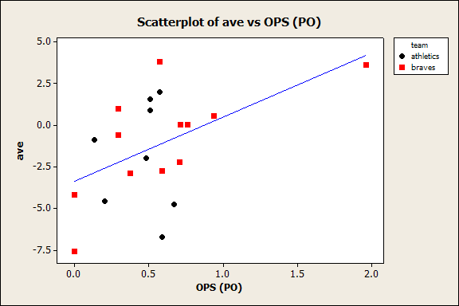

Slide 37
L. Mann
H. Gowdy
F. Baker
E. Murphy
B. James

Slide 38
Conclusions
Overwhelming evidence indicates that the Athletics did indeed perform worse in the World Series
But we can’t be entirely sure…
Thoughts?
SAY IT ON THE HOMEWORK

Slide 39
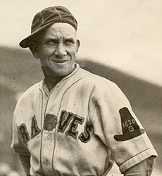
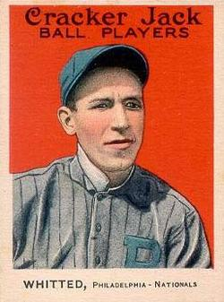
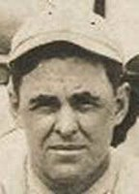
And Greatest Names…
P
Stuffy McInnis
Rabbit Maranville
Possom Whitted

